Slide 1
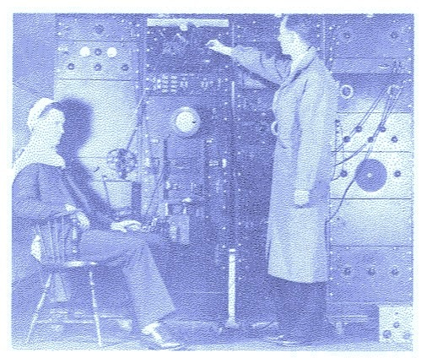
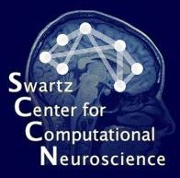
High-resolution electrocortical source imaging
Scott Makeig
Swartz Center for Computational Neuroscience
University of California San Diego
Electrophysiology Workshop
University of Sheffield, UK
September 1, 2015

Slide 2
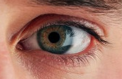

Who am I?
S. Makeig 2015
Notes:
Our most personal conception of our self is via experience, recognition and memory of cognitive events either involving purposeful motor actions …

Slide 3
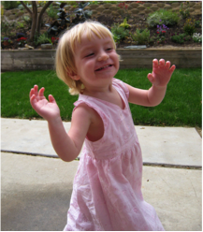
Embodied Agency
Brain processes
have evolved and function
to optimize the outcomes
of the behavior
the brain organizes
in response to
perceived challenges
and opportunities.
evaluation
perception
action
Brains meet the challenge of the moment!
S. Makeig 2011
Notes:
Our custom software base (DataRiver), developed by Andrei Vankov (SCCN / UCSD), is a set of PC-based software routines for setting up and running real-time interactive experiments that can fuse and synchronize multiple data streams (e.g., EEG, eye gaze, subject key presses, and motion capture), saving them to disk while also making them available selectively for online analysis -- the products of which can be fed back to the operating experiment control program(s).
-- The top panel shows a software flowchart of a planned mobile brain imaging (MBI) experiment involving real time audio and/or visual feedback to the subject of their distance from unseen obstacles defined by the experiments as room ‘hot’ (or ‘cold’) spots (spheres)..
-- The bottom panel shows an existing application of the same software framework, one we built in 2007for the DARPA NIA project. This EEG response classification works well (Bigdely Shamlo et al., submitted).
-- Applications of this software framework to diverse experiments and systems for mocap-based and/or EEEG-based feedback and training are straightforward.

Slide 4

Brain imaging natural cognition -- actions & interactions
Imaging Human Agency
S . Makeig, 2007

Slide 5
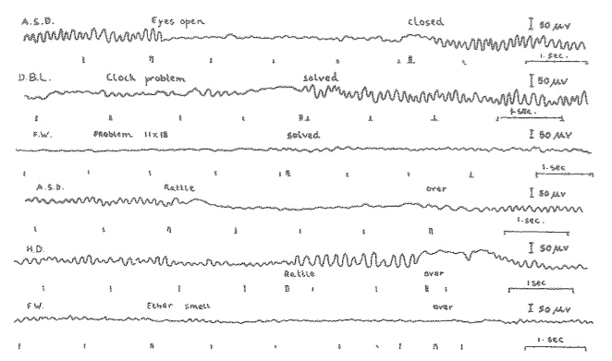
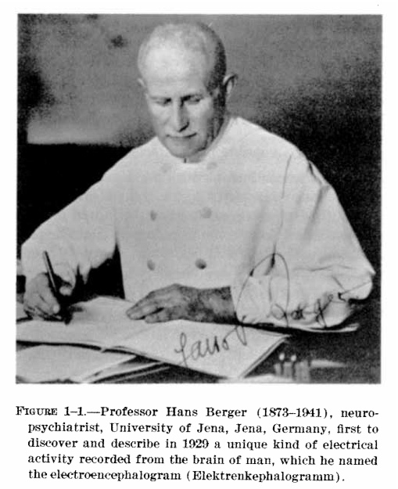
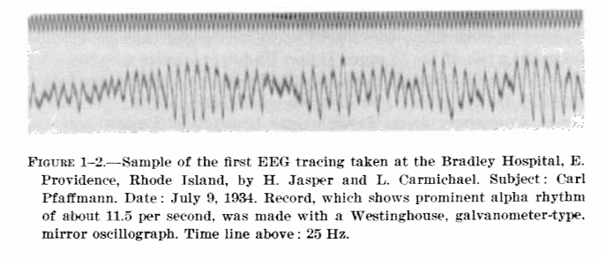
Human Functional Brain Imaging
Some human brain imaging milestones
1926 1st human EEG recordings
EEG era
1938 1st EEG spectral analysis
1962 1st computer ERP averaging (CAT)
ERP era
1979 1st event-related desynchronization
1993 1st fMRI BOLD recordings
fMRI era
1993 1st broadband ERSP
1995 1st multisource EEG filtering by ICA
2002 EEGLAB made available
2009 1st commercial dry electrode EEG toys
fEEG / BMI / MoBI era …
S. Makeig 2010
S. Makeig, 2009

Slide 6
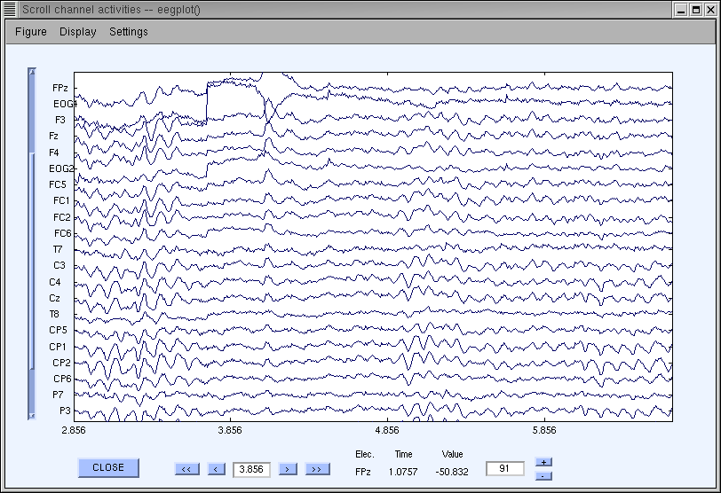
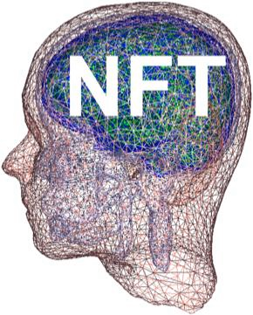
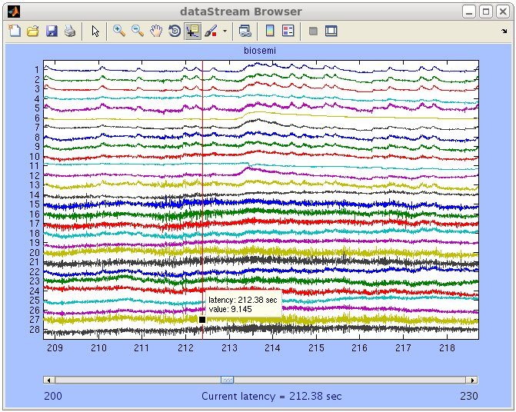
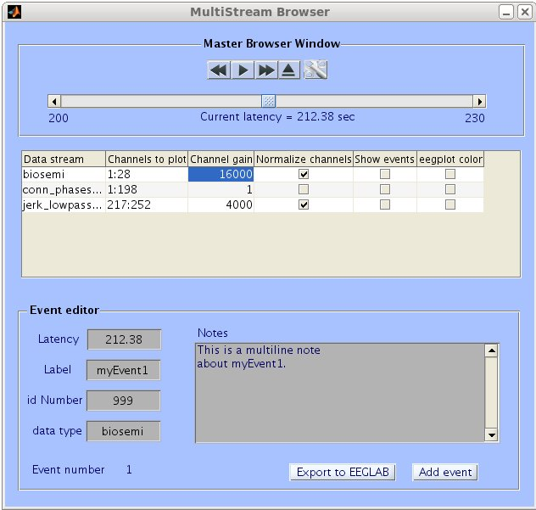
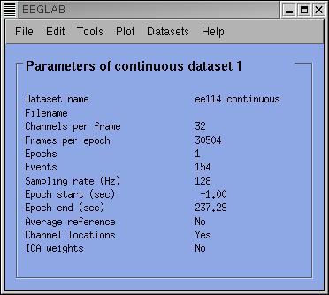
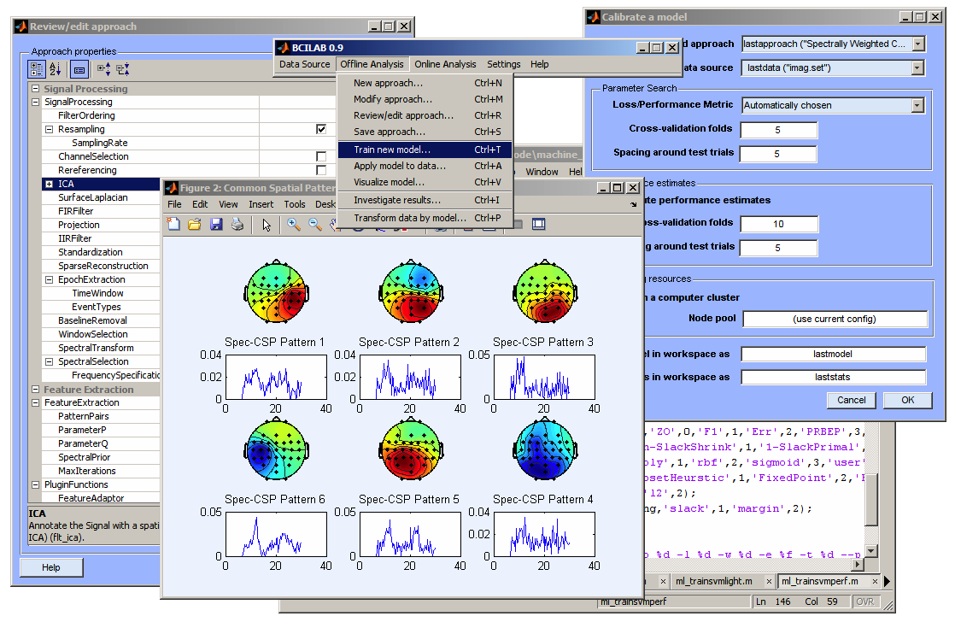
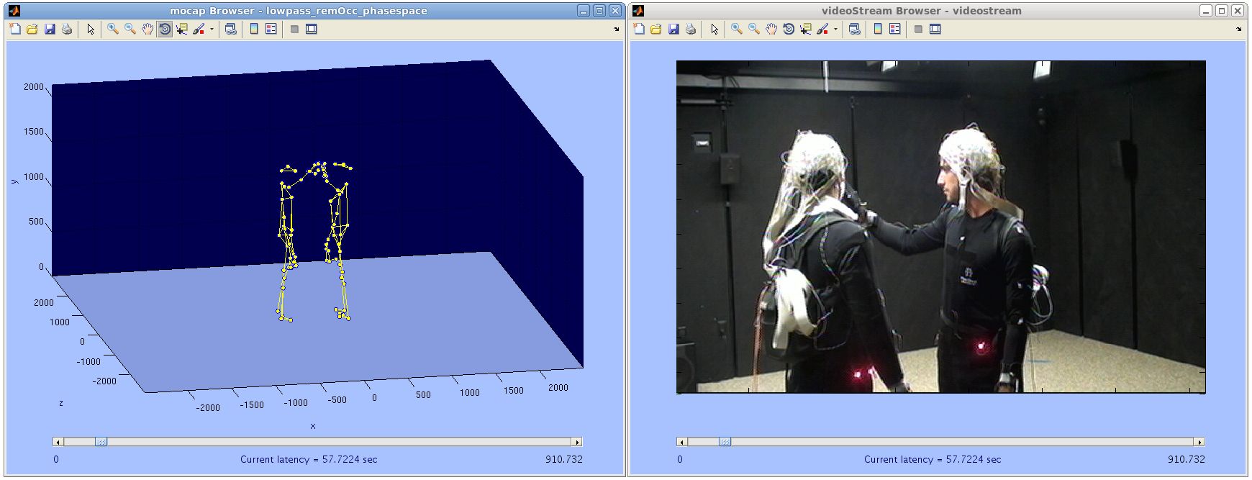
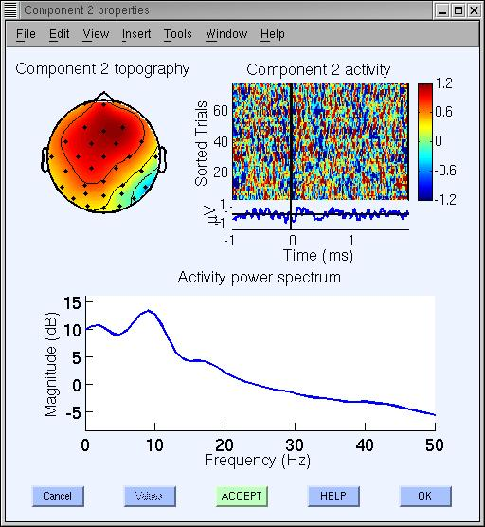
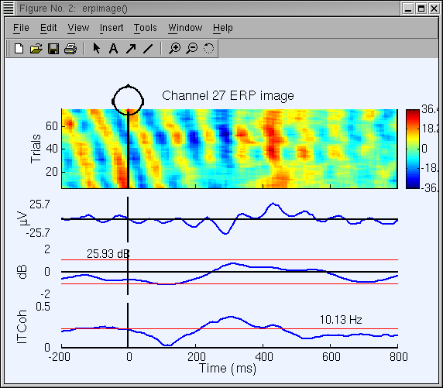
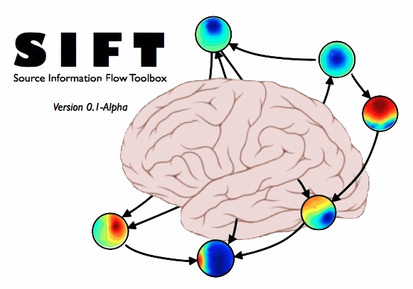
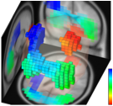
SCCN Open Source Software Tools
EEGLAB
MoBILAB
BCILAB
SIFT
MPT
Tools available -- but an (evolving?) two-cultures problem …
S Makeig, 2012
Notes:
Open source software built at and distributed by the Swartz Center for Computational Neuroscience, UCSD.
See http://sccn.ucsd.edu/eeglab

Slide 7
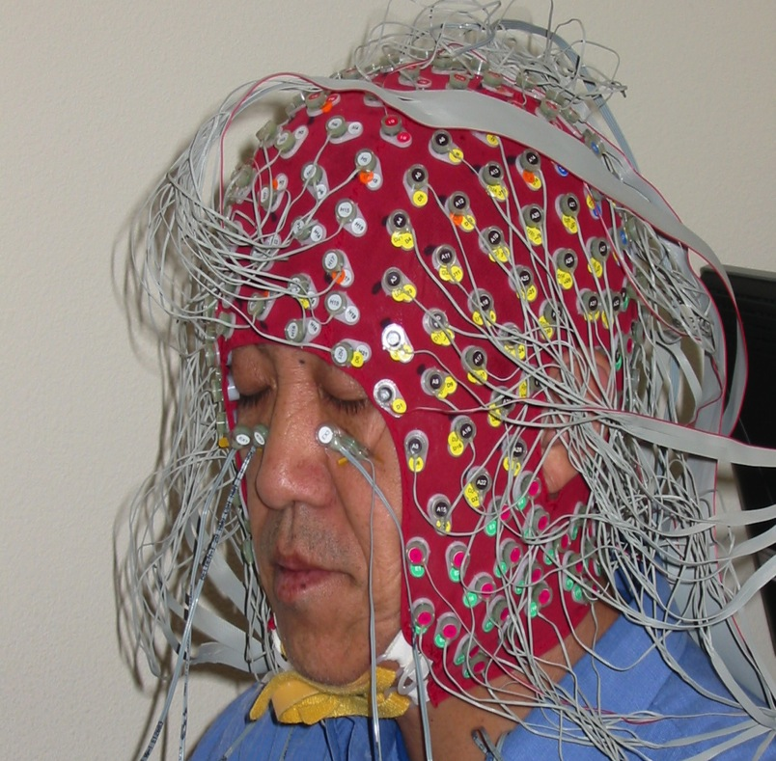
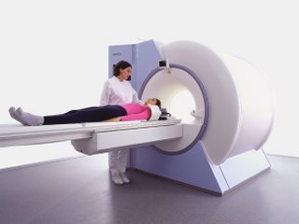
Functional Brain Imaging
Electromagnetic imaging
= imaging local cortical
Synchrony
3-D imaging requires model,
but quite fast & direct measure
of one aspect of cortical activity –
local spatial field coherence..
Hemodynamic imaging
= imaging local brain
Energy
Direct 3-D inverse model,
but quite slow & indirect
as well as expensive
and heavy (non-portable)
EEG is inexpensive / well tolerated
EEG is lightweight / mobile / wearable
S. Makeig 2014

Slide 8

Only a small portion of cortical brain electrical activity
An even smaller portion of total brain electrical activity
  But which portion?
  Triggered and modulated how?
  With what functional significance?
What is EEG?
Cloud art: Berndnaut Smilde
S. Makeig, 2015

Slide 9
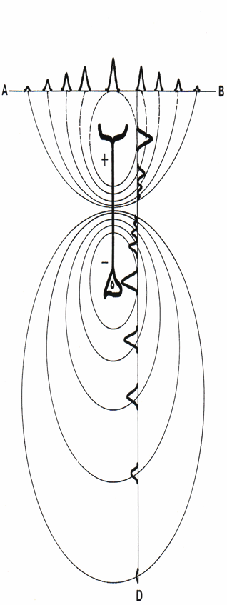
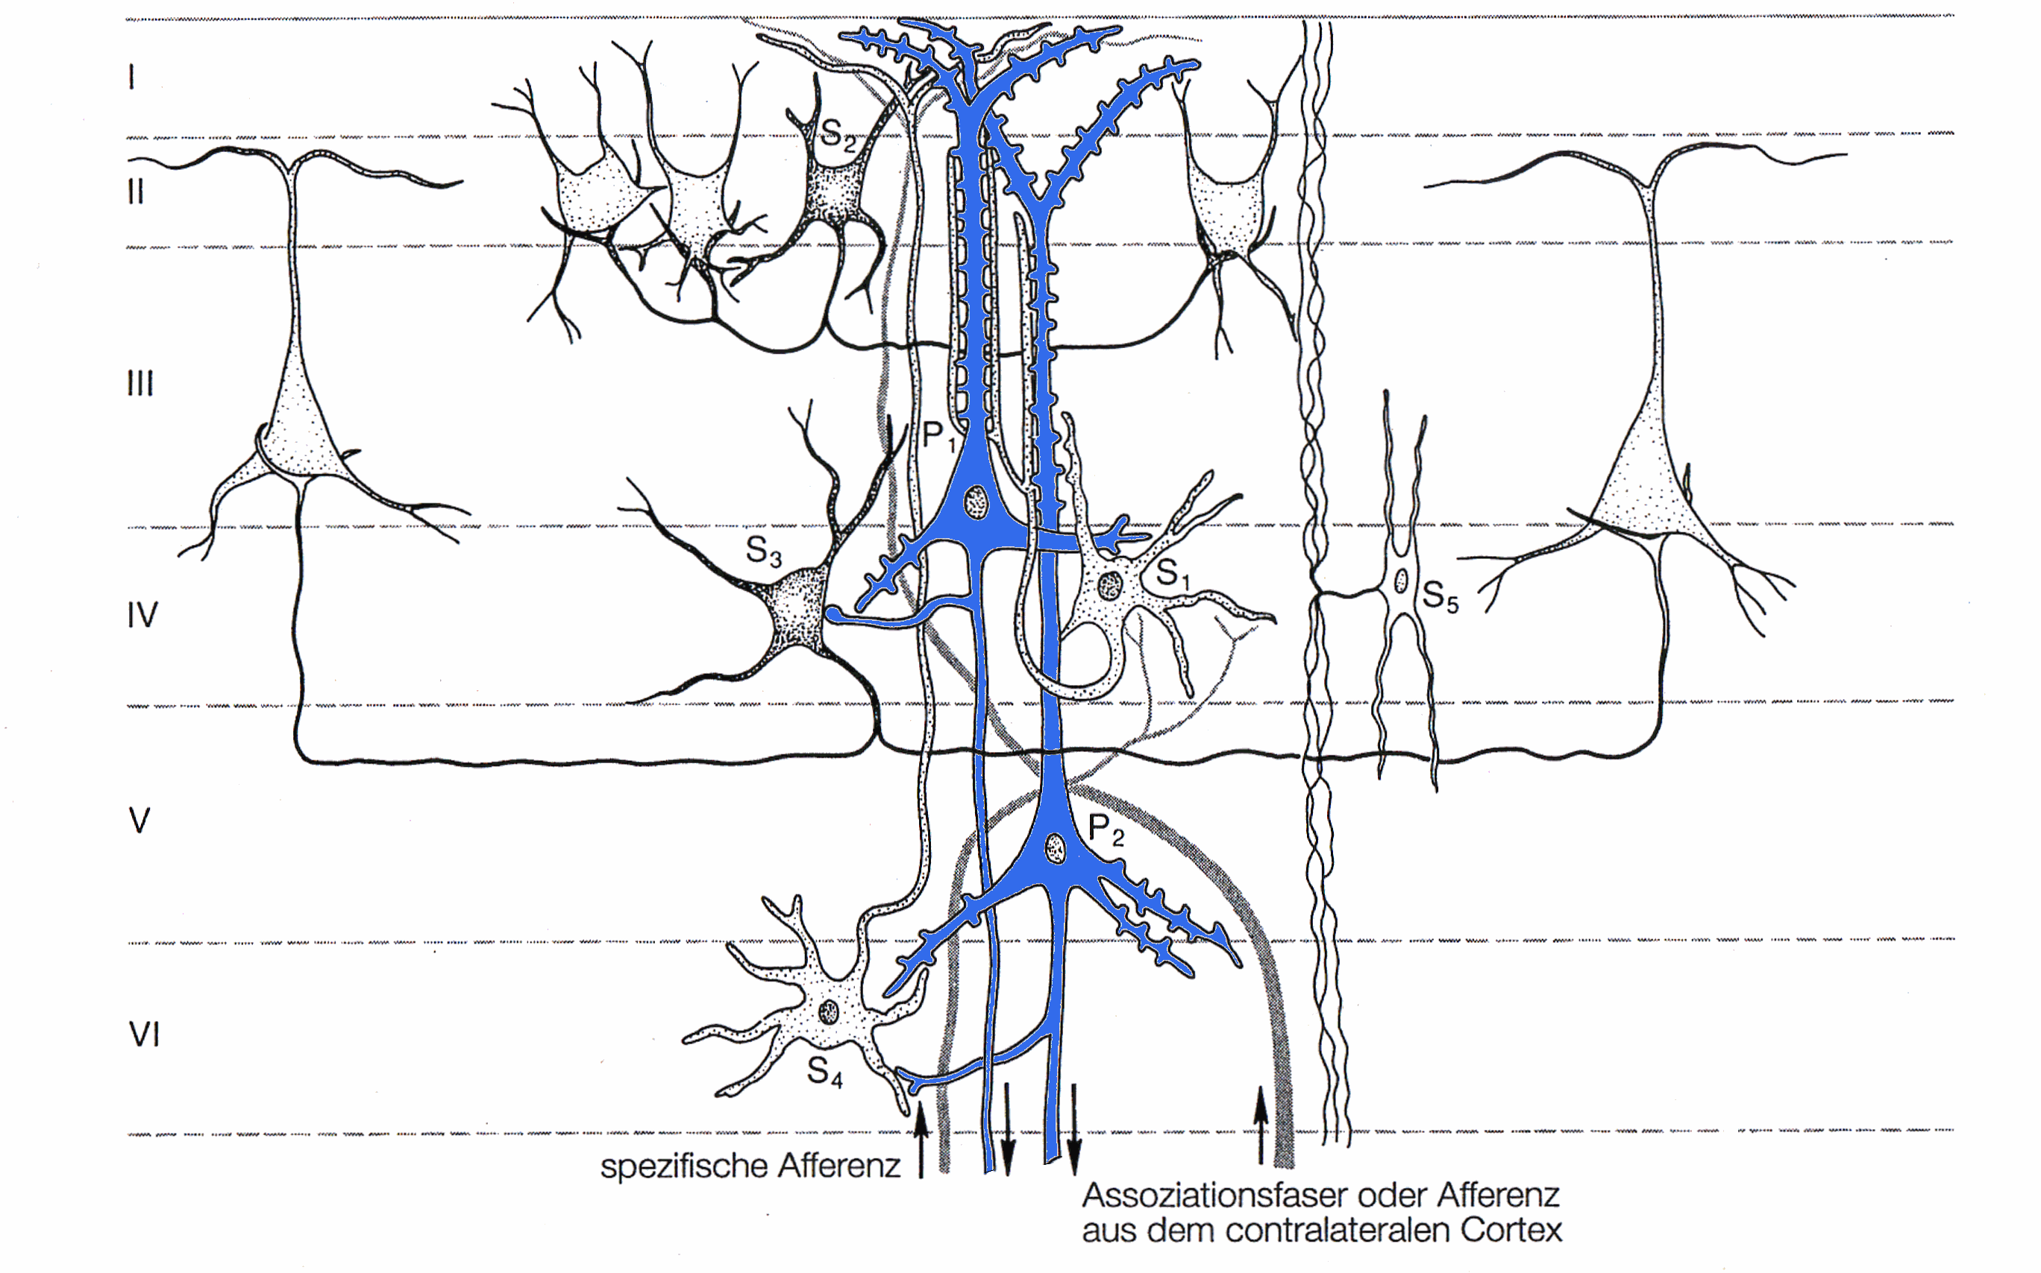
The generation and modulation of EEG
is COMPLEX and not well studied
Ephaptic Modulations
Excitatory
Inhibitory
Neuroglial
Value System Modulations
Corticocortical
Corticothalamic
S. Makeig 2007

Slide 10
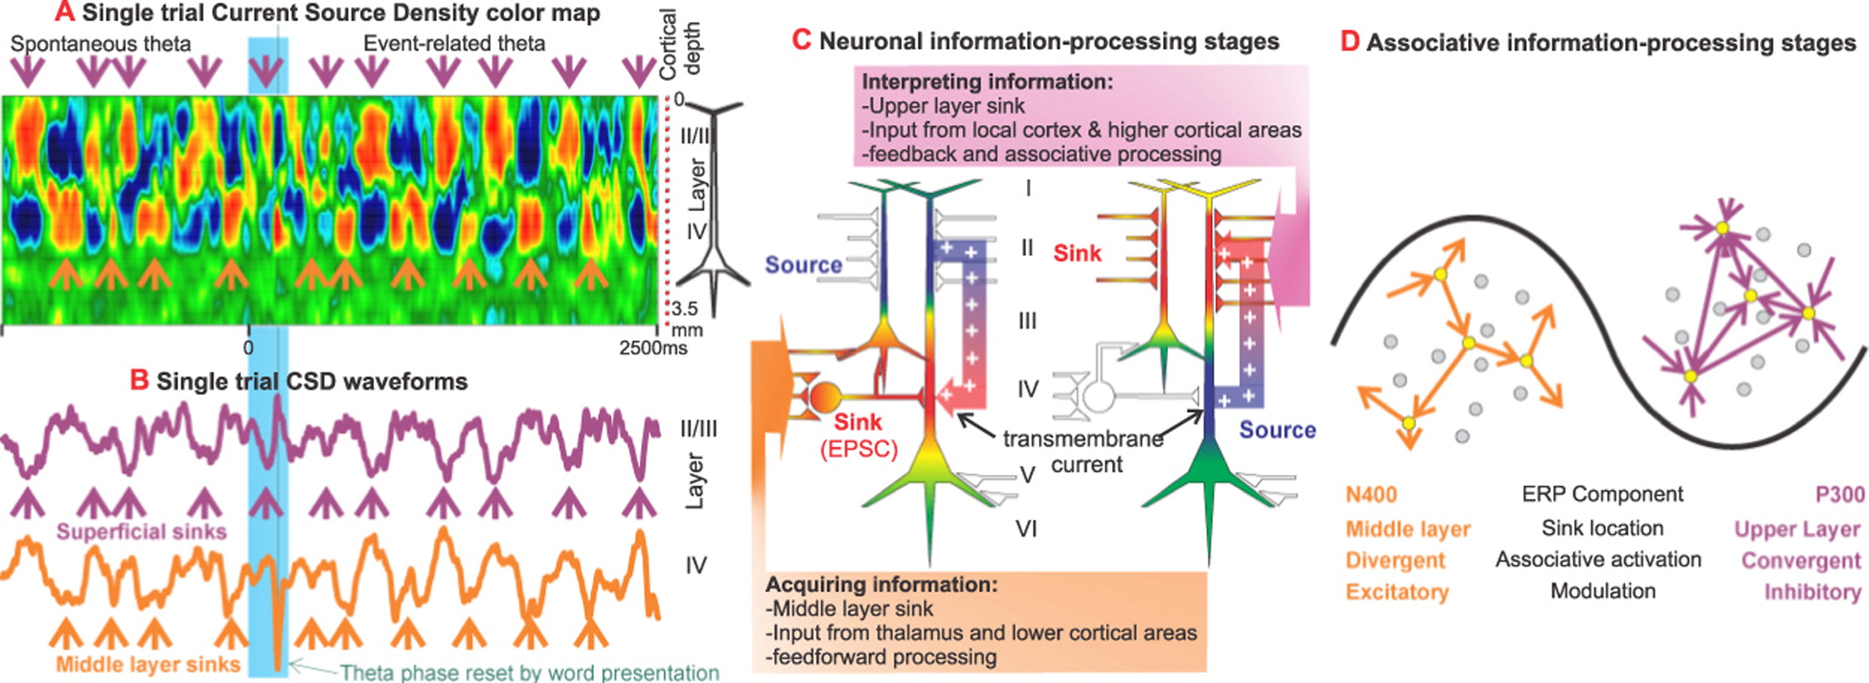
In Cortex: Up ≠ Down / +μV ≠ -μV
Cortical surface Up
I
Layer →
IV
Time (ms) →
Thalamus Down
From E. Halgren et al., 2015
S. Makeig, 2015

Slide 11
Surface
N
Surface
P
T. Elbert, ~1990
from E. Halgren et al., 2015
S. Makeig, 2015

Slide 12
Surface
N
Surface
P
from E. Halgren et al., 2015
Cf. T. Elbert, ~1990

Slide 13
EEG (scalp surface fields)
ECOG (larger cortical surface fields)
Local Extracellular Fields
At each spatial recording scale, the signal is produced by active partial coherence of distributed activities at the next smaller spatial scale.
Intracellular and peri-cellular fields
Synaptic and other trans-membrane potentials
Brain dynamics are
inherently multi-scale
Scott Makeig 2007

Slide 14
Brain dynamics are
inherently multi-scale
EEG (scalp surface fields)
ECOG (larger cortical surface fields)
Local Extracellular Fields
At each spatial recording scale, the signal is produced by active partial coherence of distributed activities at the next smaller spatial scale.
Cross-scale coupling is bi-directional!
Intracellular and peri-cellular fields
Synaptic and other trans-membrane potentials
Larger
Smaller
“The” signal one records
is not one unitary signal!
Scott Makeig 2007

Slide 15
Scale chauvinism
Brain dynamics are
inherently multi-scale
EEG (scalp surface fields)
ECOG (larger cortical surface fields)
Local Extracellular Fields
At each spatial recording scale, the signal is produced by active partial coherence of distributed activities at the next smaller spatial scale.
Cross-scale coupling is bi-directional!
Intracellular and peri-cellular fields
Synaptic and other trans-membrane potentials
Larger
Smaller
Scott Makeig 2007

Slide 16

MICRO
?
?
BRAIN
BEHAVIOR
EXPERIENCE
SPIKES
LFP
EEG
BOLD
Recorded !?
ERP
MACRO
RT
~1 MHz
~1 Hz
Mobile Brain/Body Imaging (MoBI)
~1,000,000 GHz
S. Makeig 2007
Notes:
One quadrillion molecular synaptic events occur in the brain every second. EEG or BOLD recordings follow macroscopic activity time courses in dozens of brain areas – yet psychologists have long been content to record on button press every few seconds as their measure of behavior. A reasonable hypothesis, I argue, is that the dimensionality / complexity of macroscopic brain dynamics (e.g. EEG and MEG) matches the dimensionality / complexity of the behavior the brain controls…. For psychophysiology, this suggests recording a much higher bandwidth of behavior (via motion sensors, psychophysiology, eye movement tracking, face video analysis, etc.) – and then modeling relationships between macroscopic brain dynamic events and behavior.

Slide 17

What are the effective sources
of EEG signals?
Makeig (2006)
Notes:
In this sense, EEG is a dynamically emergent phenomenon, like galaxies in the plasma of space…

Slide 18

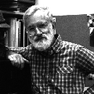
Phase cones (Freeman)
Avalanches (Plenz)
Local Cortical Synchronies
=
Effective EEG Sources
S. Makeig 2010
Notes:
… or drop ripples in a pond …

Slide 19
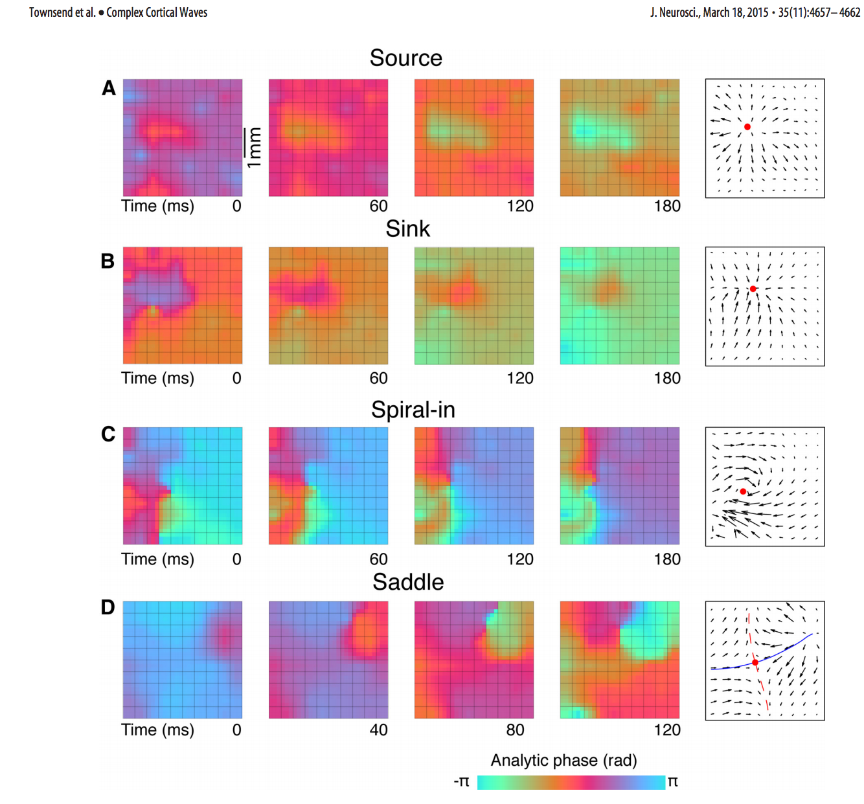
Delta band (1-4 Hz)
in
anesth.
animals
Simple patterns
“Synchrony was associated with high delta-band amplitude (averaged across the recording array), whereas complex waves were associated with low average delta-band amplitude. …
Spike rates were highest near the position and time of spirals and saddles and lowest in the presence of synchrony.”
Complex patterns
← 4 mm →
From Townsend et al., 2015
S. Makeig, 2015

Slide 20
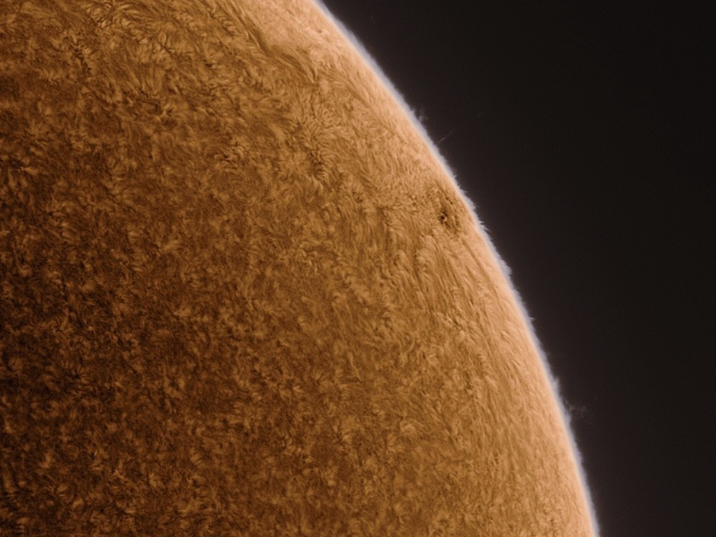
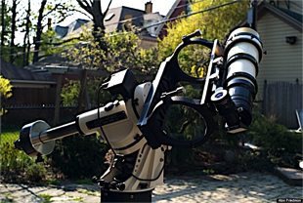
The spatiotemporal field dynamics of cortex and brain have not yet been imaged on multiple spatial scales!
Alan Friedman
S. Makeig, 2015

Slide 21
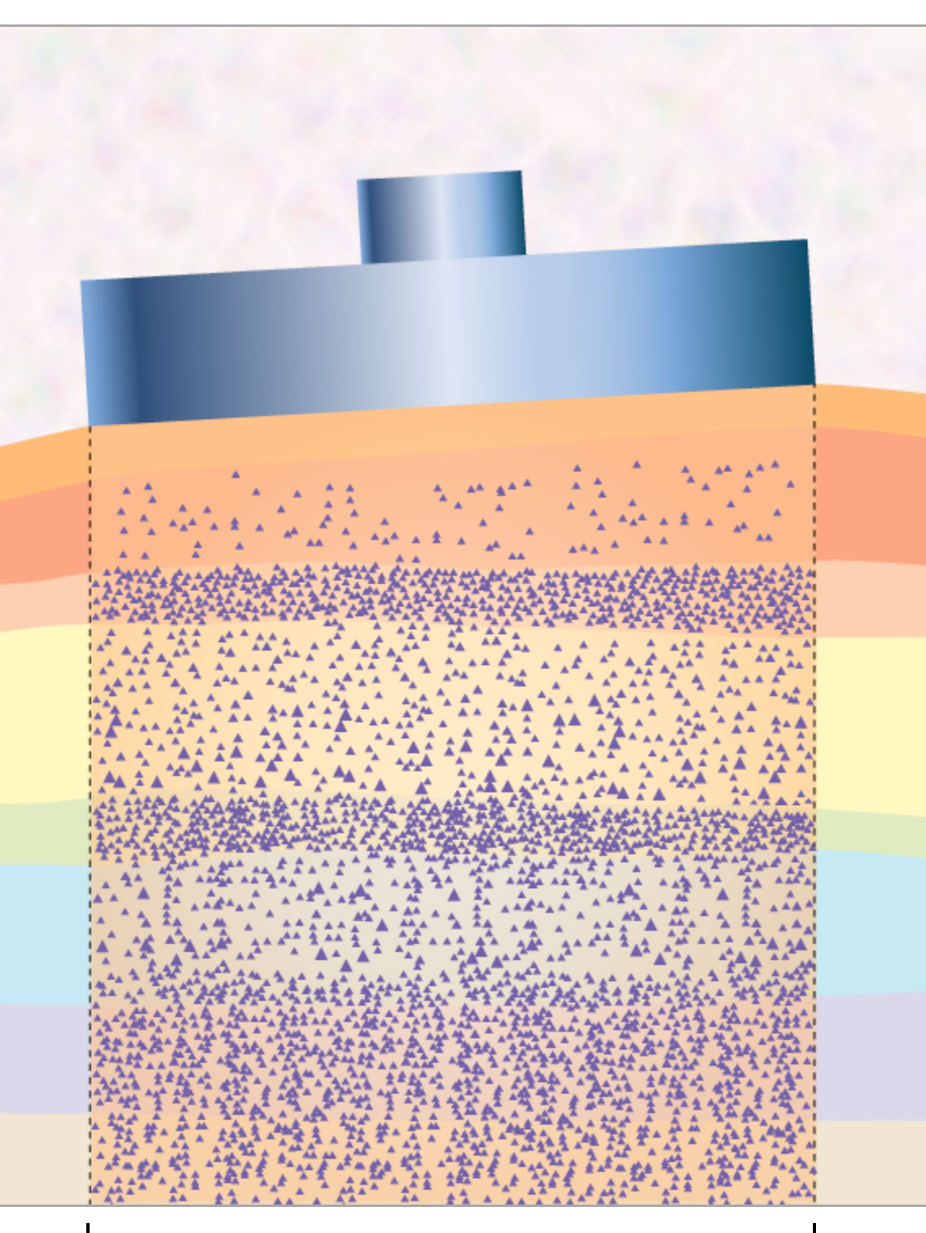
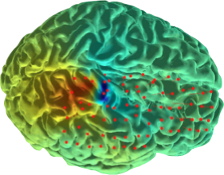
Electrodes
X
Cortex
Local Synchrony
Skin
Relative Independence
Local Synchrony
Skull
scalp signals ≠ source signals !
ECoG channel signals ≠ source signals !
S. Makeig 2007

Slide 22
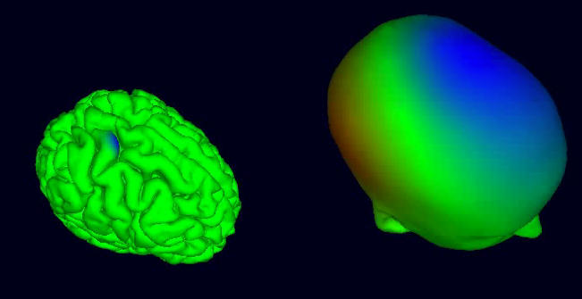
The very broad EEG point-spread function
Simulated parietal effective source
Very broad projected scalp potentials
Akalin Acar & Makeig 2010
Notes:
Partially coherent field activity across a cm-scalecortical patch (left) has a very broad, two-sided projection to the scalp (right). This simulation by Zeynep Akalin Acar was composed using her NFT toolbox.

Slide 23
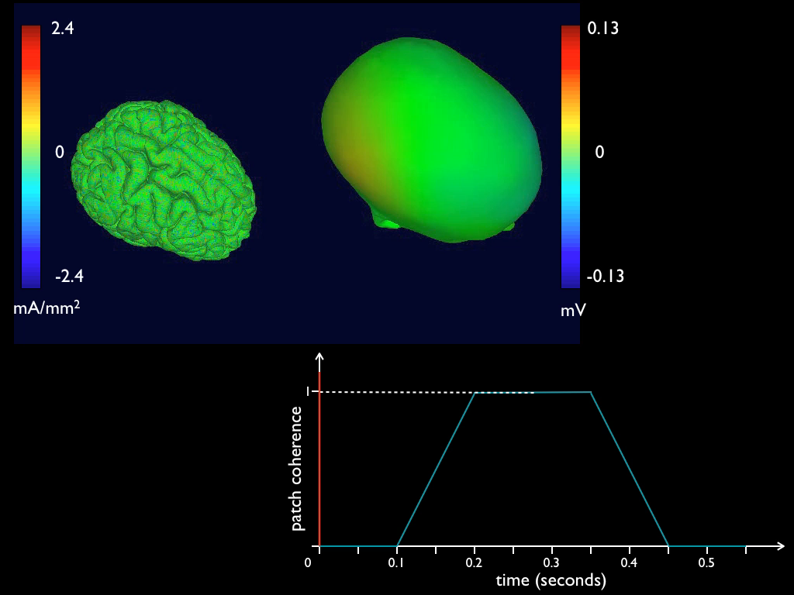
1 million active minicolumns
Summed scalp projection
One
emergent, spatially coherent effective source
The effective sources of the scalp EEG & MEG are emergent islands of local synchrony / near-synchrony.
Akalin Acar & Makeig 2014

Slide 24
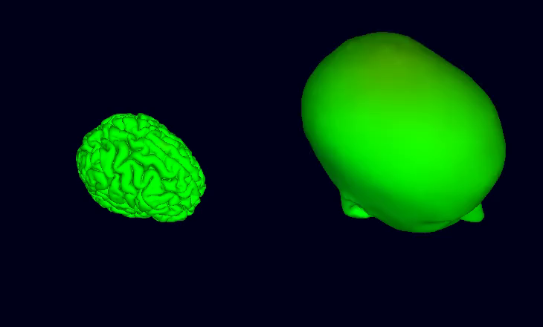
Scalp EEG Illusions
Summed scalp projection
10 Hz
9 Hz
ep·i·phe·nom·e·non: a secondary effect or byproduct that arises from but does not causally influence a process.
Their summed
scalp projection
Two Effective Sources
Z. Akalin Acar & S. Makeig 2015

Slide 25
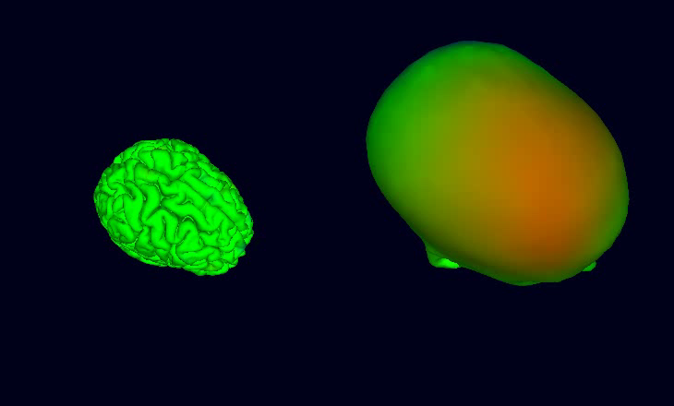
The very broad EEG point-spread function
Simulated EEG summing 30 cortical effective sources (animation at 1/5th real time)
Akalin Acar & Makeig 2010
Notes:
See http://www.youtube.com/playlist?list=PLDF9D201769ADC62D

Slide 26
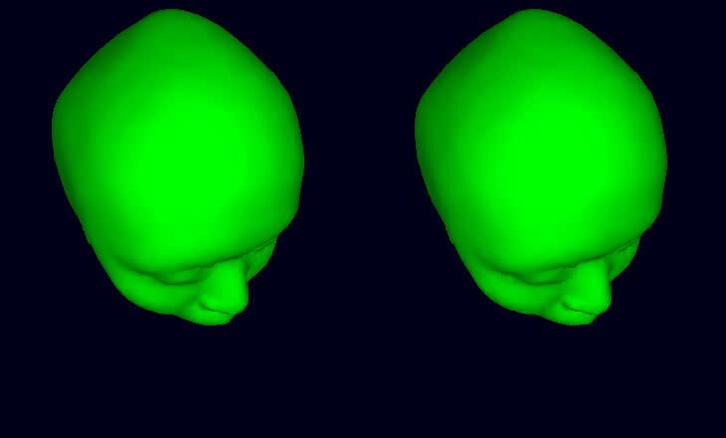
Effects of non-brain artifacts on scalp EEG
Brain sources only
With non-brain sources
Akalin Acar & Makeig 2010

Slide 27
How to find effective EEG sources?
Makeig (2006)
Notes:
In this sense, EEG is a dynamically emergent phenomenon, like galaxies in the plasma of space…

Slide 28


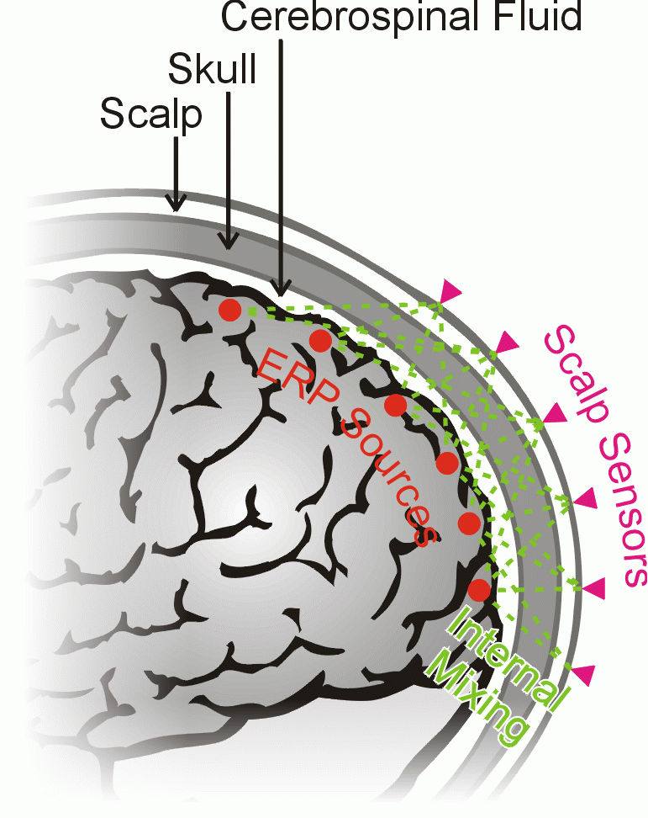
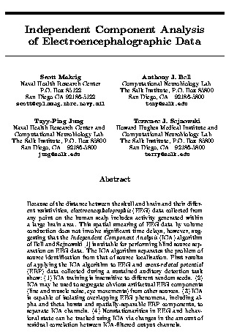
Blind EEG Source Separation by
Independent Component Analysis
ICA can find distinct effective source activities -- and their ‘simple’ scalp maps!
Tony Bell, developer of Infomax ICA
CSF
EEG
Cocktail Party
Makeig, Bell, Jung, Sejnowski, 1996
S. Makeig, 2011
Notes:
Independent Component Analysis (ICA) (right) can be used to separate N sound sources summed in recordings at N microphones, without relying on a detailed phonological model of the sounds characteristics of each source – this is so-called “blind separation.” ICA uses the presumption that the waveforms of the individual sound sources are independent over time.
Applied to EEG data (left), ICA assumes that the EEG is predominantly composed of a number of domains of synchronous neural (or neuroglial) activity, each of which must, by simple biophysics, project to most of the recording scalp electrodes. If synchronous activity within these domains are predominantly independent of each other, ICA can separate the summed signals from these domains into records of their separation activities, given that the number of such domains making large contributions to the recorded signals are smaller than the number of recording sites.

Slide 29
Independent
Domains
of Local Synchrony
Cortex
Freeman - phase cones
Plenz - avalanches
Thalamus
S. Makeig (2007)
Notes:
The extreme weighting of cortico-cortical connections toward local (nearest-neighbor) connectivity (particularly the inhibitory cell networks), and the dominance of radial thalamocortical connections support the appearance of local field synchronies whose locally-coherent activities are largely decoupled and therefore near-independent. The signature of coherent activity across a cortical patch is a scalp projection pattern (scalp map) near-perfectly resembling the projection of an equivalent dipole source located in or beneath the center of the cortical patch. Therefore, independent component (IC) scalp maps should have this dipolar quality. Sometimes, however, two cortical patches are coupled bi-directionally by a white-matter tract (e.g. corpus callosum, etc.). In this case, simultaneous activity can arise in both patches (e.g. alpha bursts) and they will form a single IC whose scalp signature should be the sum of the projections of two equivalent dipoles.

Slide 30
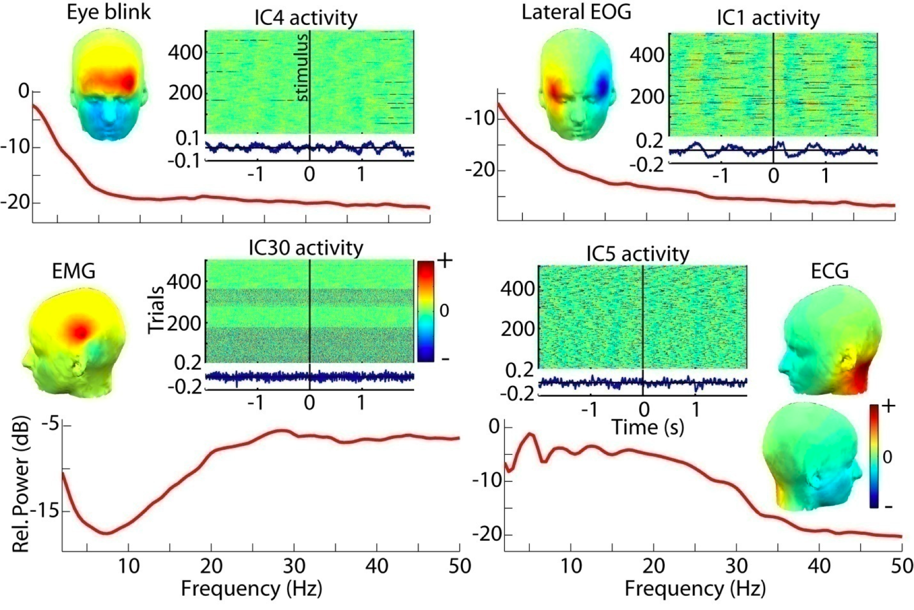
ICA finds Non-Brain Independent Component (IC) Processes …
… separates them from the remainder of the data …
J. Onton & S. Makeig 2006
Notes:
Typical component properties of four non-brain independent component processes accounting respectively for eye blinks, lateral eye movements, left post-auricular electromyographic (EMG) activity, and electrocardiographic (ECG) activity, from the 238-channel EEG recording studied in Figures 3.2 and 3.3. Upper panels show the interpolated component scalp map, activity ERP image, average ERP (below ERP image), and mean power spectrum. Lower panel shows the maximally independent activities of the four processes during a five-second period. Note the characteristic activity elements, also seen in the ERP-image representations.
From Makeig & Onton in S. Luck and E Kappenburg, Eds, Oxford Handbook of ERP Components, 2012.

Slide 31
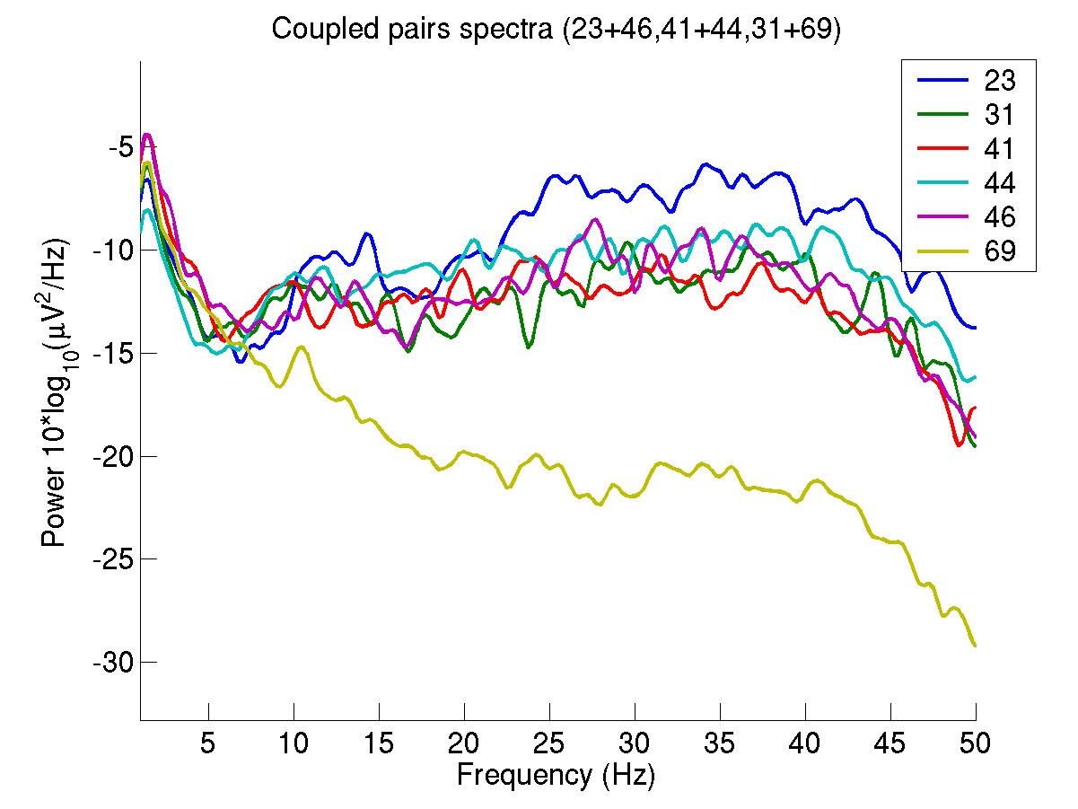
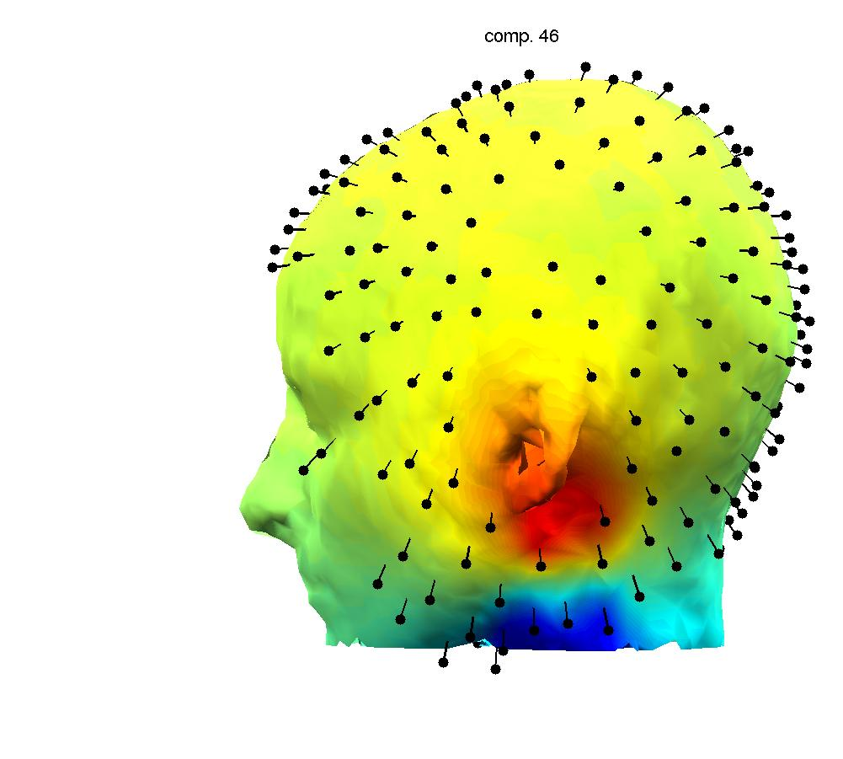
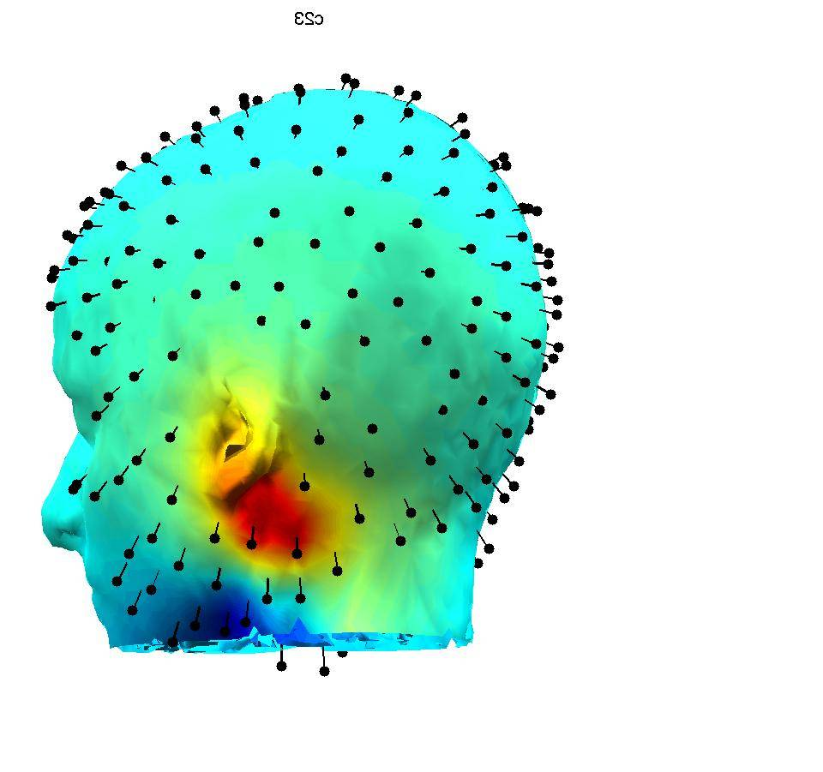
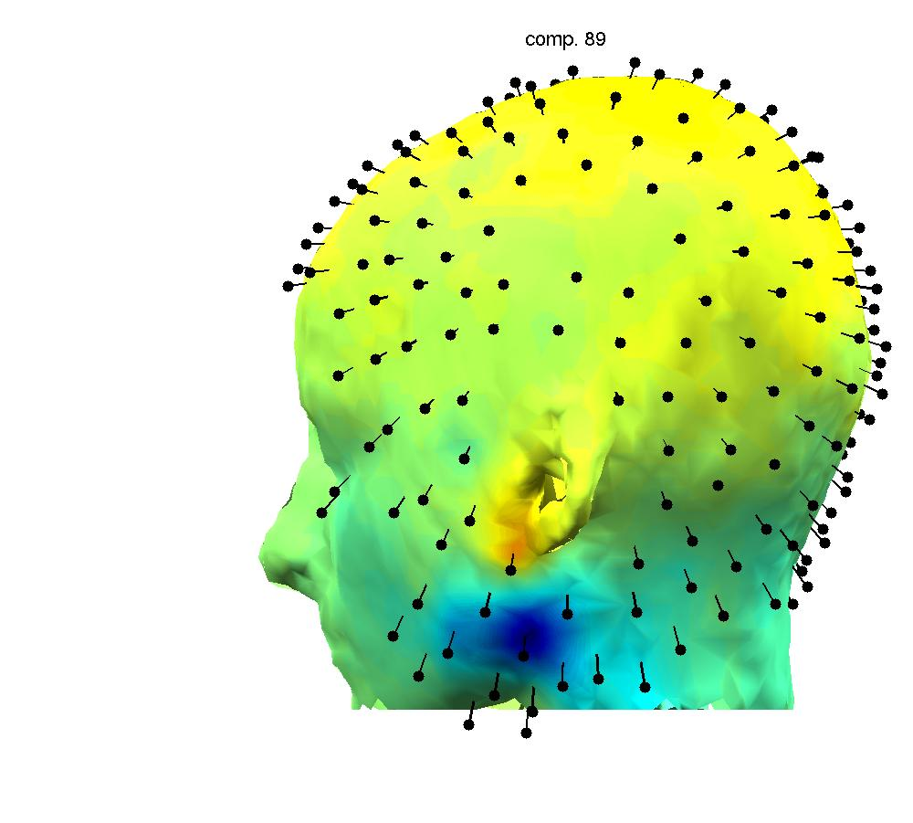
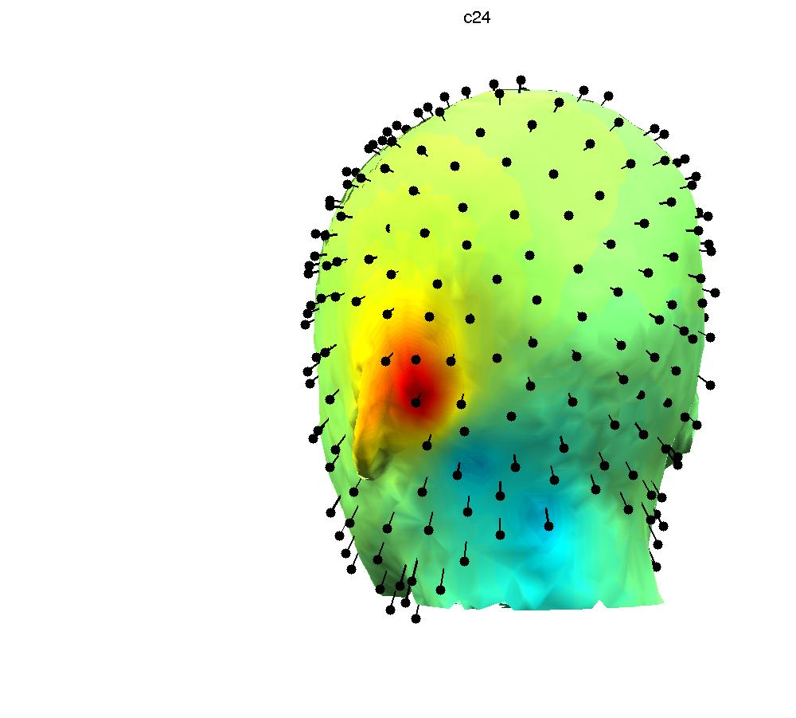
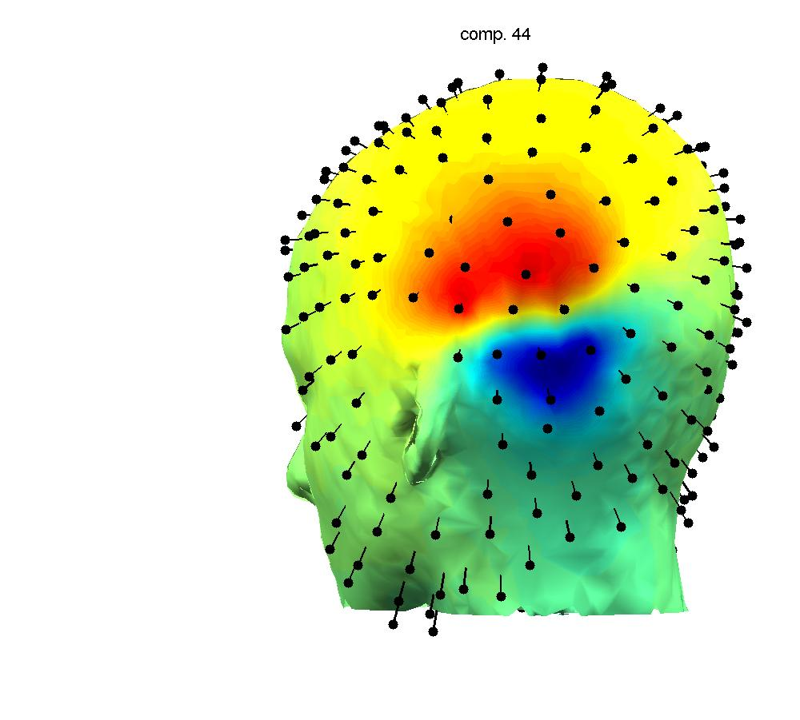
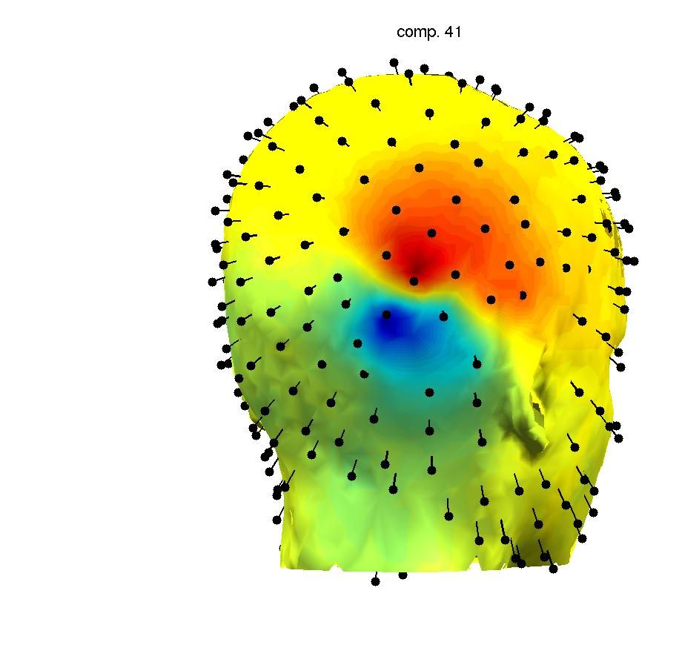
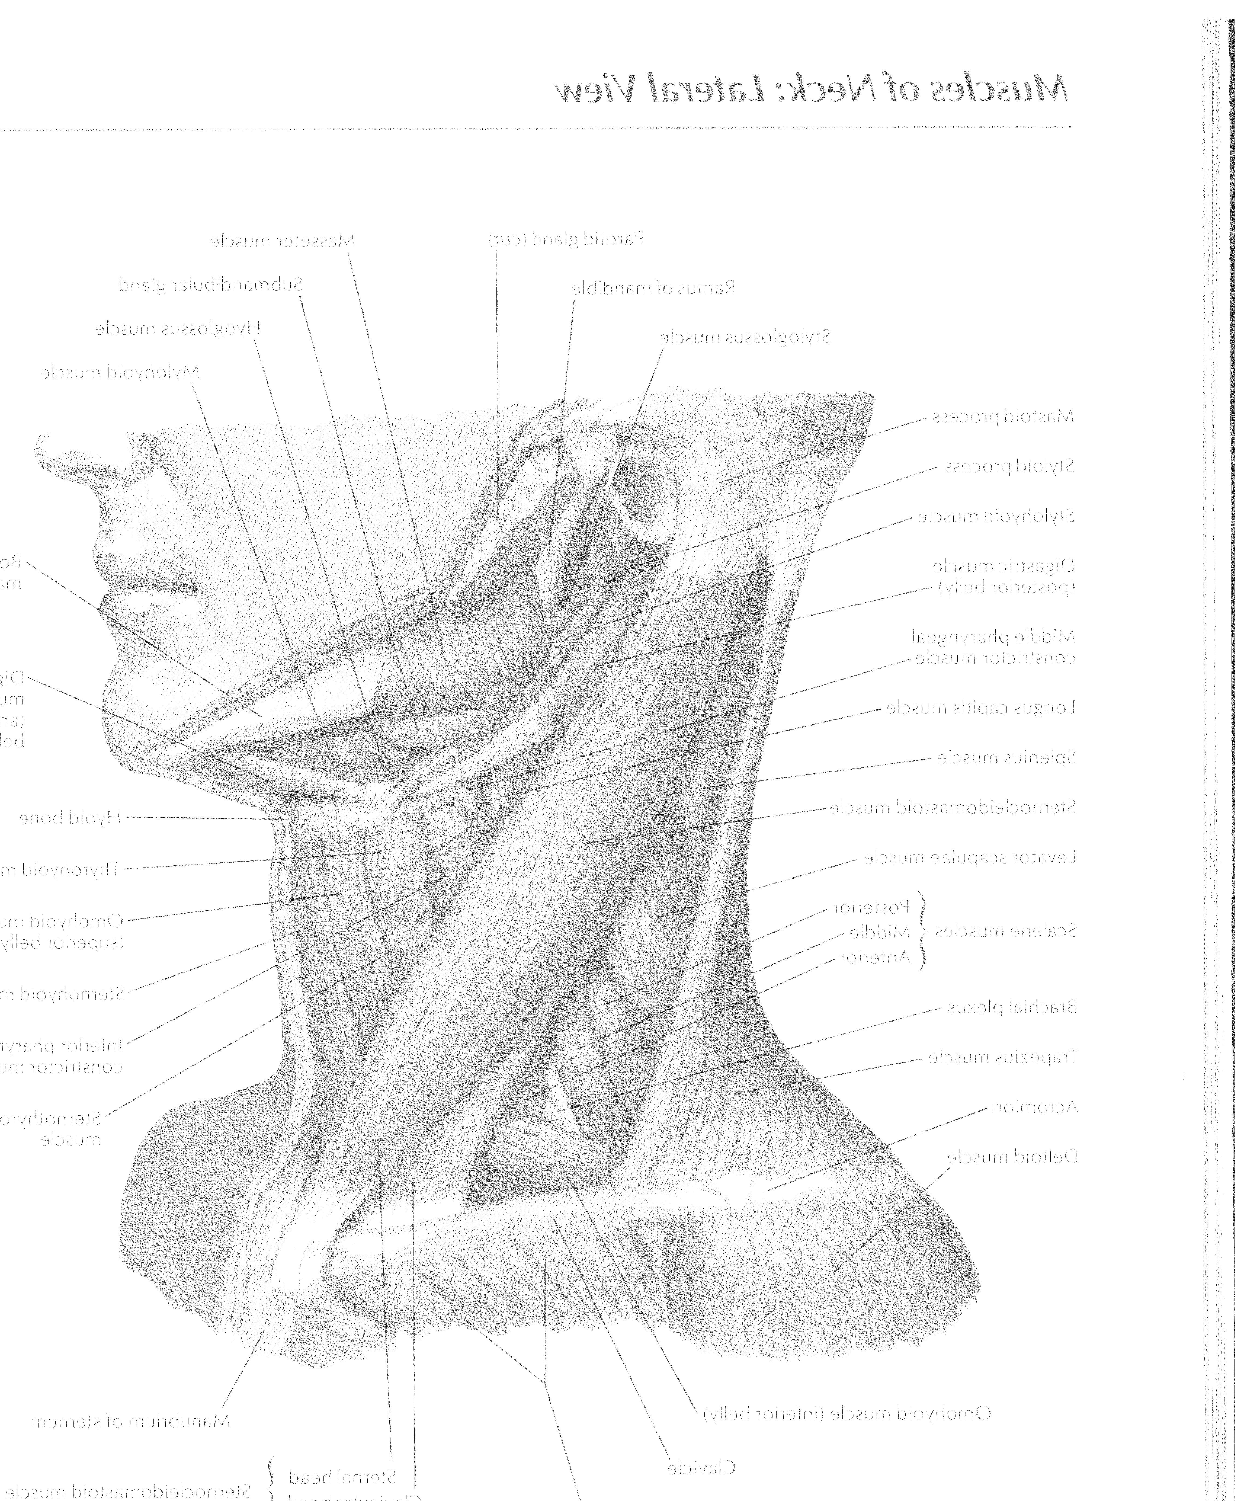
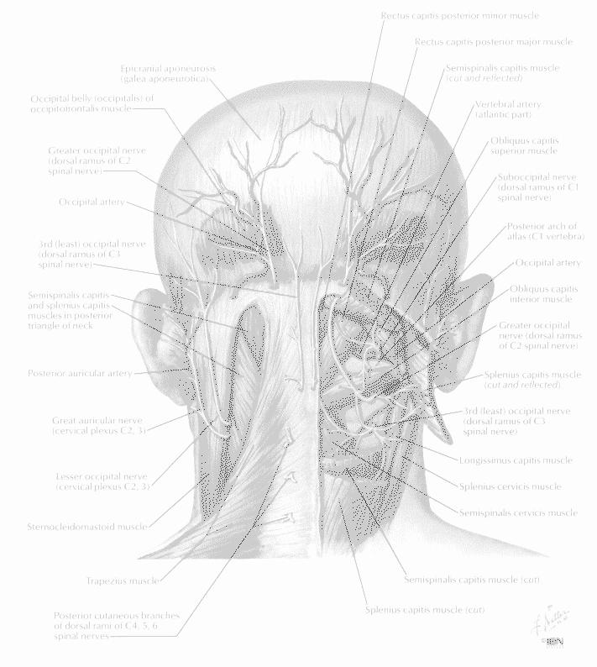
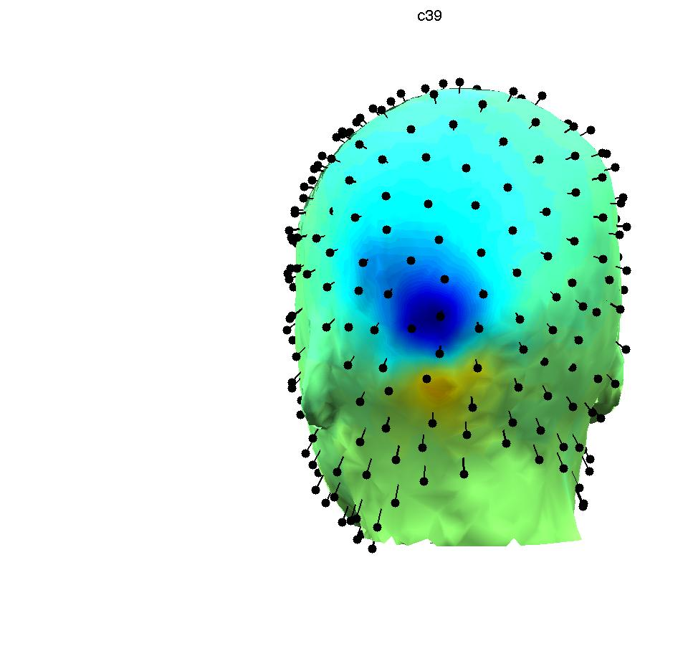
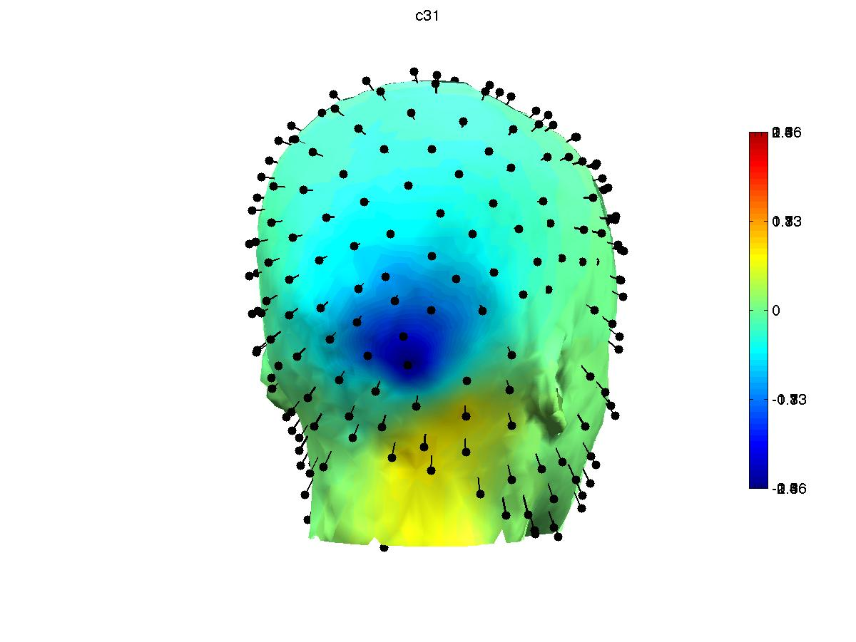
Same Session - Several Independent Muscle Components
J. Onton & S. Makeig 2006

Slide 32
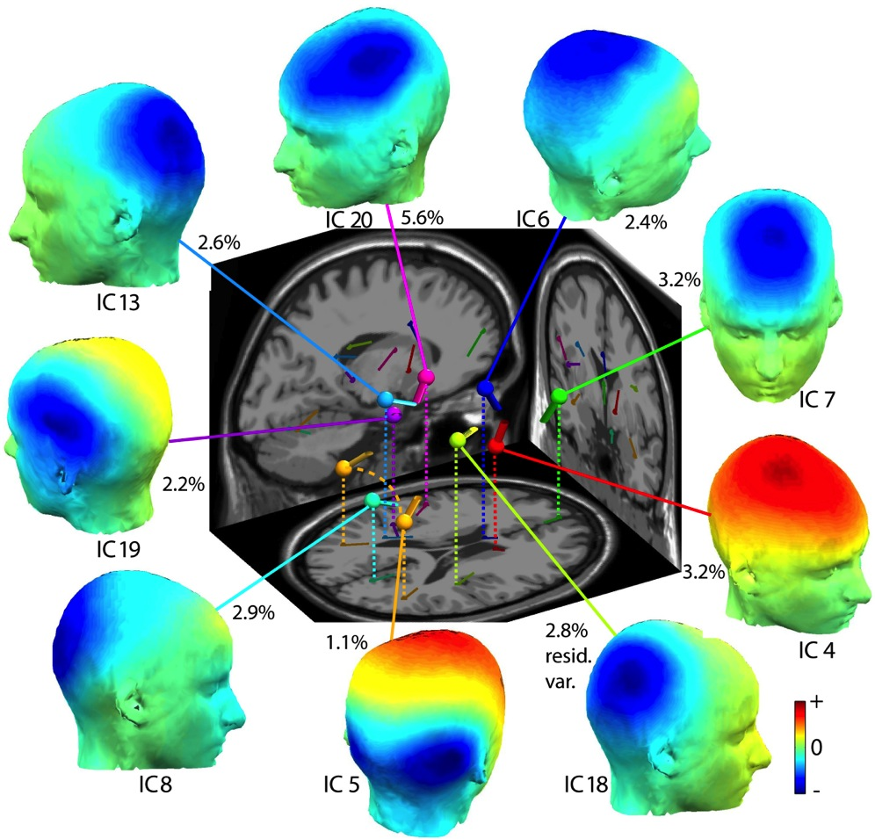
… and also separates cortical brain IC processes
Equivalent dipoles
Single dipole component
Dual-symmetric dipole component
Julie Onton & S. Makeig (2006)
Notes:
Cortical sources separated by ICA from the same dataset. Note the very low residual variances of the equivalent dipole models.

Slide 33
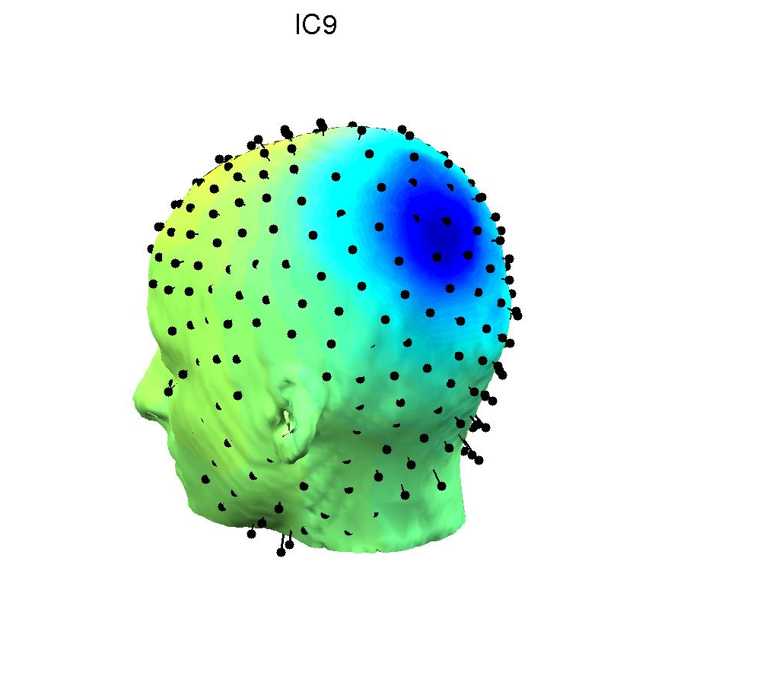




Single Session - Two Maximally Independent Alpha Processes
J. Onton & S Makeig, 2006

Slide 34


Delorme et al., PLOS One, 2012
S. Makeig, 2011
Notes:
Fig. 4B of Delorme et al., PLoS One, 2012

Slide 35

ICA in practice
Onton & Makeig, 2006
Notes:
ICA decomposition example: 15 seconds from a difficult letter twoback Continuous Performance Task. Top lanel shows 9 or 100 scalp channels decomposed (100 channels, half-hour of continuous EEG data). Bottom panel: shows 9 of 100 decomposed independent component processing (time courses and scalp maps). Note the ECG, left post-auricular EMG, two-component eyeblink subspace, frontal midline theta and left frontal theta processes, and bilateral parietal alpha-laden process…

Slide 36

Onton, Makeig (2006)

Slide 37

Equivalent dipole density
Visual Working Memory
Sternberg letter memory task
Onton et al., 2005
J Onton & S Makeig, ‘05

Slide 38
Three Eras of EEG Studies
ERD
ERSP
EEG
ICA
Brain Oscillation
SSR
EEGLAB
ERP
ERP
Computer of
Average
Transients
Loo & Makeig, 2015

Slide 39











Electromagnetic source localization using realistic head models
NFT
Simple Map
Solve the forward problem using realistic head models (BEM)
Inverse
Problem
Source
Estimate
Sensor Localization
Signal
Processing
Mesh generation
T1-weighted
T2-weighted
Proton Density
MRI
Segmentation
Z Akalin Acar & S Makeig, 2006
EEG/MEG

Slide 40


Effects of skull conductivity mis-estimation
Simulate 25
Assume 80
Simulate 25
Assume 15
Z Akalin Acar & S Makeig, 2013
Notes:
Mis-estimating the skull conductivity ratio as 80:1, instead of 25:1 produced large equivalent dipole localization errors of up to 31 mm where the equivalent dipole sources are localized more superficial. When we mis-estimated the skull to brain conductivity ratio as 15:1, i.e, assume a more conductive skull the dipoles are localized deeper.

Slide 41

The SCALE Approach
Simultaneous
Conductivity
And Location
Estimation
Z Akalin Acar & S Makeig, 2015

Slide 42


Arthur Tsai – Topological
source clustering
And
measure projection
From Arthur Tsai et al., NeuroImage, 2014
S Makeig, 2015
Notes:
Differences in cortical locations and scalp maps for functionally equivalent simulated ICs. (Top) The average fully inflated left cortical hemisphere computed using FreeSurfer (Dale et al., 1999; Fischl et al., 1999) from five individual subjects’ inflated and co-registered cortical surfaces after aligning the major cortical sulci (CS, central sulcus; SF, Sylvian fissure; STS, superior temporal sulcus; IPS, intraparietal sulcus), with all sulci shown in darker grey but IPS in green (labeled using surface-based parcellation proposed by Desikanet al., 2006 and Destrieux et al., 2010). The simulated EEG source consisted of mixture of two Gaussian-tapered patches in the superior parietal gyrus. (2nd and 3rd rows) The simulated source (darker red) was back-projected to the individual hemisphere after and before alignment, respectively, with an average folding pattern (blue traces). The downward pointing arrows in this figure schematize the simulation steps. (4th row) Corresponding source areas on the non-inflated cortical surfaces, showing their spatial disparity though are allocated in the superior parietal gyrus near IPS (green). (5throw)The computed projections of these five sources to the scalp; note that slight deviations in source orientation produced significantly different scalp projections. (6throw) Equivalent current dipoles for these simulated sources fit using EEGLAB dipfit() in a template head model (Delorme and Makeig, 2004). (7th row) Results of standardized Low Resolution Brain Electromagnetic Tomography Analysis (sLORETA) (PascualCMarqui, 2002) applied to each simulated source. Note inter-subject differences in scalp maps, dipole locations, and cortical source density estimates for topologically and therefore possibly functionally equivalent sources. From Tsai et al., 2014

Slide 43

A Passive Spatial Navigation Paradigm
Klaus Gramann et al., 2010

Slide 44

A Passive Spatial Navigation Paradigm
Klaus Gramann et al., 2010

Slide 45
A Passive Spatial Navigation Paradigm
Klaus Gramann et al., 2010

Slide 46
‘Turner’ and ‘Nonturner’ subjects use different spatial orienting styles
Turners
Nonturners
Klaus Gramann & S Makeig, 2010

Slide 47



Two parietal component clusters
Time (s)
From Klaus Gramann et al., 2010

Slide 48

Medial prefrontal component cluster
Time (s)
From Klaus Gramann et al., 2010
Notes:
Since I will use this form of power spectrum for all the upcoming Clusters I will shortly explain what you see here. I
On the lefthand side you see the horizontal
now differences with respect to the number of components entered into the cluster from the different strategy-groups

Slide 49

Clusters distinguishing Turners & Nonturners
From Klaus Gramann et al., 2010

Slide 50
from
Rissling et al., 2014
P3a
MMN
RON

Slide 51
S Makeig, 2015
from Rissling et al., 2014

Slide 52
S Makeig, 2015
from Rissling et al., 2014

Slide 53

Strong clinical symptom / score correlations ONLY with ICA source ERP waveform measures!
Here, peak amplitude correlations…
S Makeig, 2015
from Rissling et al., 2014

Slide 54

Strong clinical symptom / score correlations ONLY with ICA source ERP waveform measures!
Here, peak latency
correlations…
S Makeig, 2015
from Rissling et al., 2014

Slide 55

Psychiatric subject landscapes
= Low-dimensional spaces of functional individual differences
Example: A ‘spectrum’ of indiv. differences = 1-dim. landscape
Compare: labeled subtypes versus ‘subject space geometry’
Task: Find corresponding behavioral and neurobiological landscapes
& biomarker(s) of position within the biobehavioral landscape
S Makeig, 2015

Slide 56

HeadIT
A Human Electrophysiology, Anatomic Data, and Integrated Tools
Resource
HeadIT.org
S Makeig, 2015

Slide 57




Development of
EEG brain Imaging …
1937
Grey Walter
1957
SCALE
Toposcope
Grey Walter
1977
Oddball ERPs
K. Squires et al.
EEGLAB
‘headplot()’
1997
2015
2015
S Makeig, 2015
from A. Akalin Acar et al., 2015

Slide 58

Swartz Center for Computational Neuroscience
UC San Diego
sccn.ucsd.edu
S Makeig, 2012
10th Anniversary SCCN Impromptu celebration 1/2/12

Slide 59







Swartz Center for Computational Neuroscience
UC San Diego
AMICA
BCILAB
EEGLAB
NFT
SIFT
SIFT
MoBILAB
MPT
sccn.ucsd.edu
S Makeig, 2012
10th Anniversary SCCN Impromptu celebration 1/2/12

