Slide 1
Zhilin Zhang, Bhaskar D. Rao University of California, San Diego March 28, 2012
Recovery of Block Sparse Signals Using the Framework of Block Sparse Bayesian Learning

Slide 2
Outline
Introduction
The Framework of Block Sparse Bayesian Learning (BSBL)
The Extended BSBL Framework
Experiments
Discussions and Conclusions

Slide 3
Outline
Introduction
The Framework of Block Sparse Bayesian Learning (BSBL)
The Extended BSBL Framework
Experiments
Discussions and Conclusions

Slide 4
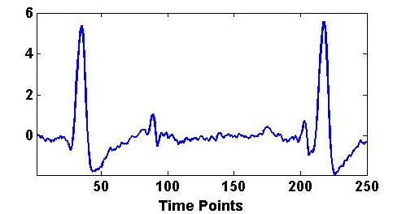
Introduction
The basic compressed sensing (CS) model ignores structure in data.
Natural signals (e.g. biosignals, images) have significant structure.
It is shown empirically and theoretically that exploiting such structure may improve recovery performance

Slide 5
Introduction
Block Structure is a common structure in many signals
Only a few blocks are nonzero
The majority of existing algorithms assumes the block partition is known:
Eg. Group Lasso;
Mixed L2/L1 Program;
Block-OMP;
Block-CoSaMP

Slide 6
Introduction
Challenges:
When the block partition is unknown?
Only a few algorithms
Some of them still need other a priori knowledge (e.g. the sparsity or block-sparsity)
Only work well in noiseless environments
Adaptively learn and exploit the intra-block correlation?
The correlation in each block is significant in natural signals
No algorithms consider this issue
Any effects of the intra-block correlation?
Can algorithms benefit from the intra-block correlation?
How to adaptively learn?

Slide 7
Introduction
Contributions of our work:
Proposed algorithms that can adaptively learn and exploit the intra-block correlation
Based on the framework of block sparse Bayesian learning (bSBL)
Work well no matter whether the block partition is known or unknown
Study the effects of the intra-block correlation
Not significantly harm the performance of most existing algorithms
But can be exploited to improve performance

Slide 8
Outline
Introduction
The Framework of Block Sparse Bayesian Learning (bSBL)
The Extended BSBL Framework
Experiments
Discussions and Conclusions

Slide 9
The BSBL Framework
Model:
Prior
Parameterized Prior:
: control block-sparsity
: capture intra-block correlation;
will be further constrained to prevent overfitting

Slide 10
The BSBL Framework
Model:
Noise model
Posterior

Slide 11
The BSBL Framework
All the hyperparameters are estimated by the Type II maximum Likelihood:
Learning rule for
Learning rule for

Slide 12
The BSBL Framework
All the hyperparameters are estimated by the Type II maximum Likelihood:
Learning rule for
When blocks have the same size:
Constrain Bi = B, then
When blocks have different sizes:
Constrain elements in each block satisfy AR(1) with the same AR coefficient

Slide 13
Outline
Introduction
The Framework of Block Sparse Bayesian Learning (BSBL)
The Extended BSBL Framework
Experiments
Discussions and Conclusions

Slide 14
The Extended BSBL Framework
Find the inverse solution when the block partition is unknown
Assume that all the nonzero blocks are of equal size h and are arbitrarily located
Consistent with some practical problems
They can overlap giving rise to larger unequal blocks
The resulting algorithm is not very sensitive to the choice of h, especially in noisy environments

Slide 15
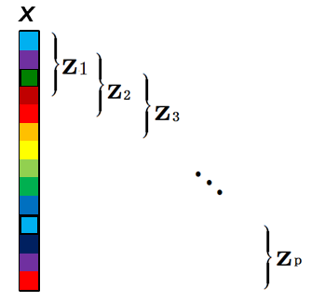
The Extended BSBL Framework
Model
Partition x into p identical overlapped blocks ( )
Blocks are assumed to be uncorrelated
Each block zi satisfies a multivariate Gaussian distribution with the mean given by 0 and the covariance matrix given by
The covariance of the prior x is no longer block-diagonal

Slide 16
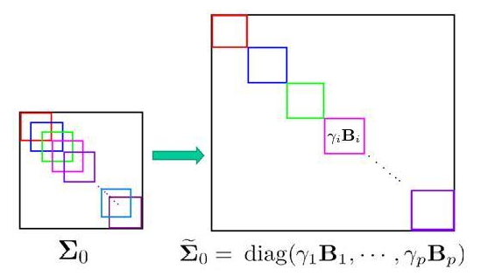
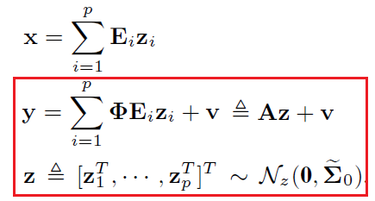
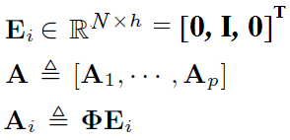
The Extended BSBL Framework
To use the bSBL framework, we want to change the structure of the covariance matrix of the prior as follows:
This corresponds to
Now is bSBL model

Slide 17
The Extended BSBL Framework
New model
Following the algorithm development in the original bSBL framework, we can directly obtain the algorithm for the above model.

Slide 18
Outline
Introduction
The Framework of Block Sparse Bayesian Learning (BSBL)
The Extended BSBL Framework
Experiments
Discussions and Conclusions

Slide 19
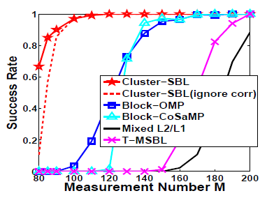
Experiments
Denote the proposed algorithm by Cluster-SBL (type I) if knowing the block partition, or by Cluster-SBL (type II) if not.
Experiment 1: Block partition is known in noiseless environments
N=512,
64 blocks with identical size
10 blocks were nonzero
Intra-block correlation varied from 0.9 to 0.99 (modeled as AR(1))
Block-OMP [Eldar, et al,2010]
Block-CoSaMP [Baraniuk, et al, 2010]
Mixed L2/L1 [Eldar and Mishali,2009]
T-MSBL [Zhang and Rao, 2011]

Slide 20
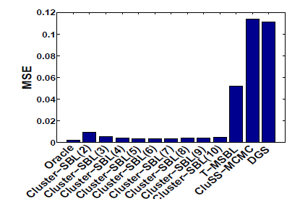
Experiments
Experiment 2: Block partition is unknown in noisy environments
M=80
N = 256
# of nonzero entries: 32
4 nonzero blocks with random sizes but the total nonzero entries were 32
SNR = 25dB
No intra-block correlation (in order to see the feasibility of the extended bSBL framework)
For our Cluster-SBL (type ii), h: 3~10
Oracle: LS solution given the true support
T-MSBL: [Zhang and Rao, 2011]
CluSS-MCMC: [Yu, et al, 2012]
DGS: [Huang, et al, 2009]

Slide 21
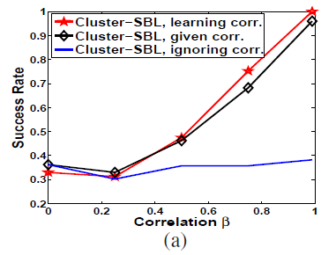
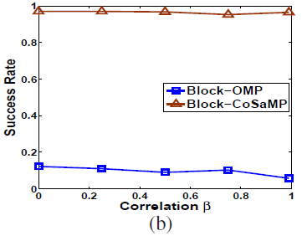
Experiments
Experiment 3: Benefits from exploiting intra-block correlation
Figure (a):
noiseless
M=100, N=300
75 blocks with the same size
20 blocks were nonzero
block partition was known
intra-block correlation varied from 0 to 0.99
Figure (b):
The same to the above settings, except the number of nonzero blocks was 15 (making the problem easier)

Slide 22
Thank You !

