Slide 1
A critical review on the physiological interpretation of independent component analysis (ICA) applied to EEG data
Makoto Miyakoshi
Swartz Center for Computational Neuroscience
Institute for Neural Computation
University of California San Diego

Slide 2
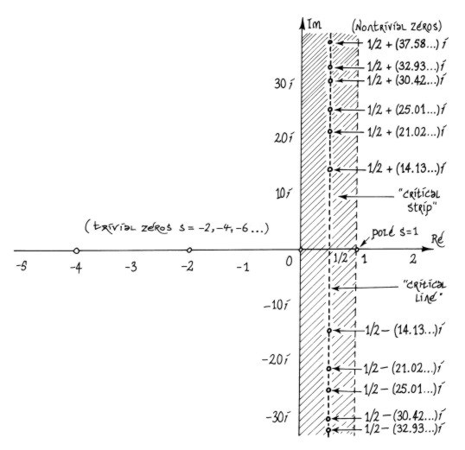
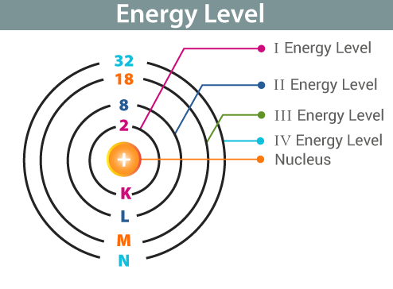
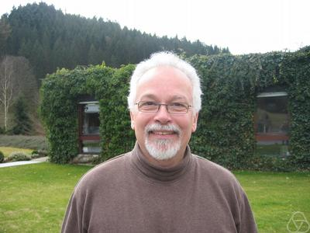
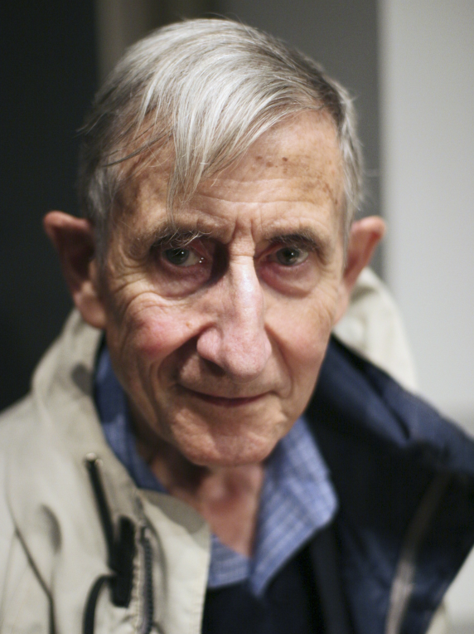


Math meets physics
$${(\frac{\sin{πu}}{πu})}^{2}$$
$${(\frac{\sin{πr}}{πr})}^{2}$$
https://empslocal.ex.ac.uk/people/staff/mrwatkin//zeta/ss-o.htm
https://en.wikipedia.org/wiki/Montgomery%27s_pair_correlation_conjecture
https://byjus.com/physics/energy-level/
https://en.wikipedia.org/wiki/Freeman_Dyson
Hugh L. Montgomery (1944-)
Freeman Dyson (1923-2020)

Slide 3
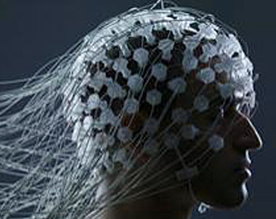
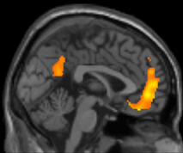
Math meets physiology?
Scalp EEG
Cortical activity?
https://3.bp.blogspot.com/-3n1E2wb-Glk/Vu04LroMJ4I/AAAAAAAAECo/x6ptckRX6HQYgo2SwVmneqQJ9jN84Juqw/s1600/cyborg-7.jpg

Slide 4


1995
Infomax
1996
1998
2000
2002
2004
2006
2008
2010
2012
2014
2016
2018
2020

Slide 5

Cocktail party problem
A
Mic 1
B
A
Mic 2
Mic 1
Mic 2
C
A
B
Mic 3
D
Mic 4
C
D
 | Mic1 | Mic2 | Mic3 | Mic4
A | 20 | 21 | 25 | 34
Mic 3
Mic 4
B | 17 | 23 | 31 | 29
C | 27 | 30 | 25 | 18
D | 31 | 28 | 16 | 25
Notes:
Recording four speakers speaking at the same time

Slide 6


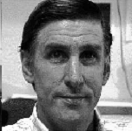
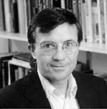
Unmixing using ICA
A
Mic 1
 | Mic1
A | 0.9
B | -1.1
C | 0.5
D | -0.2
Mic2
-0.9
1.1
-0.5
0.2
Mic3
0.7
-0.8
0.4
-0.2
Mic4
-0.6
0.8
-0.4
0.2
B
A⁻¹
Mic 2
C
Mic 3
D
Mic 4
(Photos and voices by courtesy of Scott Makeig, taken from his presentation in 1999)
Notes:
Recovering each speaker’s voice from record

Slide 7
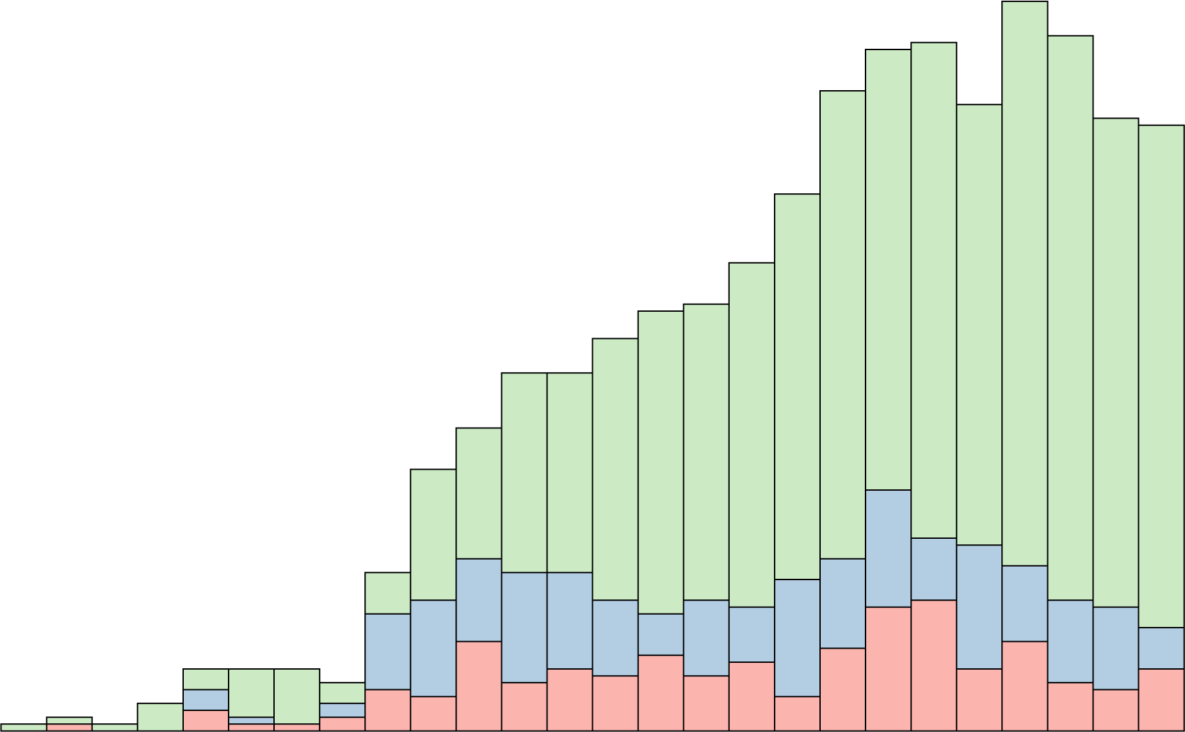

1996
ICA on EEG
1996
1998
2000
2002
2004
2006
2008
2010
2012
2014
2016
2018
2020

Slide 8
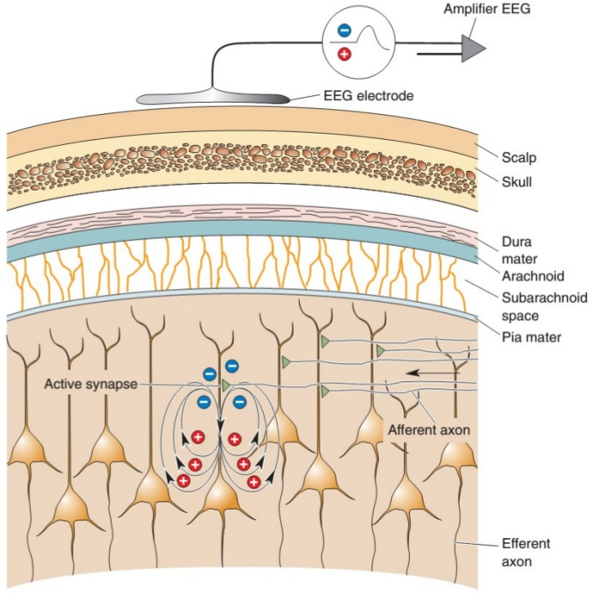

Cocktail party problem vs. spatial averaging on cell assembly
PDF is close to Gaussian
due to $∑$ (Central Limit Theorem)
Gaussian
Mixing
Unmixing
Mixing
Unmixing
Mixing
Unmixing
PDF is close to super-Gaussian
(sparsity of neural activity)
Super-Gaussian
Figure by Dr. Mayank Agarwal https://www.slideshare.net/drmayankmanu/eeg-69533120

Slide 9
1997
PNAS
Infomax
1996
1998
2000
2002
2004
2006
2008
2010
2012
2014
2016
2018
2020
Graduated a high school

Slide 10
2002
Science
ICA on EEG from PNAS
First ICA on EEG
Infomax
1996
1998
2000
2002
2004
2006
2008
2010
2012
2014
2016
2018
2020
Graduated a high school
Entered a university

Slide 11
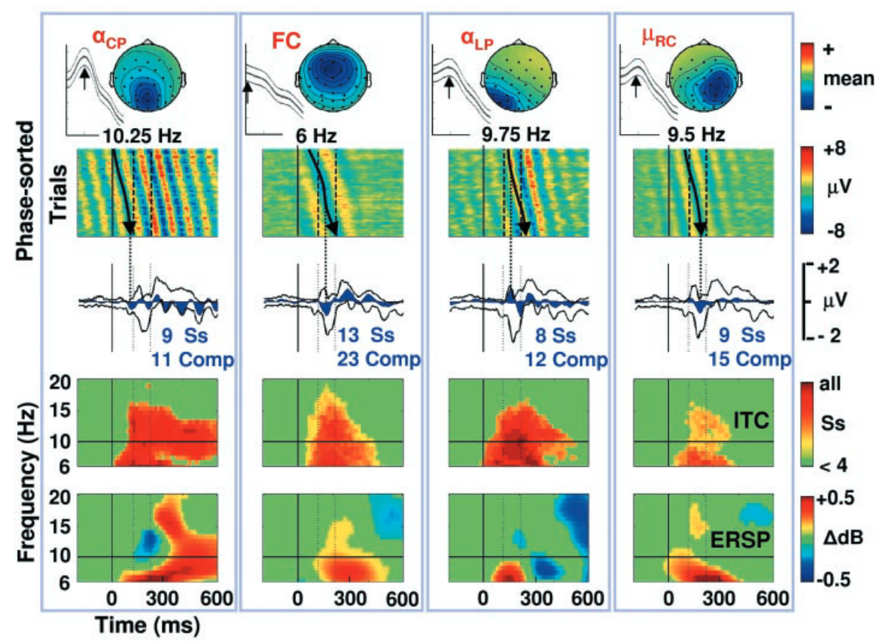
Makeig et al. (2002)

Slide 12

2002
SCCN launched
ICA on EEG from PNAS
First ICA on EEG
Infomax
1996
1998
2000
2002
2004
2006
2008
2010
2012
2014
2016
2018
2020
Graduated a high school
Entered a university

Slide 13
2004
TICS
ICA on EEG from Science
SCCN Launched
ICA on EEG from PNAS
First ICA on EEG
Infomax
1996
1998
2000
2002
2004
2006
2008
2010
2012
2014
2016
2018
2020
Graduated a high school
Entered a university
Entered a grad school

Slide 14
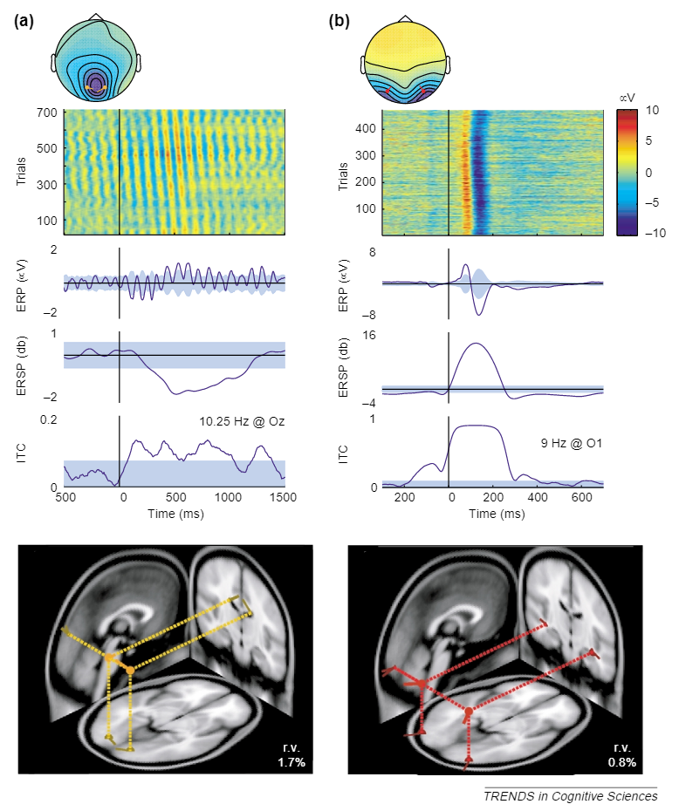
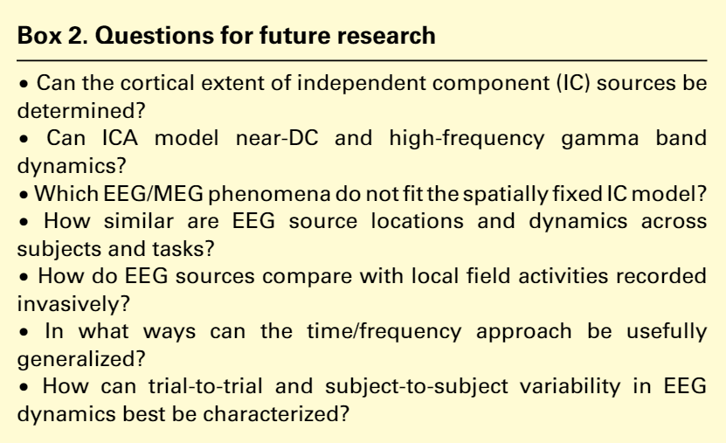
Makeig et al. (2004)

Slide 15

ICA on EEG from Science
SCCN Launched
ICA on EEG from PNAS
ICA on EEG from TICS
First ICA on EEG
Infomax
1996
1998
2000
2002
2004
2006
2008
2010
2012
2014
2016
2018
2020
Graduated a high school
Entered a university
Entered a grad school
2005
2nd EEGLAB Workshop

Slide 16
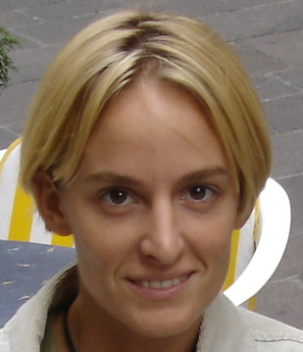
2006
Physiol. Interp.
of ICA 1
ICA on EEG from Science
SCCN Launched
ICA on EEG from PNAS
ICA on EEG from TICS
First ICA on EEG
Infomax
1996
1998
2000
2002
2004
2006
2008
2010
2012
2014
2016
2018
2020
Graduated a high school
Entered a university
2nd EEGLAB Workshop
Entered a grad school

Slide 17
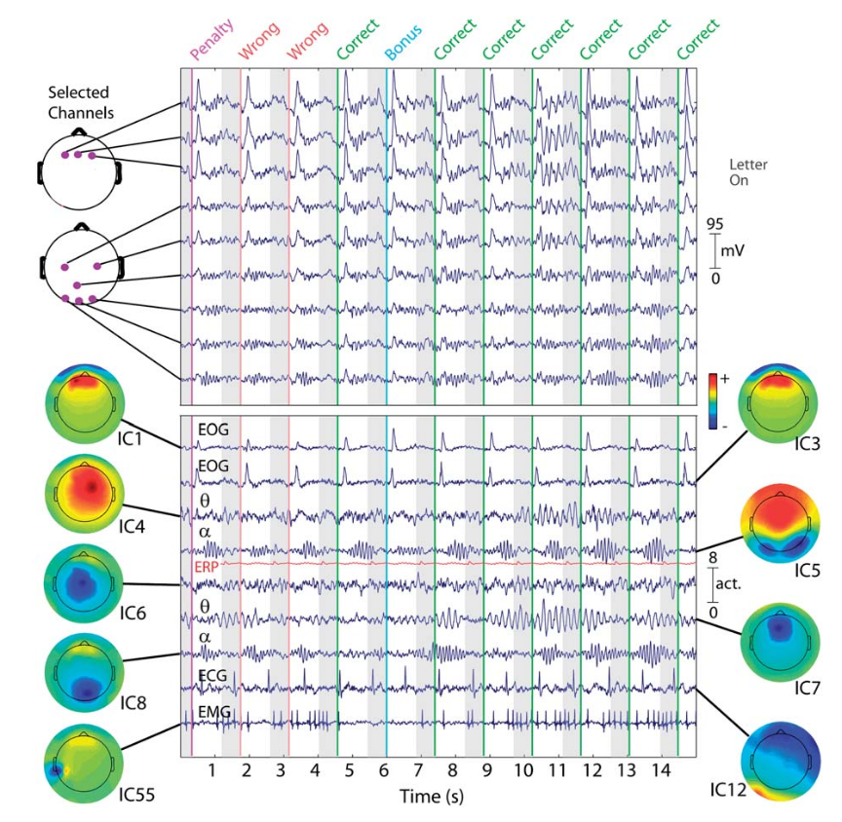
Mixing
Unmixing
Onton and Makeig (2006)

Slide 18
ICA on EEG from Science
SCCN Launched
ICA on EEG from PNAS
Physiol. interp. of ICA 1
First ICA on EEG
Infomax
1996
1998
2000
2002
2004
2006
2008
2010
2012
2014
2016
2018
2020
Graduated a high school
Entered a university
2nd EEGLAB Workshop
Entered a grad school
Started posts-doc (MRI)
2011
Joined SCCN as a post-doc

Slide 19

2012
Physiol. Interp.
of ICA 2
ICA on EEG from Science
SCCN Launched
ICA on EEG from PNAS
Physiol. interp. of ICA 1
ICA on EEG from TICS
First ICA on EEG
Infomax
1996
1998
2000
2002
2004
2006
2008
2010
2012
2014
2016
2018
2020
Graduated a high school
Joined SCCN as a post-doc
Entered a university
2nd EEGLAB Workshop
Entered a grad school
Started posts-doc (MRI)

Slide 20
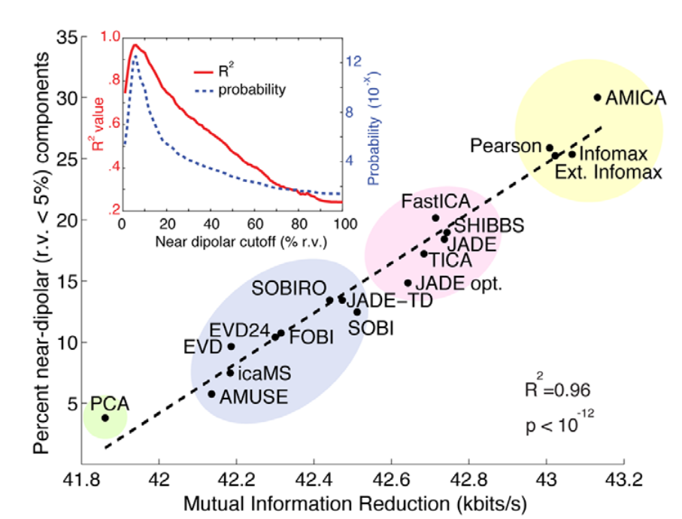
Physiology
Math
Delorme et al. (2012)

Slide 21
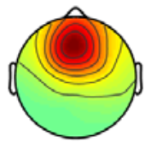
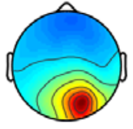
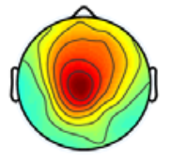
Independence-Dipolarity identity (IDID)
Scalp-channel time-domain data PDF
IC time-domain data PDF
ch1
ch2
ch3
IC1
IC2
IC3
IC spatial-domain problem solved as well?

Slide 22

2016
Physiol. Interp.
of ICA 3
ICA on EEG from Science
SCCN Launched
ICA on EEG from PNAS
Physiol. interp. of ICA 1
Physiol. interp. of ICA 2
ICA on EEG from TICS
First ICA on EEG
Infomax
1996
1998
2000
2002
2004
2006
2008
2010
2012
2014
2016
2018
2020
Graduated a high school
Joined SCCN as a post-doc
Entered a university
2nd EEGLAB Workshop
Entered a grad school
Meeting Hiro Tanaka
Started posts-doc (MRI)
‘Brain circulation’ started

Slide 23
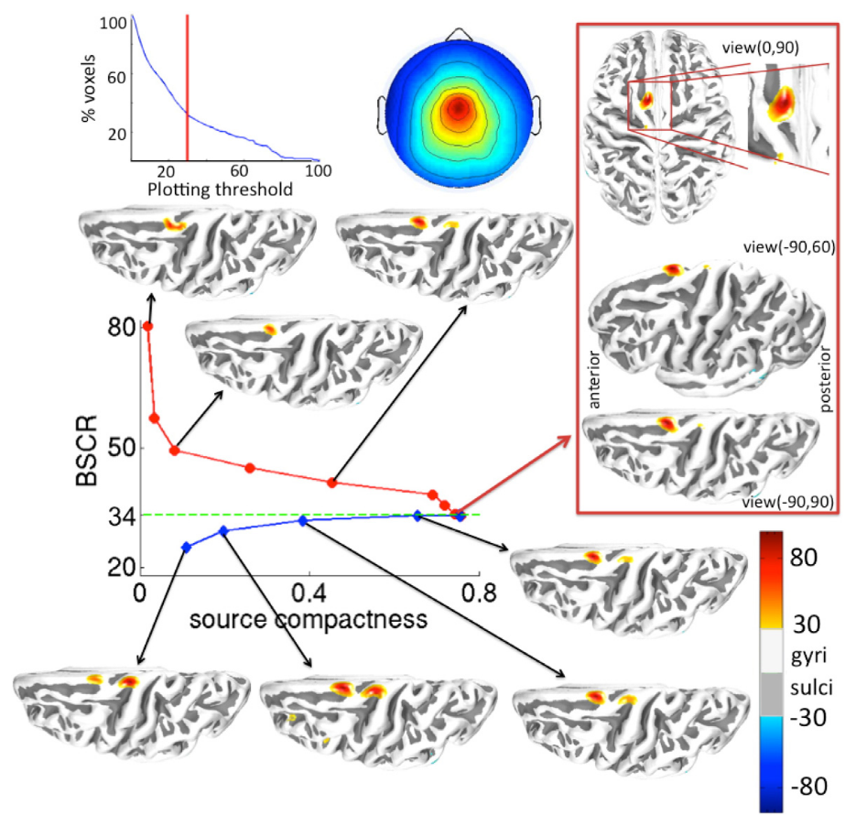
Simultaneous tissue conductivity And source Localization Estimation (SCALE)
Algorithm:
Search for the skull resistivity that minimizes the cortical patch size.
Skull resistivity
Akalin Acar et al. (2016)

Slide 24
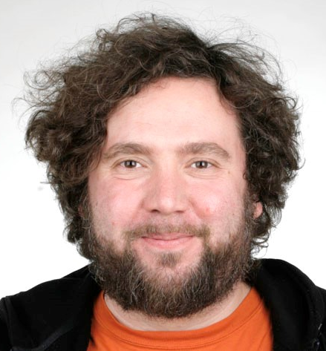

ICA on EEG from Science
SCCN Launched
ICA on EEG from PNAS
Physiol. interp. of ICA 1
Physiol. interp. of ICA 2
Physiol. interp. of ICA 3
ICA on EEG from TICS
First ICA on EEG
Infomax
1996
1998
2000
2002
2004
2006
2008
2010
2012
2014
2016
2018
2020
Graduated a high school
Joined SCCN as a post-doc
Entered a university
2nd EEGLAB Workshop
Entered a grad school
Meeting Hiro Tanaka
Started posts-doc (MRI)
Brain circulation
2017
ICA’s dimension reduction effect

Slide 25
Challenging the Physiological interpretation of ICA (1)
ICA’s dimension reduction effect

Slide 26
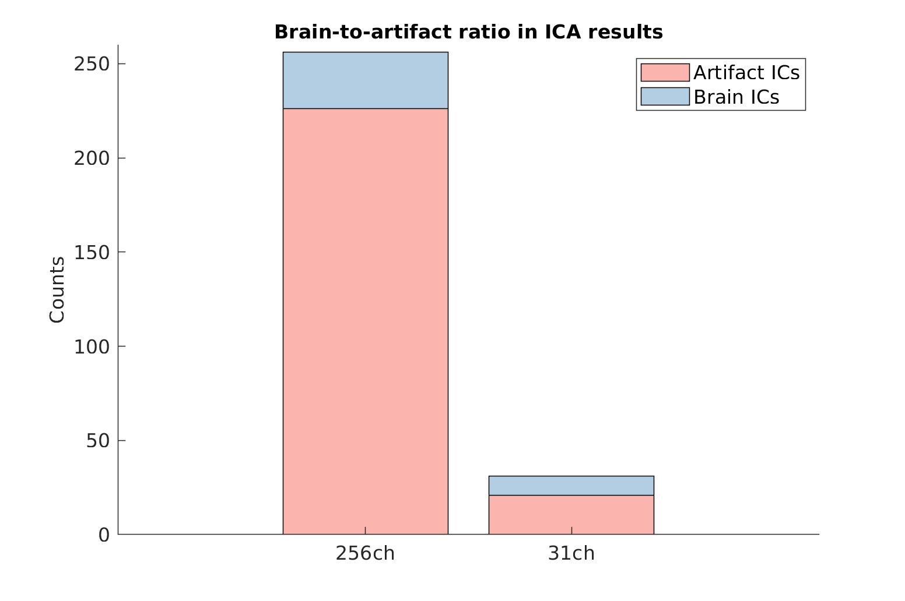
Motivation: Too few brain ICs produced
Onton and Makeig (2006)

Slide 27
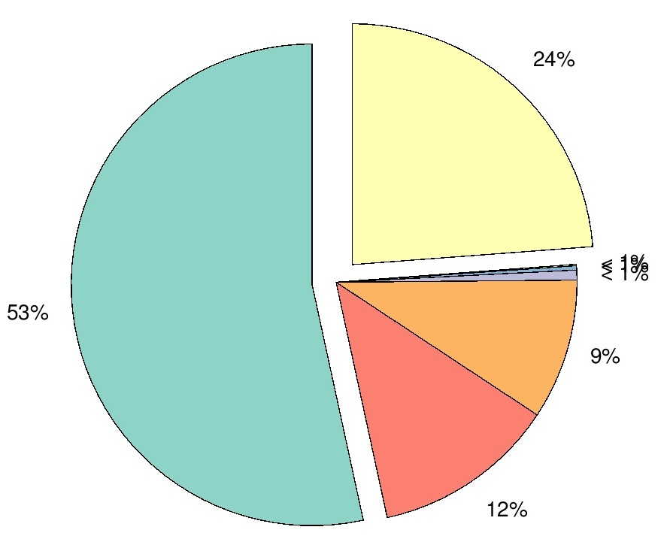
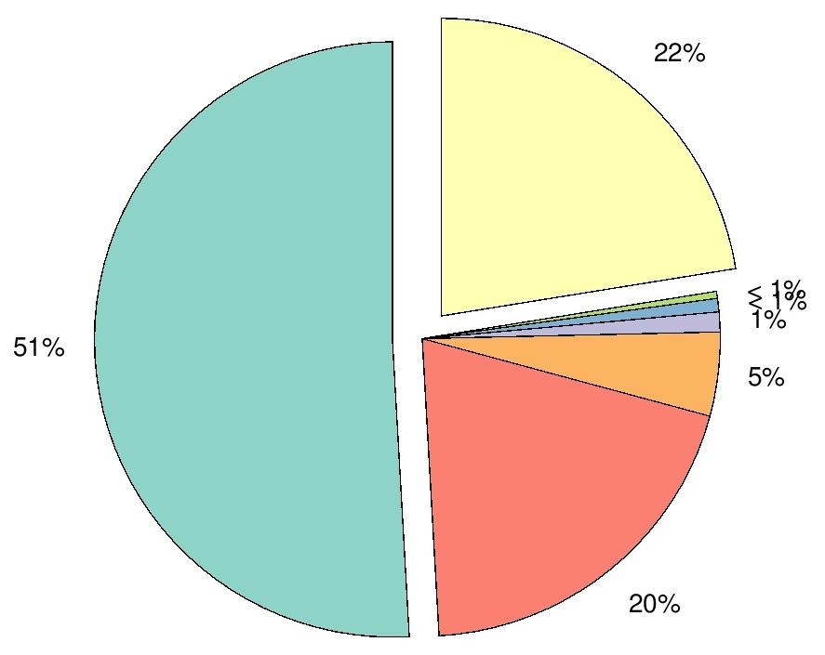
ICLabel results, 21 ch EEG data
ICLabel results, 62 ch EEG data
Other
Other
Brain
Brain
Eye
Eye
Muscle
Muscle
N = 200, healthy children, Resting
Miyakoshi et al. (2021)
N = 208, healthy adults, Resting
Public EEG database by Babayan et al. (2019)
Unpublished observations (in prep)

Slide 28
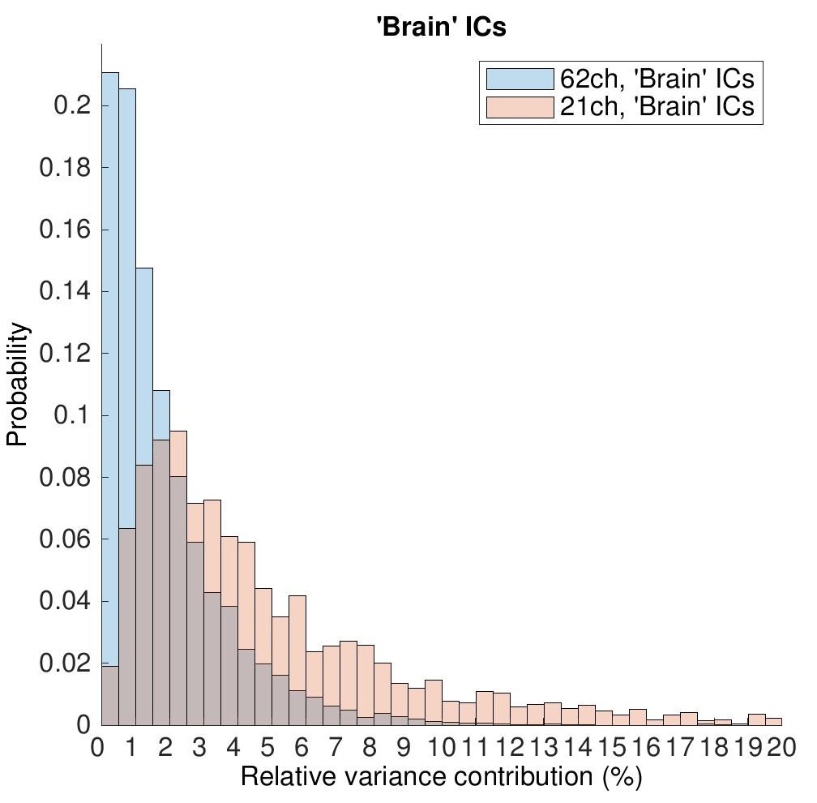
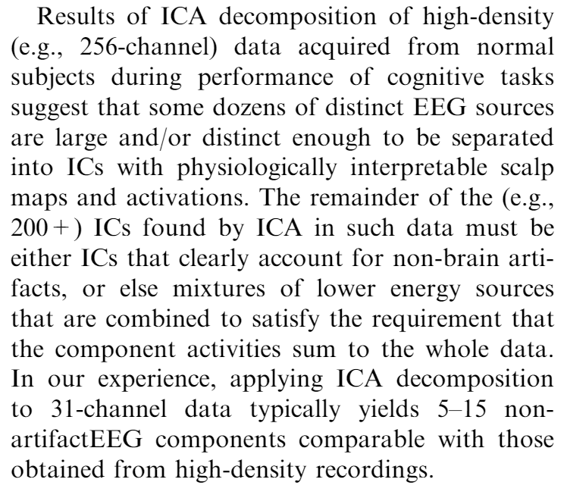
Numerical junk!
Increasing the number of electrodes increases the number of junk ICs from 8% to 42%.
Onton and Makeig (2006)
Low
SNR
High
Unpublished observations (in prep)

Slide 29
Conclusion (1): ICA’s dimension reduction effect
As the number of the electrodes increases, the number of low-SNR ‘brain’ ICs increases.
This is as if brain’s innate degrees of freedom (DOF) is limited to a low rank order, which is revealed by using ICA.
  However, later I found that this is probably because ICA is sensitivity to power distribution across frequencies, and ICA’s low DOF derives from the low DOF of the low-frequency, high-amplitude EEG signals.
  Cf. the resolution of spline Laplacian method linearly increases as the number of the electrode increases.

Slide 30


ICA on EEG from Science
SCCN Launched
ICA on EEG from PNAS
Physiol. interp. of ICA 1
Physiol. interp. of ICA 2
Physiol. interp. of ICA 3
ICA on EEG from TICS
First ICA on EEG
Infomax
1996
1998
2000
2002
2004
2006
2008
2010
2012
2014
2016
2018
2020
Dimension reduction
Graduated a high school
Joined SCCN as a post-doc
Entered a university
2nd EEGLAB Workshop
Entered a grad school
Meeting Hiro Tanaka
Started posts-doc (MRI)
‘Brain circulation’ started
2018
Start to translate ‘EFB’
Meeting Paul Nunez

Slide 31
ICA on EEG from Science
SCCN Launched
ICA on EEG from PNAS
Physiol. interp. of ICA 1
Physiol. interp. of ICA 2
Physiol. interp. of ICA 3
ICA on EEG from TICS
First ICA on EEG
Infomax
1996
1998
2000
2002
2004
2006
2008
2010
2012
2014
2016
2018
2020
2019
The small-patch hypothesis
Graduated a high school
Joined SCCN as a post-doc
Entered a university
2nd EEGLAB Workshop
Entered a grad school
Meeting Hiro Tanaka
ICA’s dimension reduction
Started posts-doc (MRI)
‘Brain circulation’ started

Slide 32
Challenging the Physiological interpretation of ICA (2):
The small patch hypothesis

Slide 33
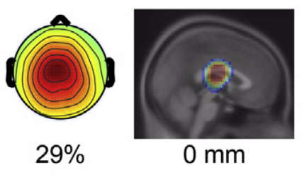
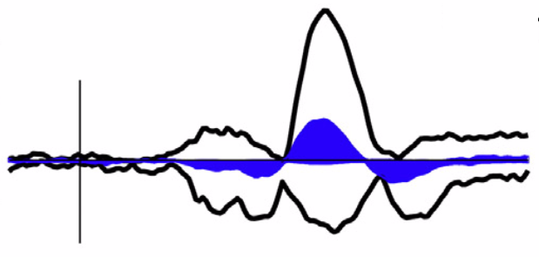
Motivation: Physiologically invalid deep dipoles
Rissling et al. (2014)

Slide 34
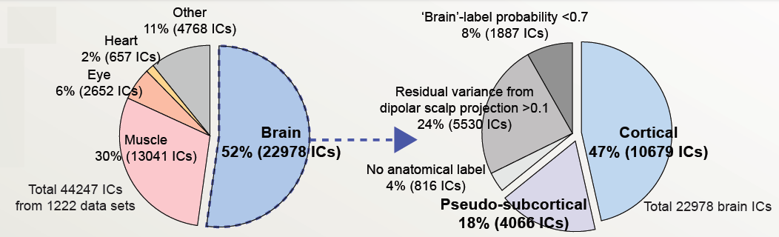
Highest probability in ICLabel()
4066:10679 = 1:2.7
1 out of 2.7 ‘Brain’ ICs is localized in the subcortical regions
Miyakoshi, Koshiyama, Light, Makeig. (2019) Why does ICA-decomposed EEG sometimes show deep dipoles? Poster presentation at Neuroscience2019, Chicago, IL.

Slide 35
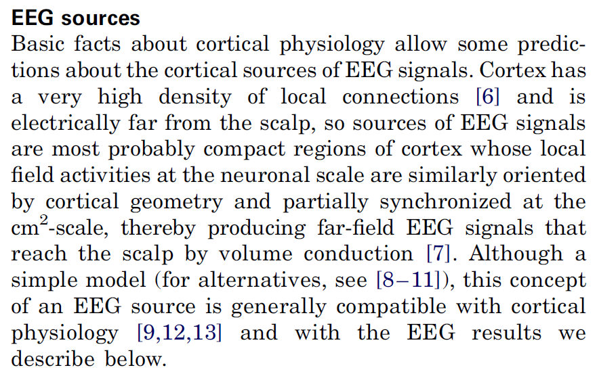
2004
TICS
ICA on EEG from Science
SCCN Launched
ICA on EEG from PNAS
First ICA on EEG
Infomax
1996
1998
2000
2002
2004
2006
2008
2010
2012
2014
2016
2018
2020
Graduated a high school
Entered a university
Entered a grad school
Makeig et al. (2004)

Slide 36
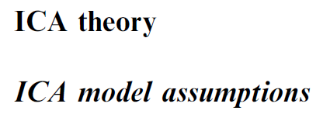
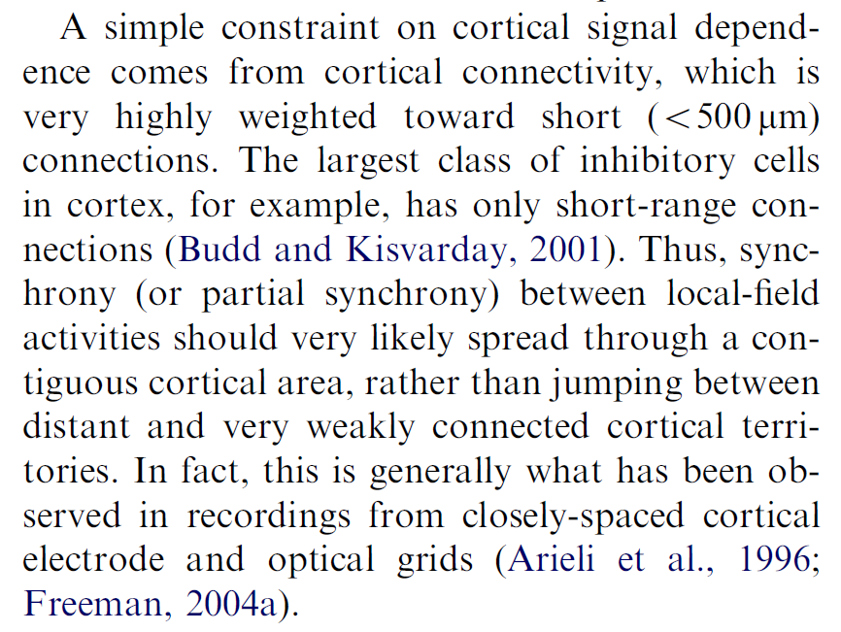
2006
Physiol. Interp.
of ICA 1
ICA on EEG from Science
SCCN Launched
ICA on EEG from PNAS
ICA on EEG from TICS
First ICA on EEG
Infomax
1996
1998
2000
2002
2004
2006
2008
2010
2012
2014
2016
2018
2020
Graduated a high school
Entered a university
2nd EEGLAB Workshop
Entered a grad school
Onton and Makeig et al. (2006)

Slide 37
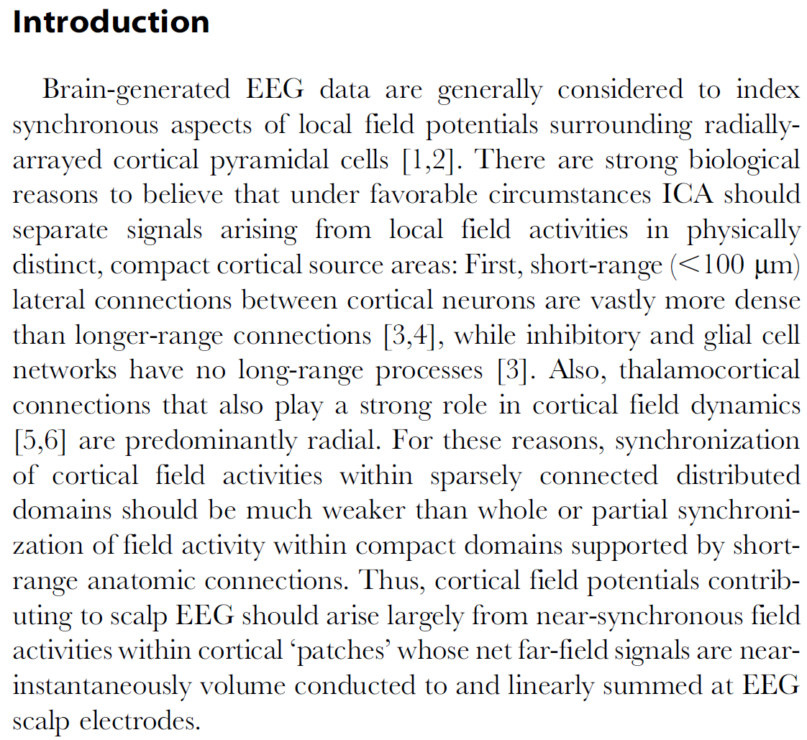
2012
Physiol. Interp.
of ICA 2
ICA on EEG from Science
SCCN Launched
ICA on EEG from PNAS
Physiol. interp. of ICA 1
First ICA on EEG
Infomax
1996
1998
2000
2002
2004
2006
2008
2010
2012
2014
2016
2018
2020
Graduated a high school
Joined SCCN as a post-doc
Entered a university
2nd EEGLAB Workshop
Entered a grad school
Started posts-doc (MRI)
Delorme et al. (2012)

Slide 38

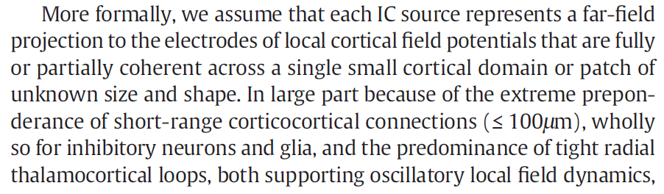
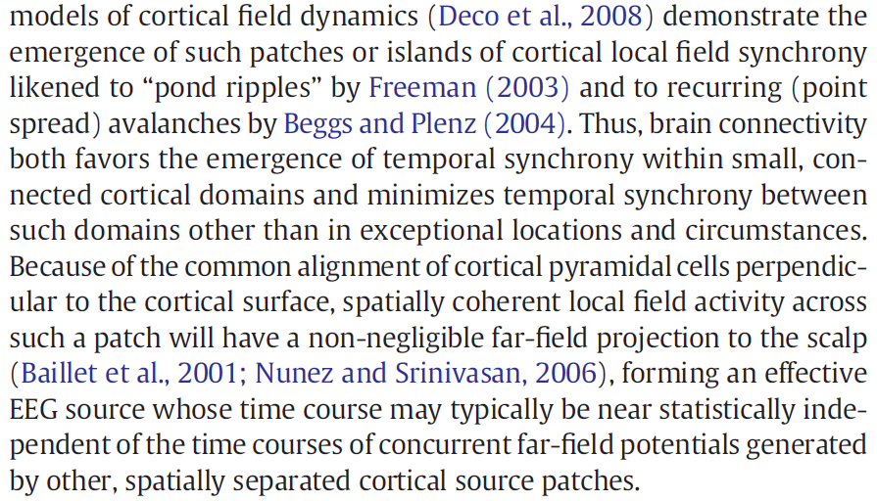
2016
SCALE algorithm
ICA on EEG from Science
SCCN Launched
ICA on EEG from PNAS
Physiol. interp. of ICA 1
Physiol. interp. of ICA 2
First ICA on EEG
Infomax
1996
1998
2000
2002
2004
2006
2008
2010
2012
2014
2016
2018
2020
Graduated a high school
Joined SCCN as a post-doc
Entered a university
2nd EEGLAB Workshop
Entered a grad school
Meeting Hiro Tanaka
Started posts-doc (MRI)
‘Brain circulation’ started
Akalin Acar, Acar, and Makeig (2016)

Slide 39
But… it is based on wrong reading/citations

Slide 40
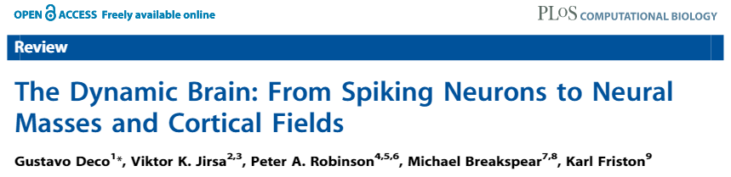
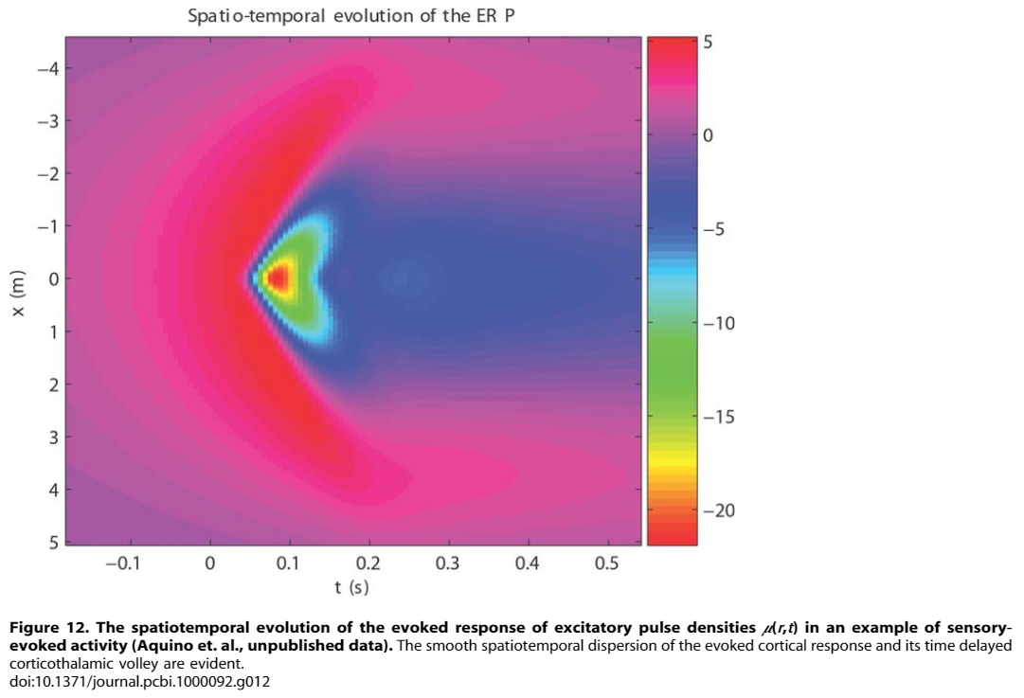
Deco et al. (2008)

Slide 41
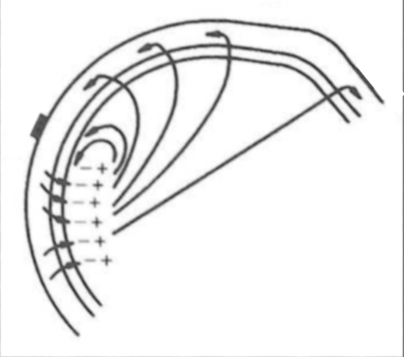
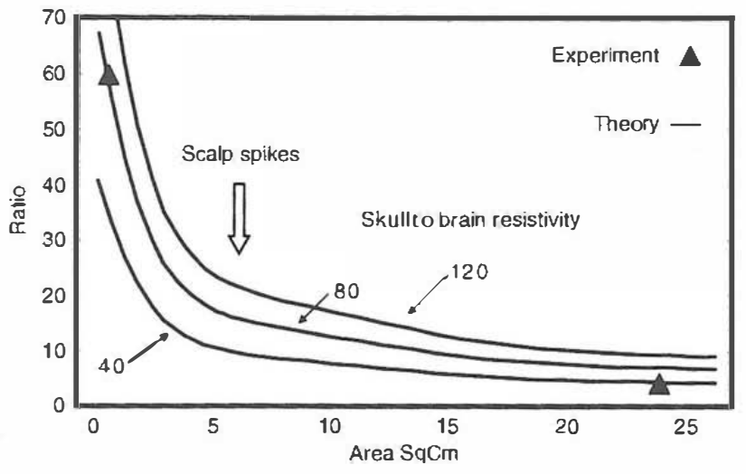


Air
Scalp
Dura
Brain
$$\frac{dura potential}{scalp potential}$$
Scalp-measurable region
6
For the case of small (< 1 cm²) patch,
For the case of > 10-20 cm² patch,
Nunez and Srinivasan (2006) EFB Fig 1-20

Slide 42






EFB Eq(2.7)
Head model: 3-layer (brain, skull, scalp) radii: [0.08 0.085 0.09]
$Φ\left(r,0\right)$, measured potential on the dipole axis
$r$, radius of the measurement point
$q$, conversion factor from infinite, homogeneous to finite, inhomogeneous [0.25-2]
$A_{s}$, Ares of the dipole sheet
$ΔV_{s}$, Potential difference across a small radial dipole layer of area $A_{s}$
$$Φ\left(r,0\right)≅\frac{qA_{s}}{4πr^{2}}ΔV_{s}$$
Onton and Makeig (2006)
Delorme and Makeig (2012)
Akalin Acar and Makeig (2006)
$$r=0.09, q=2 (i.e. the source region is in the center of the head)$$
$A_{s}$ = (1000$μ$m)²
Using 2-5 times longer edge than suggested
$Φ\left(r,0\right)$= 20$μ$V (i.e. amplitude of the observed scalp potential)
Substituting them into Eq(2.7), we obtain
$ΔV_{s}$ = 1,017,900 $μ$V ($\sim$1V)
1.5V
1.0V?
If $A_{s}$ = (1cm)², $ΔV_{s}$ = 10,179 $μ$V ($\sim$10mV) still impossible
If $A_{s}$ = (10cm)², $ΔV_{s}$ = 102 $μ$V which is electrically feasible but anatomically impossible

Slide 43
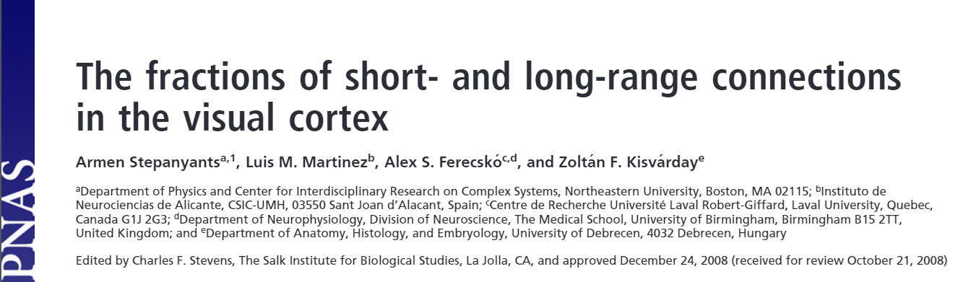
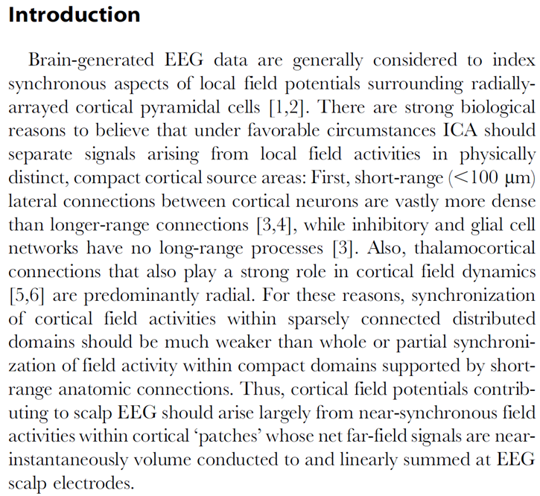
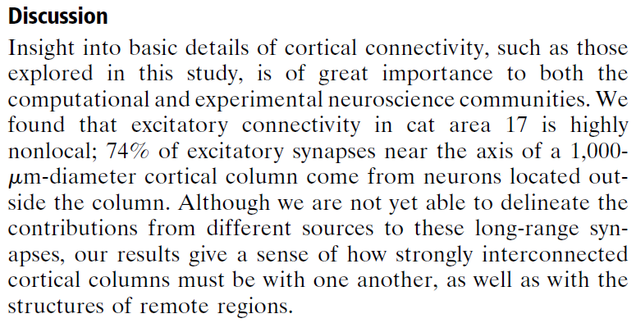
Delorme et al. (2012)
Stepanyants et al. (2008)

Slide 44
Forward-inverse simulation to test the 2-D arrey effect (BSCR=25)
Unpublished observation (in prep)

Slide 45
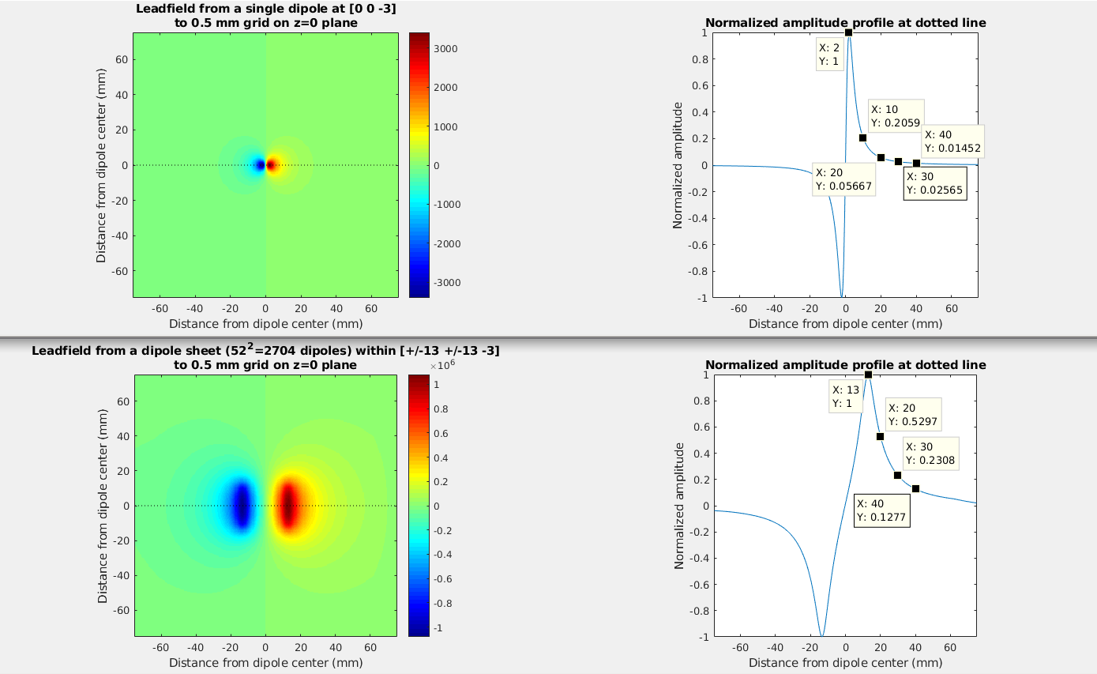
Array effect
Single dipole: Peak at 2 mm
1inch² dipole sheet: Peak at 13mm
Unpublished observation (in prep)

Slide 46
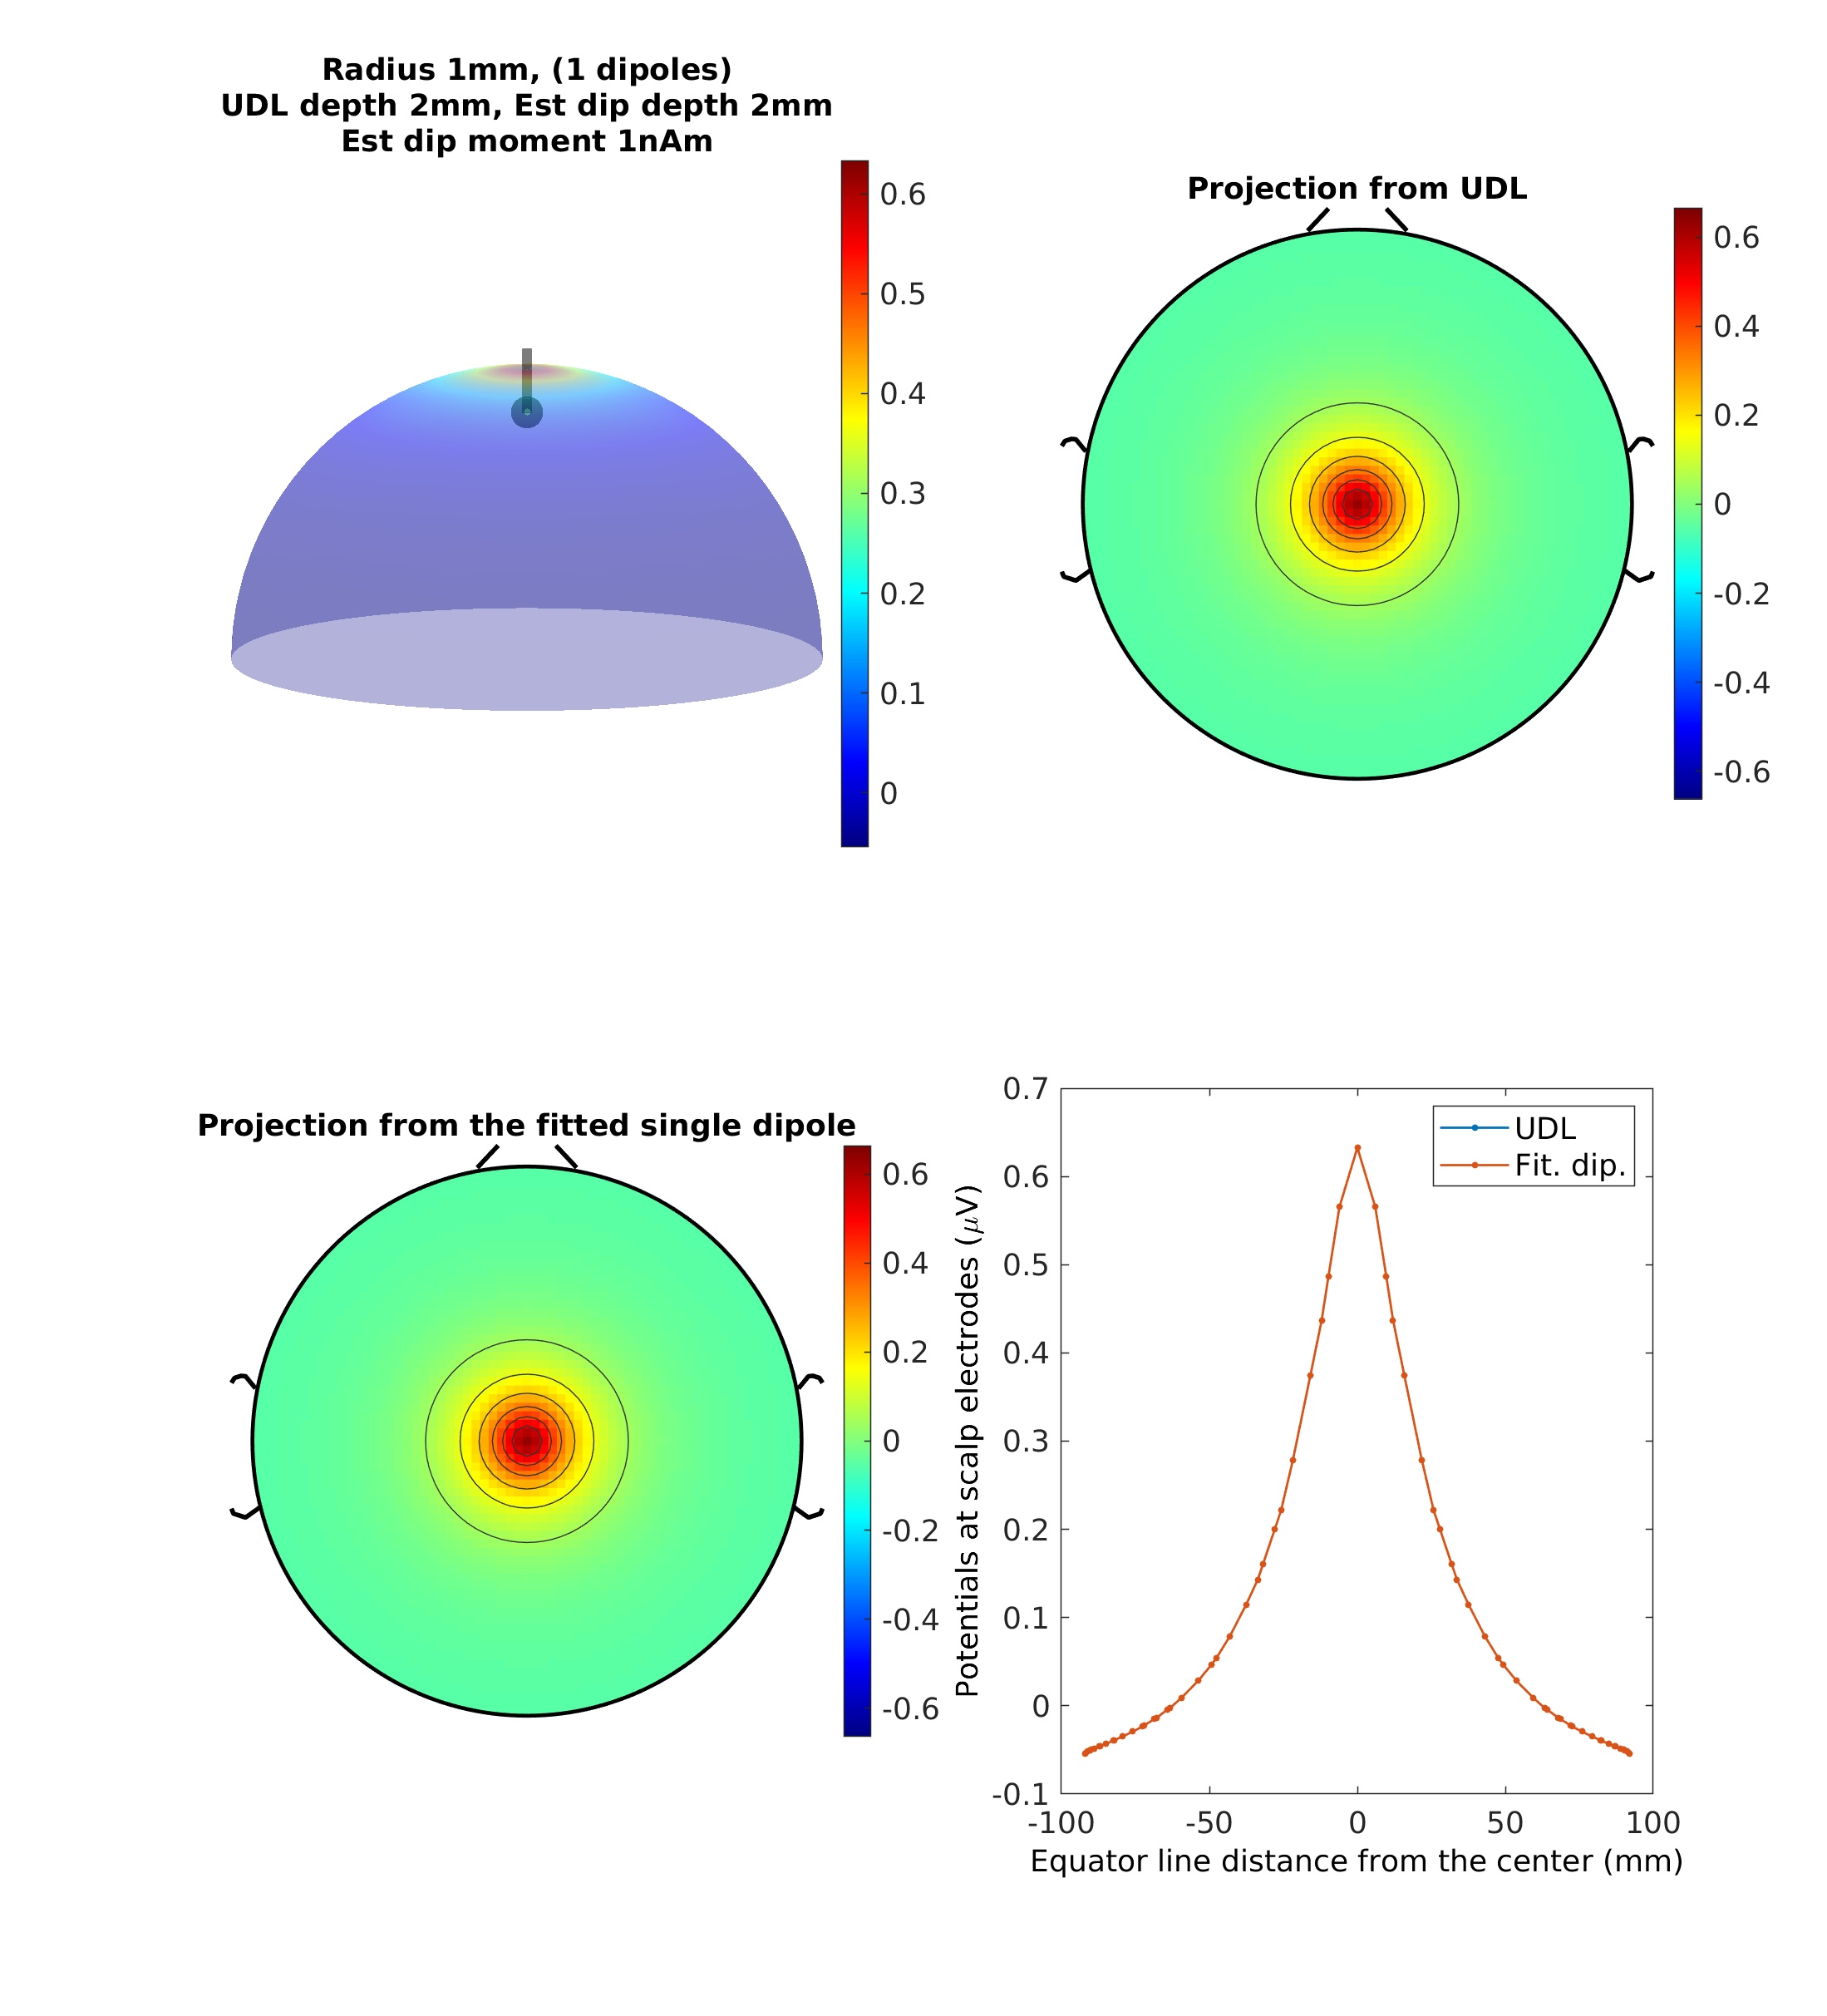

Slide 47
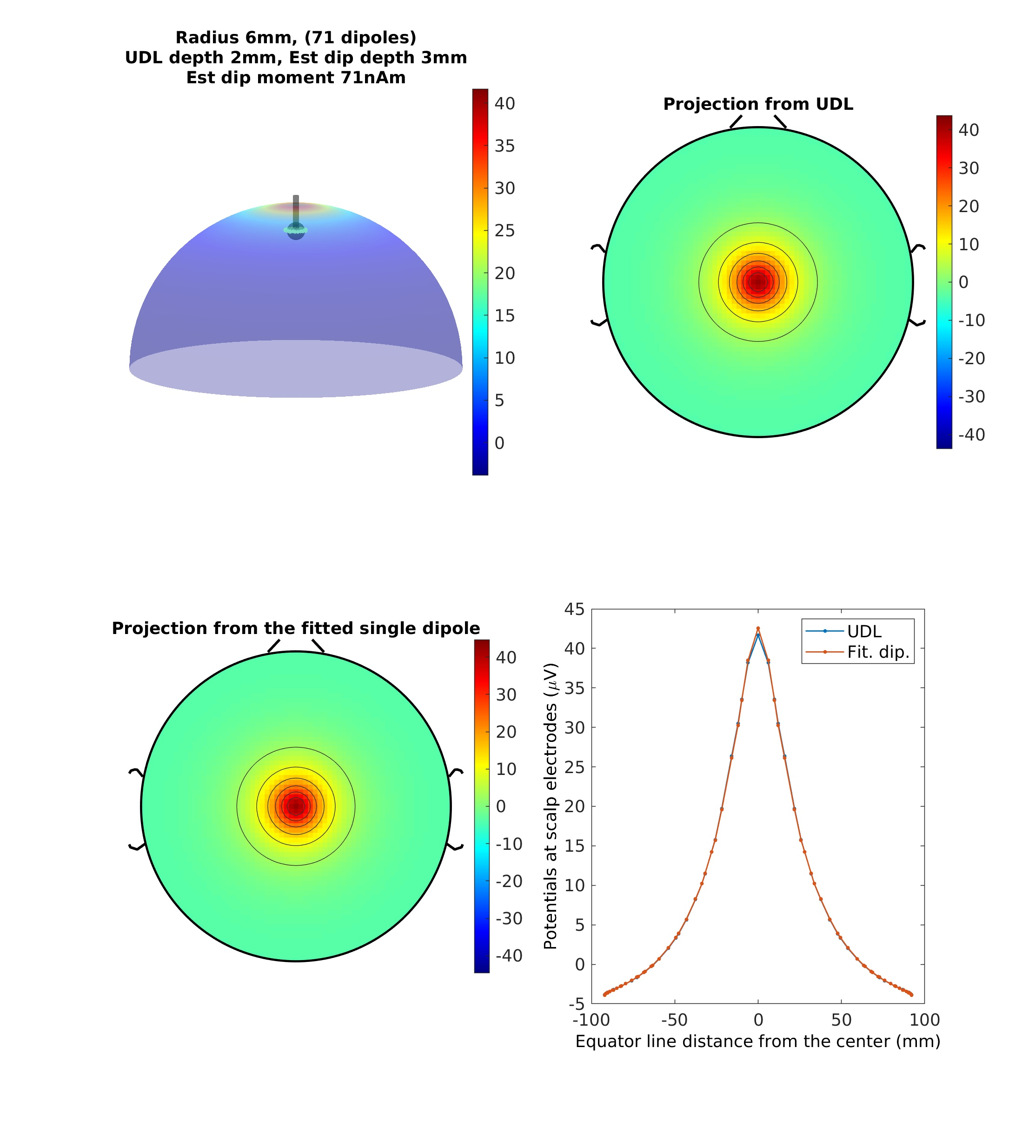

Slide 48
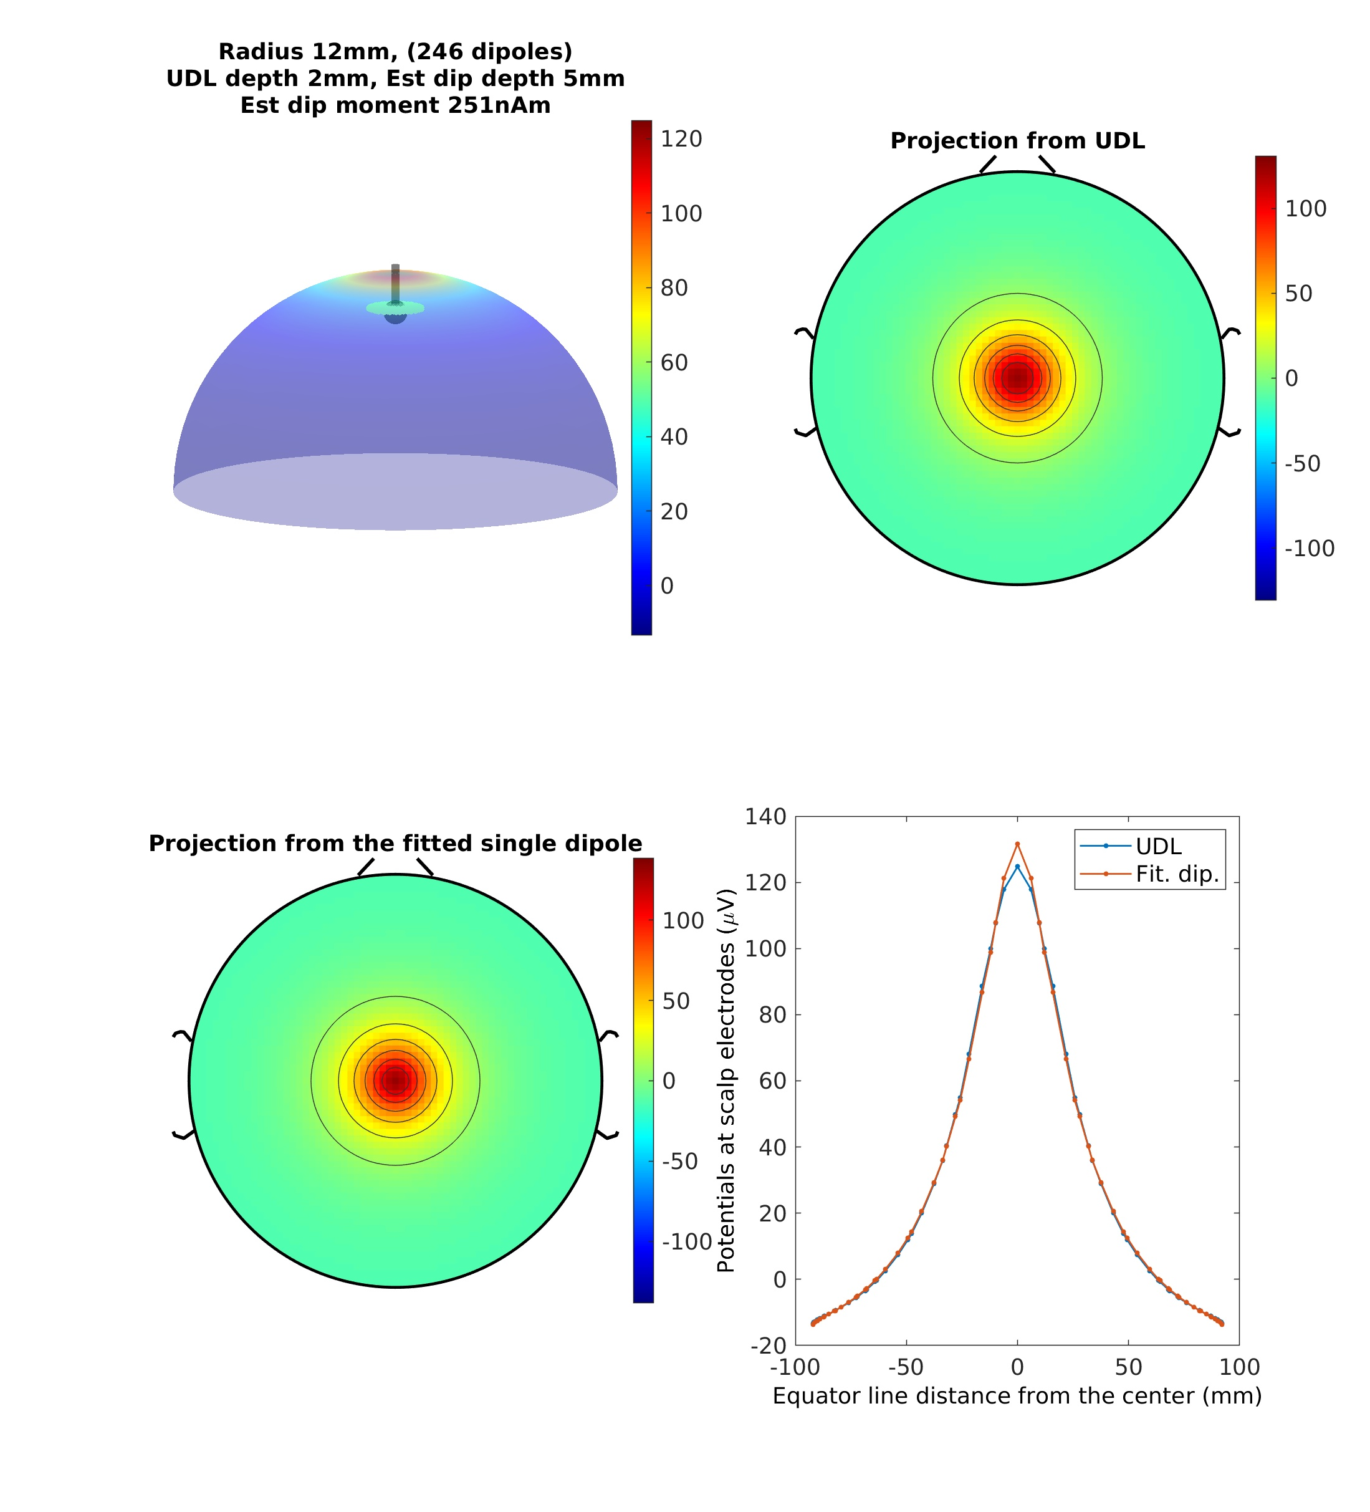

Slide 49
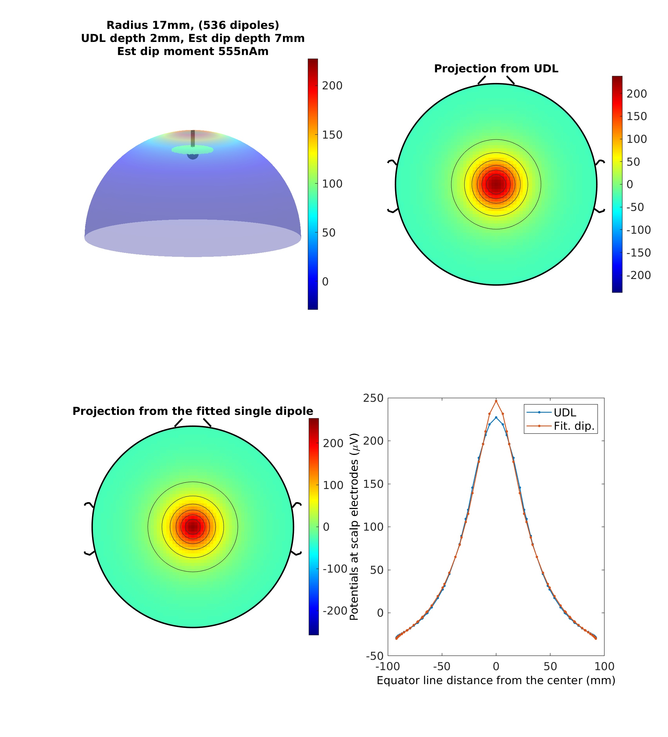

Slide 50
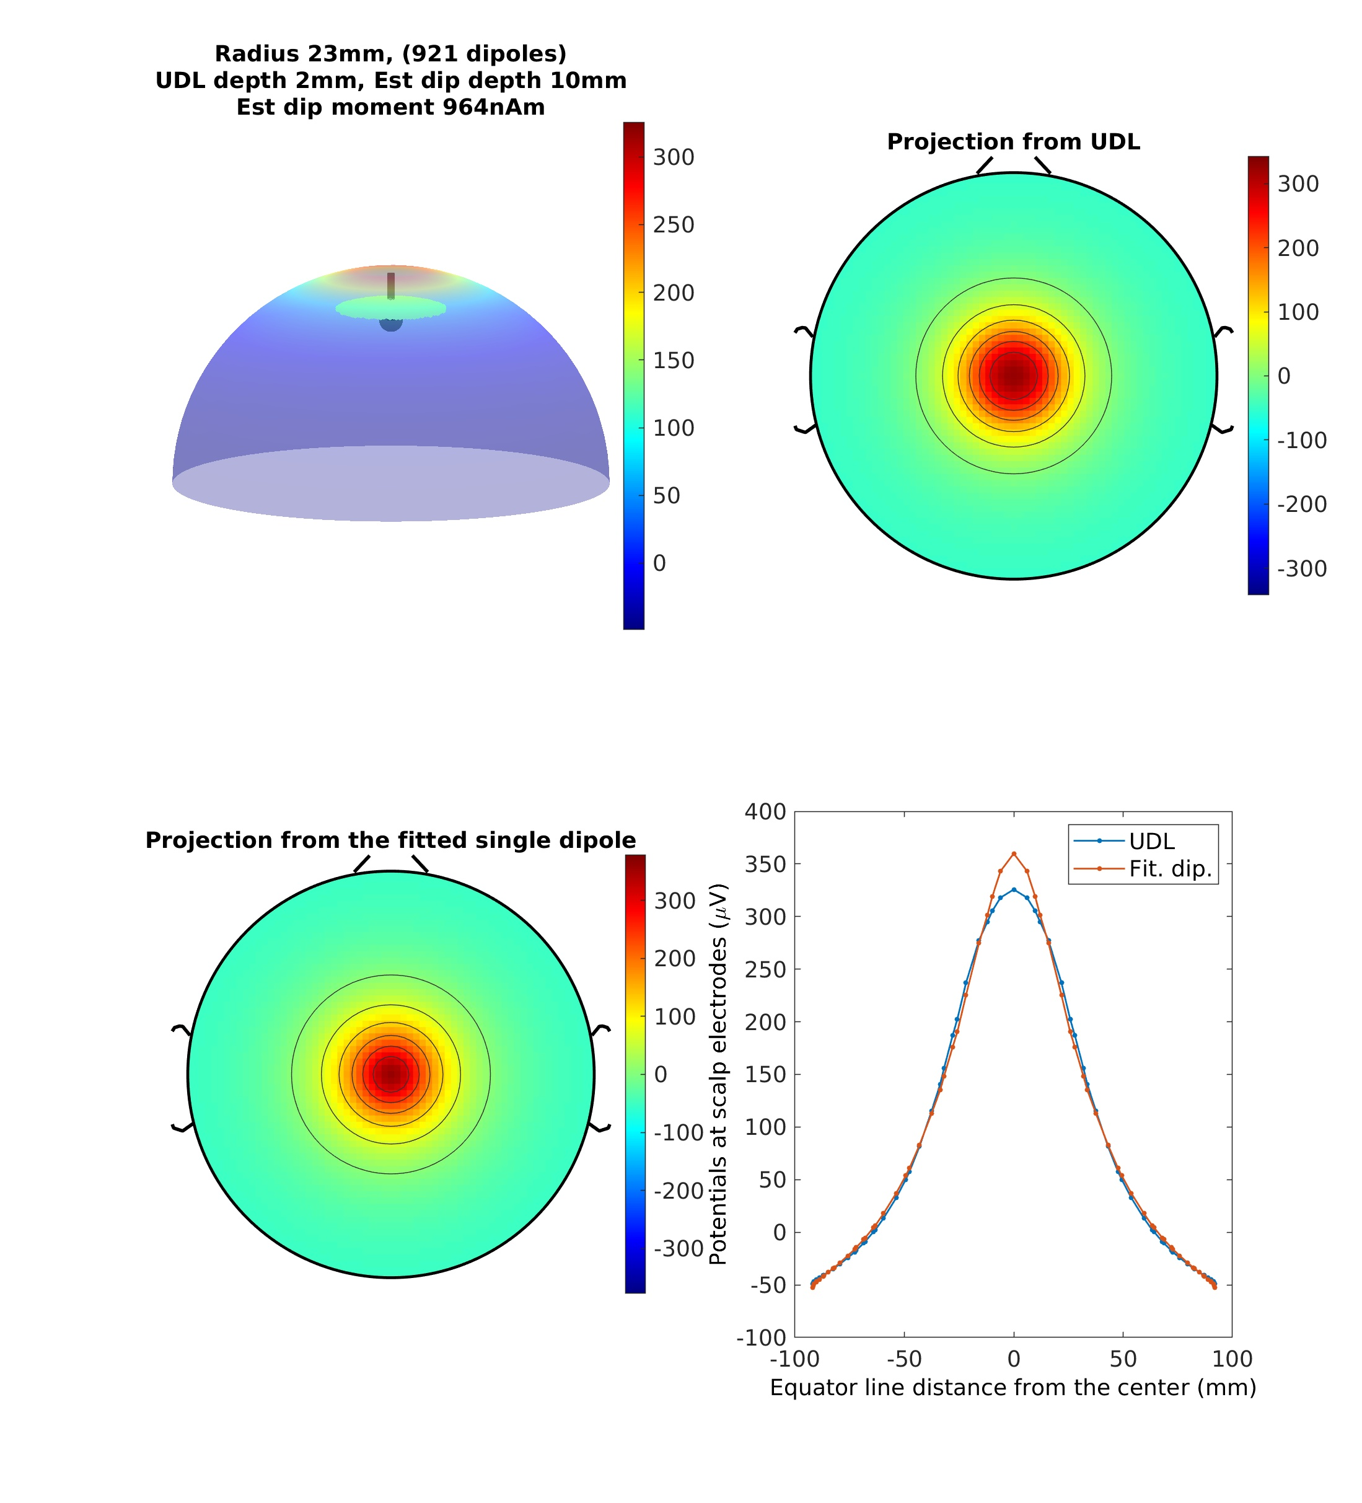

Slide 51


Slide 52


Slide 53


Slide 54


Slide 55

True dipole depth = 2mm
Estimated depth = 30 mm

Slide 56


Muller et al. (2016)

Slide 57
Conclusion (2): The small patch hypothesis
The small patch hypothesis is rejected by biophysics.
Deep dipoles derived from ICA indicates ICA returns a broadly synchronized cortical patch, which rejects the small-patch hypothesis.

Slide 58
ICA on EEG from Science
SCCN Launched
ICA on EEG from PNAS
Physiol. interp. of ICA 1
Physiol. interp. of ICA 2
Physiol. interp. of ICA 3
ICA on EEG from TICS
First ICA on EEG
Infomax
1996
1998
2000
2002
2004
2006
2008
2010
2012
2014
2016
2018
2020
2021
Frequency dependency of ICs
Meeting Paul Nunez
Graduated a high school
Joined SCCN as a post-doc
Small patch hypohtesis
Entered a university
2nd EEGLAB Workshop
Entered a grad school
Meeting Hiro Tanaka
ICA’s dimension reduction
Started posts-doc (MRI)
‘Brain circulation’ started

Slide 59
Challenging the Physiological interpretation of ICA (3):
Independent components are not independent

Slide 60

Motivation: IC rejection increases gamma power
All blue, as expected
Some increase?
Miyakoshi et al. (2021)

Slide 61

Power comparison: Before – After ASR+ICrej2
Subjects
Channels
Yellow, channel EEG power increased after IC rejection
Unpublished observation from Miyakoshi et al. (2021)

Slide 62
Simulation study on injecting correlation across ICs

Slide 63
Simulation study on injecting correlations in source signals
Generate 20-channel simulated EEG data
  EEG.data = pinknoise(EEG.pnts, EEG.nbchan)’;
  EEG.icawinv = randn(EEG.nbchan, EEG.nbchan);
Introduce correlation from r = 0.1 to 0.9 into EEG.icaact.
Leave one out cross validation (LOOCV): Reject 1 out of 20 ICs, calculate backprojected ERPs (gray), compare them with the original ERP (red)

Slide 64

Correlation 0.1 (red > gray)
Red: All the ICs projected
Gray: One of the ICs rejected, then projected

Slide 65

Correlation 0.2 (red > gray)
Red: All the ICs projected
Gray: One of the ICs rejected, then projected

Slide 66

Correlation 0.3 (gray > red started!)
Red: All the ICs projected
Gray: One of the ICs rejected, then projected

Slide 67

Correlation 0.4
Red: All the ICs projected
Gray: One of the ICs rejected, then projected

Slide 68

Correlation 0.5
Red: All the ICs projected
Gray: One of the ICs rejected, then projected

Slide 69

Correlation 0.6
Red: All the ICs projected
Gray: One of the ICs rejected, then projected

Slide 70

Correlation 0.7
Red: All the ICs projected
Gray: One of the ICs rejected, then projected

Slide 71

Correlation 0.8
Red: All the ICs projected
Gray: One of the ICs rejected, then projected

Slide 72

Correlation 0.9
Red: All the ICs projected
Gray: One of the ICs rejected, then projected

Slide 73
Simulation study summary
IC rejection increases power when ICs have r > 0.3 correlations.

Slide 74
Empirical EEG data study on IC’s frequency dependency

Slide 75

IC-IC correlation: Broadband (1-100 Hz)
Counts
Pearson’s correlation coefficient
Pairwise IC-correlation across 21 ICs (i.e. 21x21 pairs except self correlation) is basically zero for n=600.
Is it also the case for narrow-band signals?

Slide 76

DELTA
Theta
Alpha
Beta
Gamma
IC data are more correlated in higher frequencies.

Slide 77

This is NOT a sumulation!
20 % of IC pairs have r > 0.3 above 50 Hz
10 % of IC pairs have r > 0.3 above 20 Hz

Slide 78

Let the two sinusoidal waves (i.e. IC activation time series) and the synthesized wave (i.e. back-projected electrode signal time series) be
$$X=A\sin\left(ωt+α\right)$$
$$Y=B\sin{(ωt+β)}$$
$$X+Y=C\sin{(ωt+γ)}$$
where
$$C=\sqrt{A^{2}+B^{2}+2AB\cos{(α−β)}}$$
Removing the square root sign,
$$C^{2}=A^{2}+B^{2}+2AB\cos{(α−β)}$$
The power of IC $X$, $Y$, and $X+Y$ are $A^{2}$, $B^{2}$, and $C^{2}$, respectively. Since A, B, C are amplitudes, $A≥0, B≥0, and C≥0$.
Here, we consider the conditions under which $C^{2}$ becomes smaller than $A^{2}$(or $B^{2}$). First, we compare one of the original waves’s power, say $A^{2}$, with the power of the synthesized wave $C^{2}$.
$$C^{2}−A^{2}$$
$$=A^{2}+B^{2}+2AB\cos{(α−β)}−A^{2}$$
$$=B^{2}+2AB\cos{(α−β)}$$
If $B^{2}+2AB\cos{(α−β)}<0$, $C^{2}−A^{2}<0$. Thus we consider the next inequality.
$$B^{2}+2AB\cos\left(α−β\right)<0$$
$$B^{2}<−2AB\cos\left(α−β\right)$$
$$B<−2A\cos\left(α−β\right)$$
To make the right-hand side positive, $\cos\left(α−β\right)$ must be negative. This gives the lower and upper boundary of the relative phase difference $\frac{π}{2}<α−β<\frac{3π}{2}$.

Slide 79
No
2004
TICS
ICA on EEG from Science
SCCN Launched
ICA on EEG from PNAS
First ICA on EEG
Infomax
1996
1998
2000
2002
2004
2006
2008
2010
2012
2014
2016
2018
2020
Graduated a high school
Entered a university
Entered a grad school
Makeig et al. (2004)

Slide 80
Conclusion (3): Independent Components are not independent
Independent components (ICs) are less independent toward higher frequencies: Above 20 Hz, more than 10% of IC pairs have r > 0.3 correlations, and above 50 Hz, 20%.
This frequency dependency may derive from 1/f power distribution.

Slide 81
Grand summary of my critical works on PI-ICA
1st criticism: ICA’s dimension reduction effect.
  Group-level analysis suffers from little overlap across subjects!
2nd criticism: The small-patch hypothesis.
  1 out of 2.7 brain ICs are localized in the subcortical regions!
3rd criticism: Independent components are not independent.
  IC rejection increases gamma power!

Slide 82
ICA on EEG from Science
SCCN Launched
ICA on EEG from PNAS
Physiol. interp. of ICA 1
Physiol. interp. of ICA 2
Physiol. interp. of ICA 3
ICA on EEG from TICS
First ICA on EEG
Infomax
1996
1998
2000
2002
2004
2006
2008
2010
2012
2014
2016
2018
2020
Meeting Paul Nunez
Frequency dependency
Graduated a high school
Joined SCCN as a post-doc
Small patch hypohtesis
Entered a university
2nd EEGLAB Workshop
Entered a grad school
Meeting Hiro Tanaka
ICA’s dimension reduction
Started posts-doc (MRI)
‘Brain circulation’ started

Slide 83
ICA on EEG from Science
SCCN Launched
ICA on EEG from PNAS
Physiol. interp. of ICA 1
Physiol. interp. of ICA 2
Physiol. interp. of ICA 3
ICA on EEG from TICS
First ICA on EEG
Infomax
1996
1998
2000
2002
2004
2006
2008
2010
2012
2014
2016
2018
2020
Meeting Paul Nunez
Frequency dependency
Graduated a high school
Joined SCCN as a post-doc
Small patch hypohtesis
Entered a university
2nd EEGLAB Workshop
Entered a grad school
Meeting Hiro Tanaka
ICA’s dimension reduction
Started posts-doc (MRI)
‘Brain circulation’ started

Slide 84
ICA on EEG from Science
SCCN Launched
ICA on EEG from PNAS
Physiol. interp. of ICA 1
Physiol. interp. of ICA 2
Physiol. interp. of ICA 3
ICA on EEG from TICS
First ICA on EEG
Infomax
1996
1998
2000
2002
2004
2006
2008
2010
2012
2014
2016
2018
2020
2022
Leaving
SCCN
Meeting Paul Nunez
Graduated a high school
Joined SCCN as a post-doc
Small patch hypohtesis
Entered a university
2nd EEGLAB Workshop
Entered a grad school
Meeting Hiro Tanaka
ICA’s dimension reduction
Started posts-doc (MRI)
‘Brain circulation’ started

Slide 85
Grand conclusion: The physiological interpretation requires revision
ICA
Scalp EEG
Cortical activity?
Apply the following revisions
  Stationarity assumption should hold (apply ICA to a single-task block, use the ERP paradigm, etc.)
  Dimension reduction effect should be expected (poor overlap across subjects etc.),
  Broad-patch hypothesis should be adopted (‘single’ dipole fitting always produces depth bias)
  Cross-frequency generalizability should be given up (apply a band-pass filter first, then ICA)
...and the physiological interpretation of ICA is still valid!
https://3.bp.blogspot.com/-3n1E2wb-Glk/Vu04LroMJ4I/AAAAAAAAECo/x6ptckRX6HQYgo2SwVmneqQJ9jN84Juqw/s1600/cyborg-7.jpg

Slide 86


Thank you for your attention
This study is supported by NSF 2011716 CRCNS US-Japan Research Proposal: A computational neuroscience approach to skill acquisition and transfer from visuo-haptic VR to the real-world (a.k.a., ‘Jugging on the moon’) and NINDS 5R01NS047293-16 ‘EEGLAB: Software for Analysis of Human Brain Dynamics’. The Swartz Center is supported by The Swartz Foundation (Old Field, New York).

Slide 88
Additional analysis (11/08/2022 added)
After my presentation, Scott suggested that the gamma-power increase after IC rejection may be due to the low number of electrodes (21 ch).
Can we replicate the post-IC-rejection channel power increase with datasets with more number of channels?
  Requested by Hyeonseok.

Slide 89
Power comparison: Before – After ASR+ICrej2
Subjects
Channels
Yellow, channel EEG power increased after IC rejection
Unpublished observation from Miyakoshi et al. (2021)

Slide 90
Materials and Methods
N=212, 62ch, publicly available EEG database by Babayan et al. (2019)
Resting eyes open and closed, 7 min each, concatenated.
Rejecting all non-’Brain’ ICs labeled by ICLabel (Pion-Tonachini et al., 2019)

Slide 91

Results: All-subjects all-channel matrix

Slide 92

Results: Grand-mean scalp topo in Cohen’s d

Slide 93


Slide 94
Conclusion from the additional analysis
The post-IC-rejection channel power increase found in UCLA child psychiatry database (21ch, n=600; Miyakoshi et al., 2021) was reproduced with Leipzig Study for Mind-Body-Emotion Interactions (LEMON) database (62ch, n=212, Babayan et al. 2019).
It was confirmed again that the post-IC-rejection channel power increase was maximal at gamma band in the midline region.
The more inter-IC correlation, the more power increase (r = 0.629)

