Slide 1

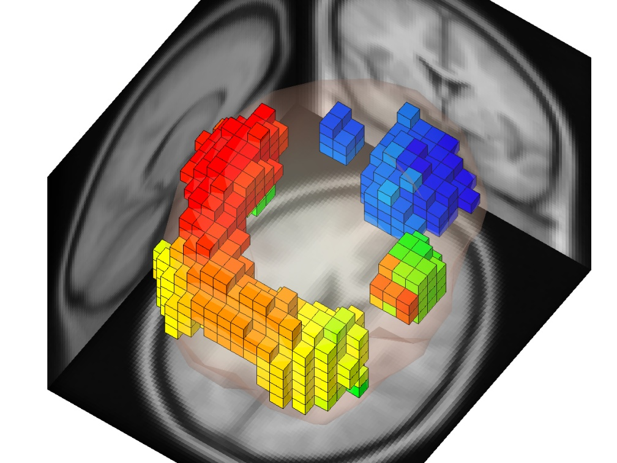
Measure Projection Analysis
Nima Bigdely-Shamlo, Tim Mullen, Ozgur Yigit Balkan
Swartz Center for Computational Neuroscience
INC, UCSD, 2011

Slide 2
Outline
Current EEGLAB Workflow
STUDY IC Clustering
Issues with IC Clustering
Measure Projection method
Practicum
(please start copying the content of workshop USB driver to your computer)

Slide 3
Current EEGLAB Workflow
Collect EEG
Pre-Process (filter…)
Remove artifacts
Run ICA
Look at ICs (maybe)
Single Session Analysis
Select dipolar ICs from all sessions
Pre-compute EEG measures (ERP, ERSP, ITC…)
Select clustering parameters
Look at clusters
Study Analysis
Trying to produce ‘Nice clusters’

Slide 4
Study IC Clustering
Assumes there are functionally equivalent ICs across most subjects.
Assumes these ICs have similar responses to experimental conditions across all measures (ERP, ERSP, ITC…)
Creates Non-Overlapping partitions: each IC belongs only to one cluster.

Slide 5
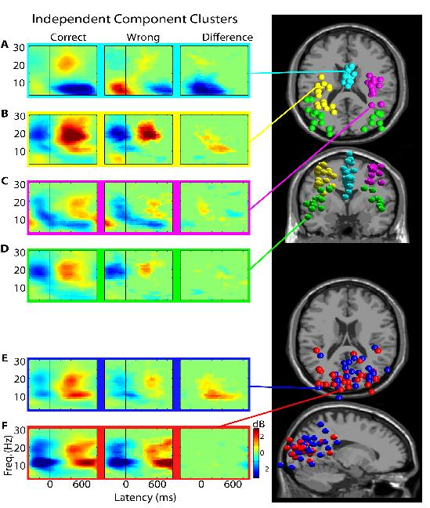
Study IC Clustering
Sometime clusters are spatially separate AND have distinct responses.
In other cases, they have similar responses or they overlap spatially.

Slide 6
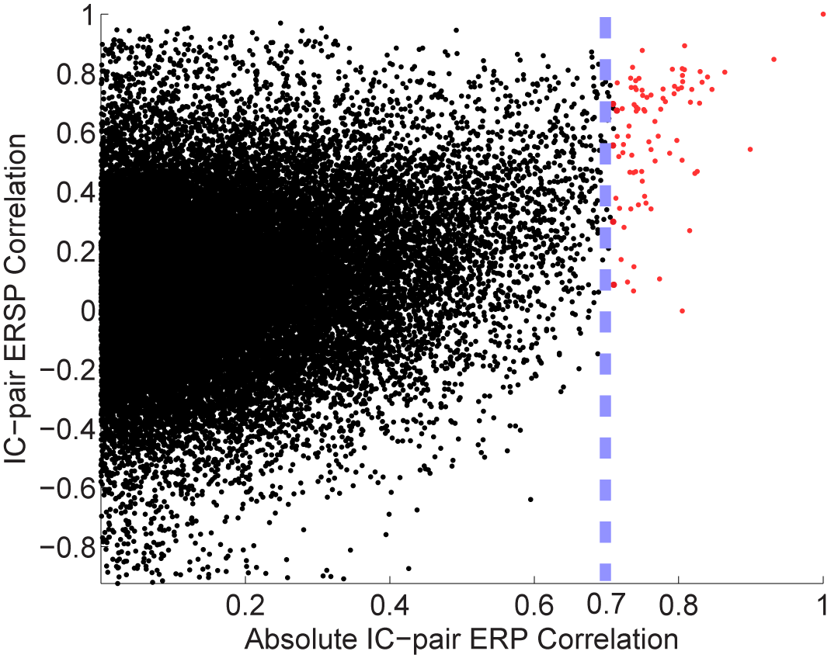
Conceptual Problems with Study IC Clustering
Components may have similar responses for one measure (e.g. ERSP) but not for the other (e.g. ERP).

Slide 7
Conceptual Problems with Study IC Clustering
Clustering boosts evidence by rejecting ICs that are in the same brain area but show different responses. This makes calculating significance values difficult.
How can we make sure that we are not ‘imagining clusters’?

Slide 8
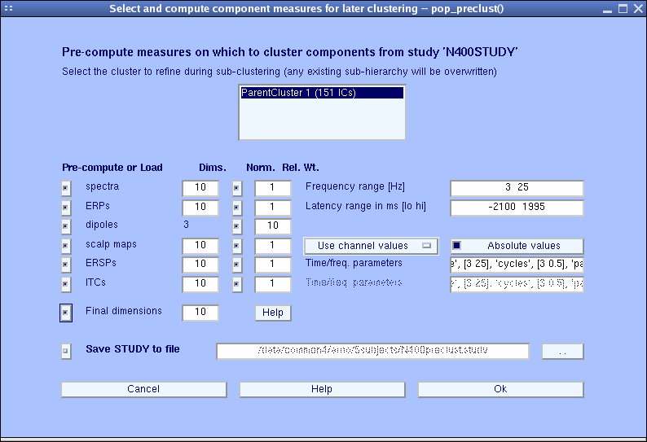

Practical problems with current methods of Study IC Clustering
Large parameter space issue: many different clustering solutions can be produced by changing parameters and measure subsets. Which one should we choose?
EEGLAB original clustering has ~12 parameters

Slide 9
Problems with multi-measure clustering
What are the clusters according to location?

Slide 10
Problems with multi-measure clustering
What are the clusters according to circle Size ?

Slide 11
Problems with multi-measure clustering
What are the clusters according to both circle location and size?
The answer highly depends on how much weight is given to each factor (measure).

Slide 12
Problems with multi-measure clustering
Alternatively we could find local neighborhoods (on a grid) with significant (unlikely by chance) similarity in circle Size.

Slide 13
Problems with multi-measure clustering
We can define a local-average circle size for each grid location and then cluster these values to form Domains.
Domain 2
Domain 1
Domain 3

Slide 14
Measure Projection
Instead of clustering, we assign to each location in the brain a unique EEG response.
The response at each location is calculated as the weighted sum of IC responses in its neighborhood.
Weights are assigned by passing the distance between the location and IC dipole through a Gaussian function.
The std. of this function represent expected error in dipole localization and inter-subject variability.

Slide 15
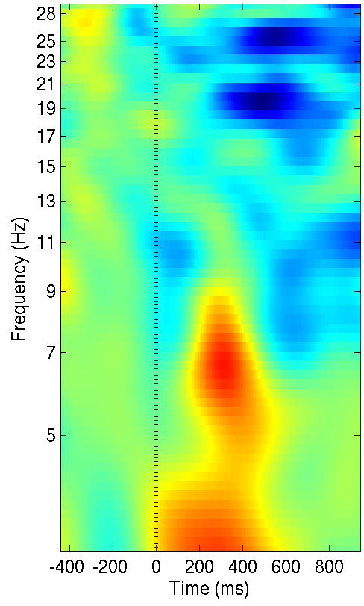
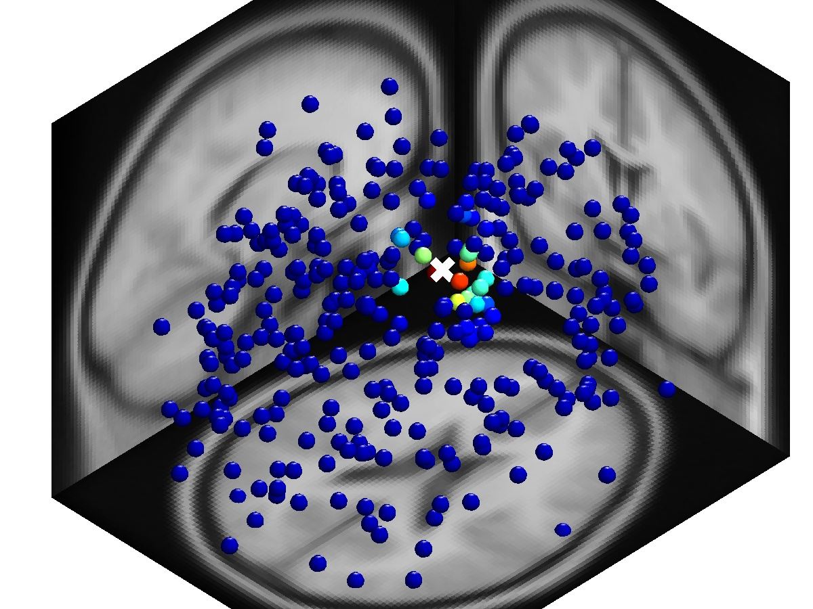
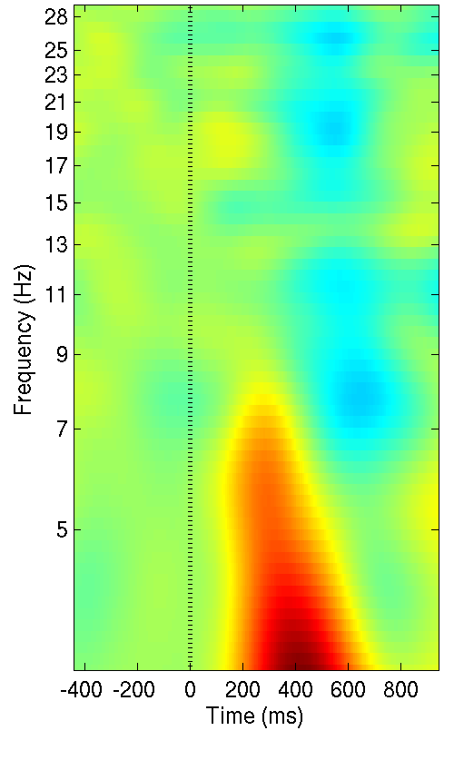
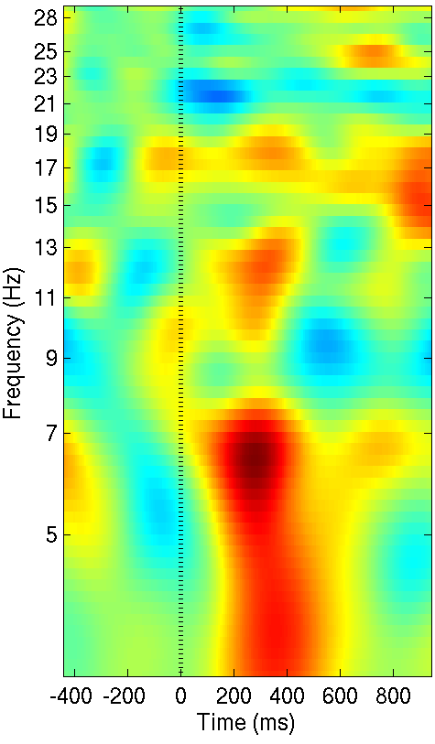
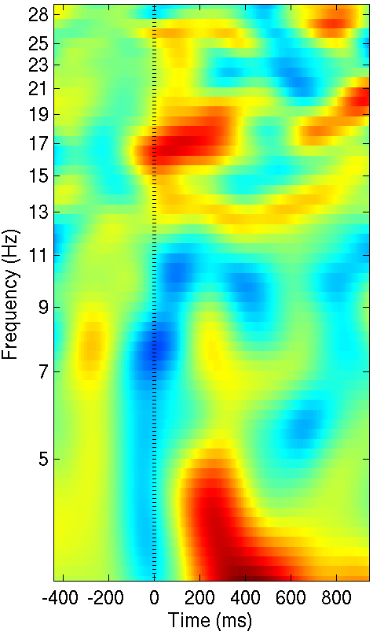
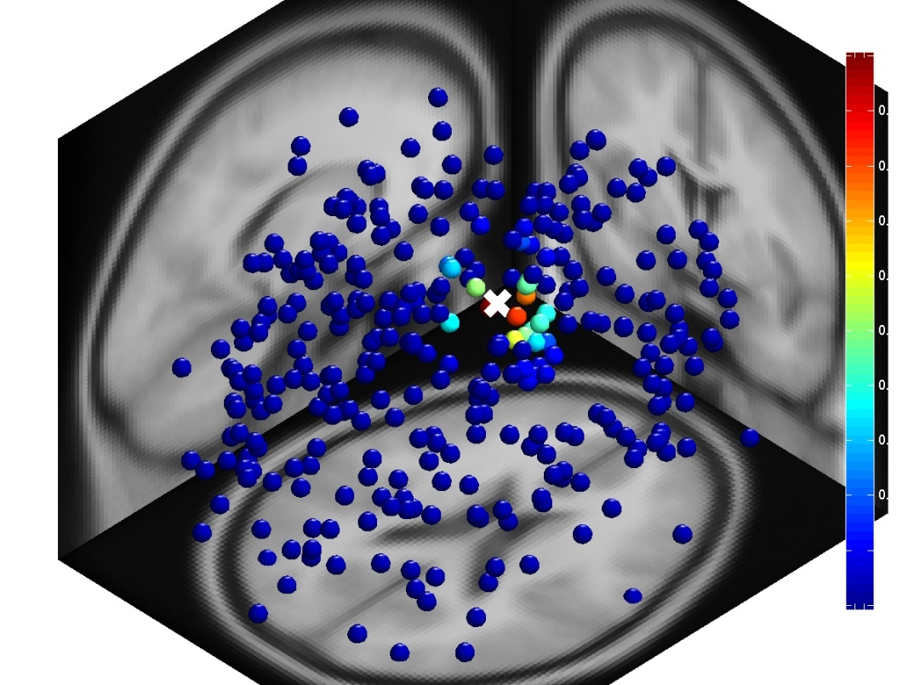
Measure Projection
Gaussian neighborhood (12 mm std.)
IC
Local Mean
IC
IC
max
min

Slide 16
Measure Projection
Each EEG measure (ERP, ERSP..) is projected separately.
Only has one (1) parameter: std. of Gaussian (which has a biological meaning).
Bootstrap (permutation) statistics can be easily and quickly performed for each point in the brain.
A regular grid is placed in the brain to investigate every area (with ~8 mm spacing).

Slide 17
Measure Projection
Not all projected values are significant.
Some are weighted means of ICs with very dissimilar responses.
Only projected values in neighborhoods with convergent responses are significant.
Convergence can be expressed as the mean of pair-wise similarities in a spatial neighborhood.
The significance of convergence at each location can be calculated with bootstrapping (permutation).

Slide 18
Measure Projection
For a neighborhood with a ‘fixed’ boundary, for each IC pair we can define a membership function:
Where M(IC) is one (1) if IC is in the neighborhood and zero (0) otherwise.
Convergence can then be defined:
Where M is the neighborhood membership matrix and S is the pairwise similarity matrix. This is basically the mean of pairwise IC similarities around a location in the brain.

Slide 19
Measure Projection
Now we can extend this concept of convergence to neighborhoods with ‘soft’ Gaussian boundaries, for each IC pair we modify the membership function:
Where (d is distance from IC equiv. dipole to neighborhood center). Convergence can now be defined as:
IC1
d1
d2
IC2
Where S is the pair-wise similarity matrix.
This is basically the weighted mean of IC similarities around a location in the brain.

Slide 20
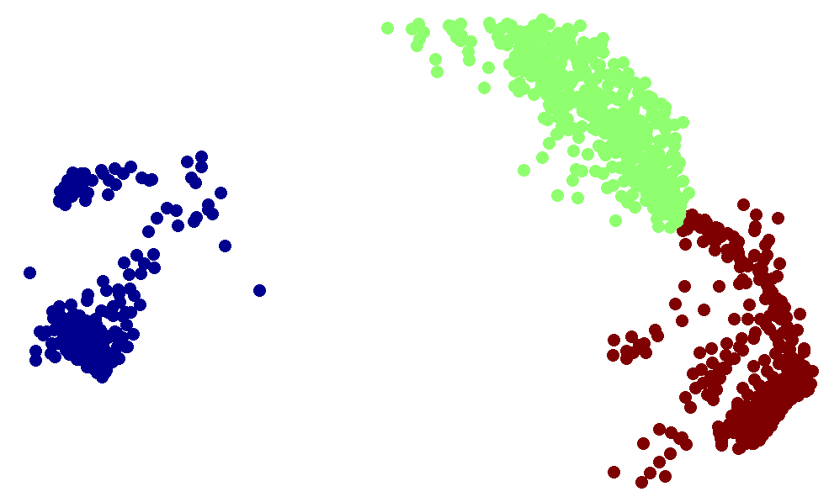
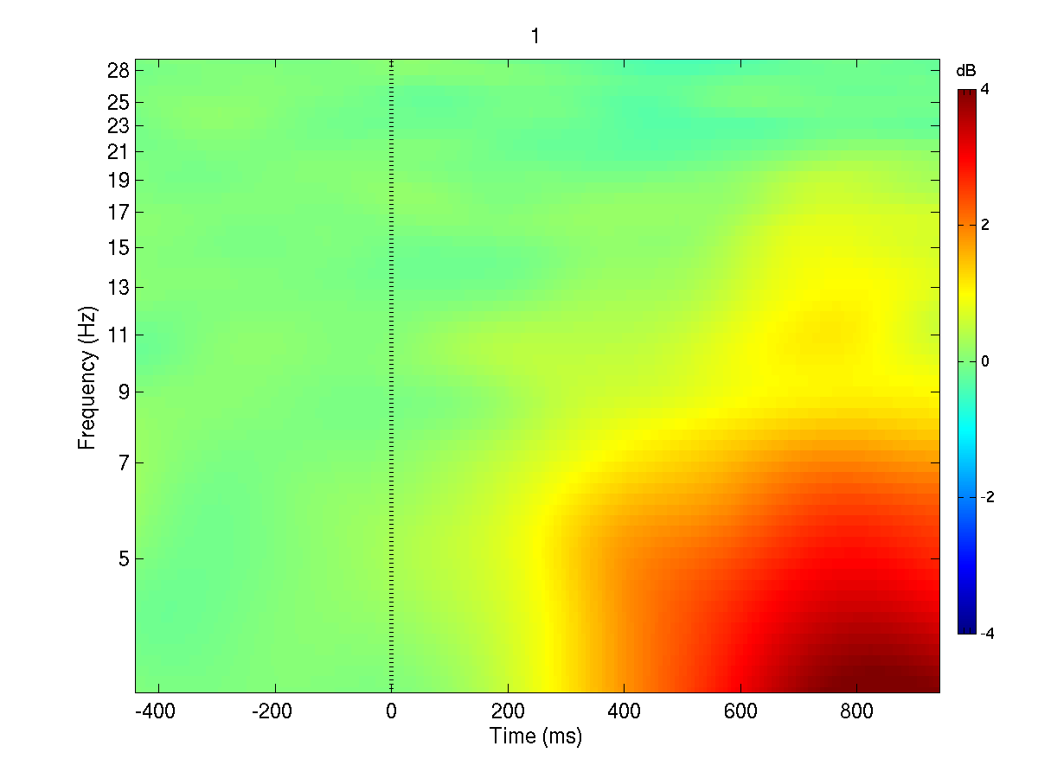
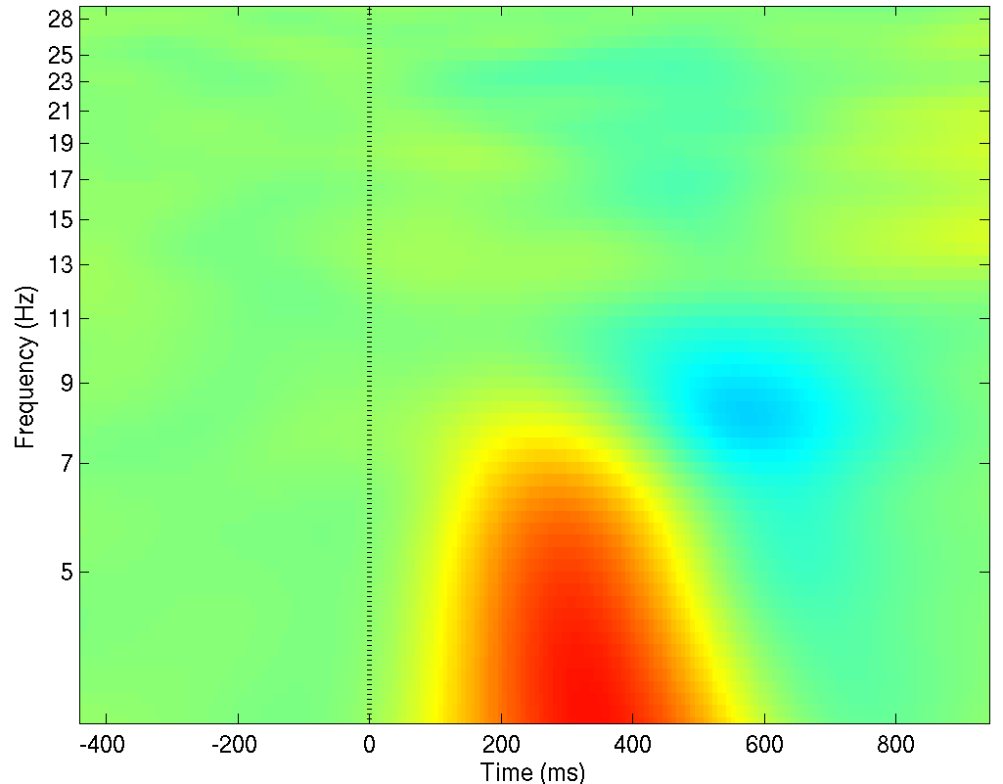
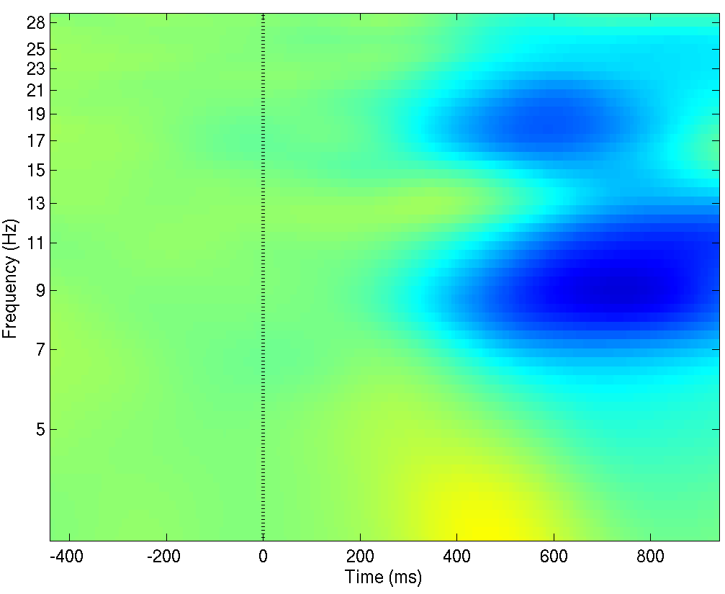
Measure Projection: RSVP Example
To better visualize measure responses in areas with significant convergence, they can be summarized into different domains. The exact number of these domains depends on how similar their exemplars are allowed to be.
Below you can see ERSP responses in an EEG experiment form three (3) domains.
Domain 2 (P300 -like)
Domain 3
Domain 1
Multi-dimensional scaling visualization of ERSP projections for convergent locations.
Notes:
Correlation threshold 0.8

Slide 21
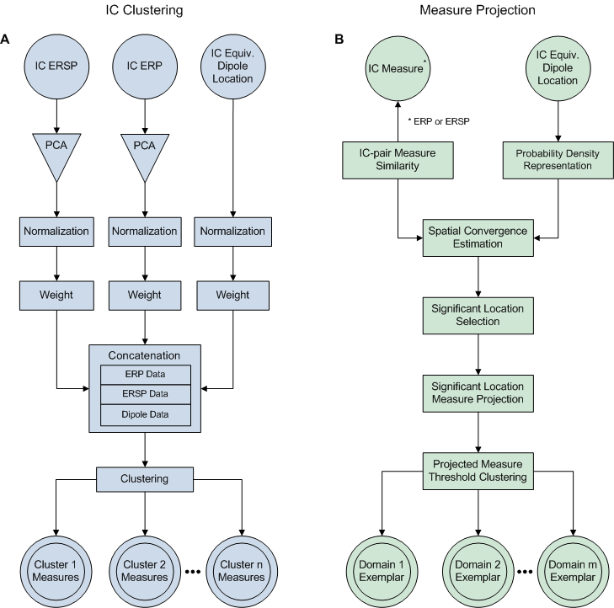

Slide 22
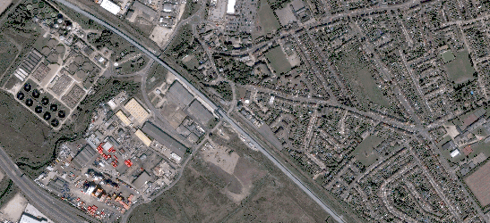
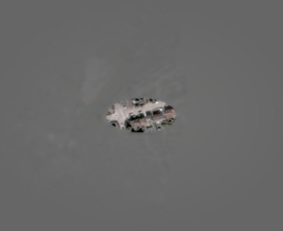
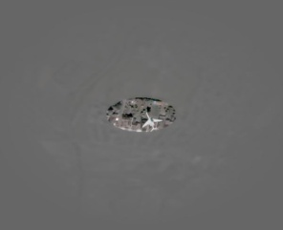
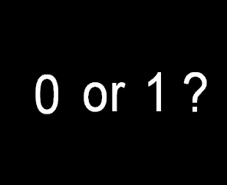
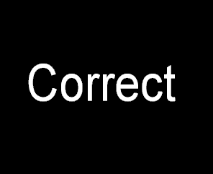

Measure Projection: RSVP Example
Rapid Serial Visual Presentation Experiment
8 subjects
15 Sessions
Visual target detection
257 components with equiv. dipoles inside the brain
1 s
4.1 s
Fixation screen
Burst of 49 clips at 12 Hz
Subject input
Time
Non-target
Target
Non-target

Slide 23
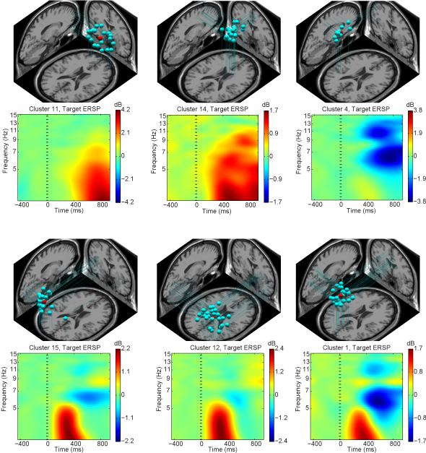
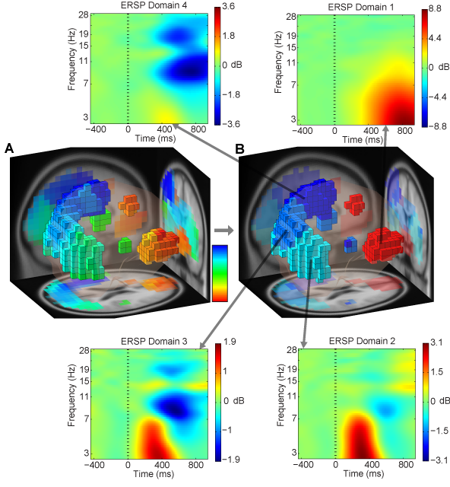
Measure Projection: RSVP Example
Clusters
Domains

Slide 24
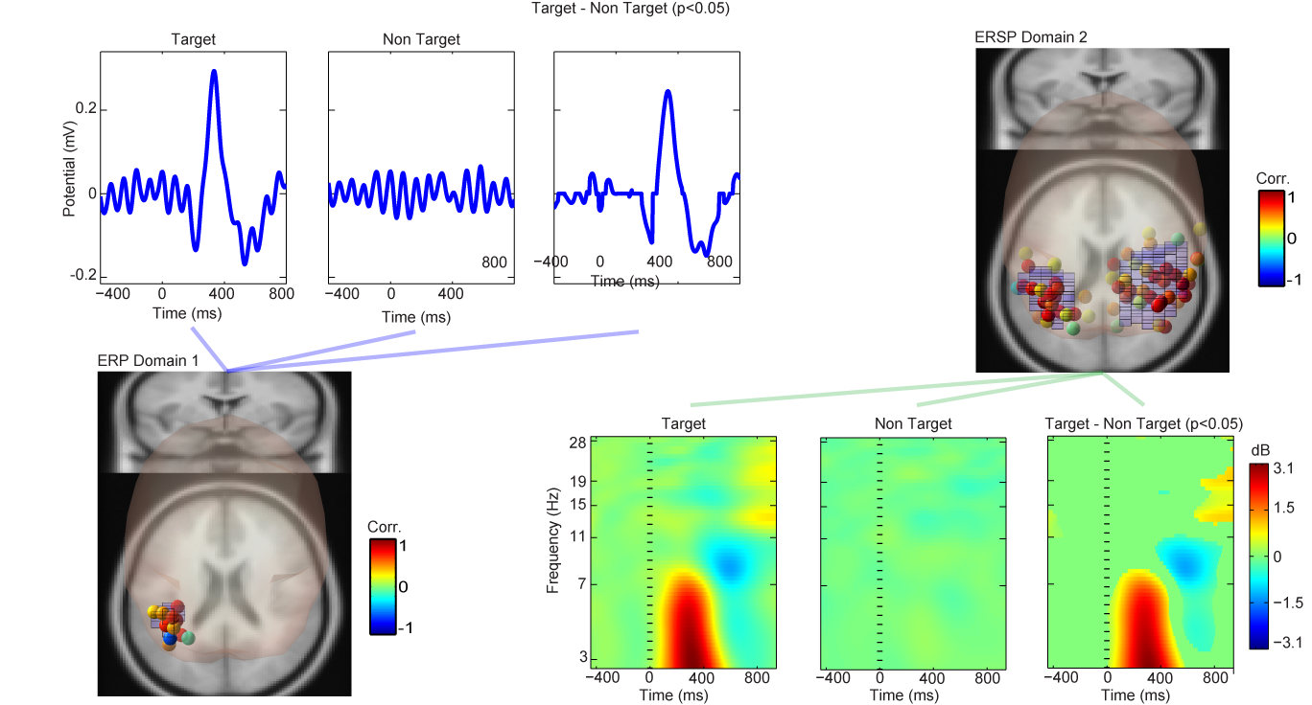
Measure Projection: RSVP Example

Slide 25
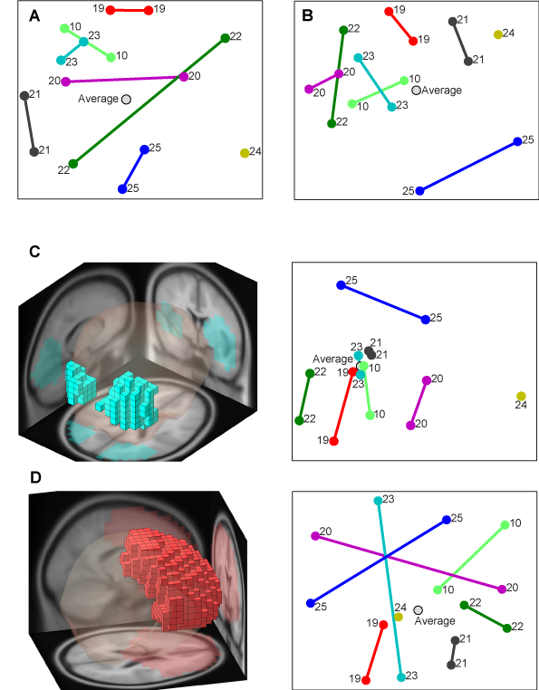
Subject Space
Measure or dipole density similarity between each two EEG subjects (or sessions) may be averaged over a region of interest (ROI) and visualize using multi-dimensional scaling.
Dipole density
Projected ERSP at ROIs
Projected ERSP at all brain locations

Slide 26
Measure Projection: Summary
Enables us to compare subjects, groups and conditions at every brain location.
Enables us to calculate significance on every step.
Enables us to perform new types of analysis that we could not do with IC clusters (e.g. subject similarity space)
All types of analysis that can be done on IC clusters, can also be performed in Measure Projection framework.

Slide 27
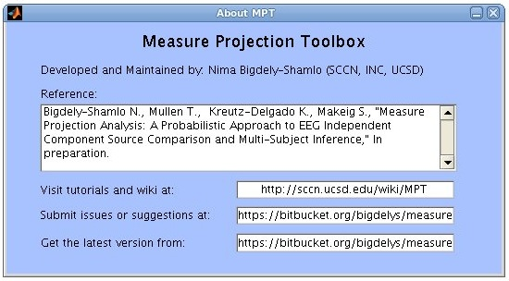
Measure Projection Toolbox
Roadmap:
Multiple ICA models for each session.
Expansion of support for subject session comparison on regions of interest (ROIs).
Operate on projections into anatomical regions (alternative to domains). May enable investigation of diverse group responses (that may not form domains since measures could be quite different across subjects)

Slide 28
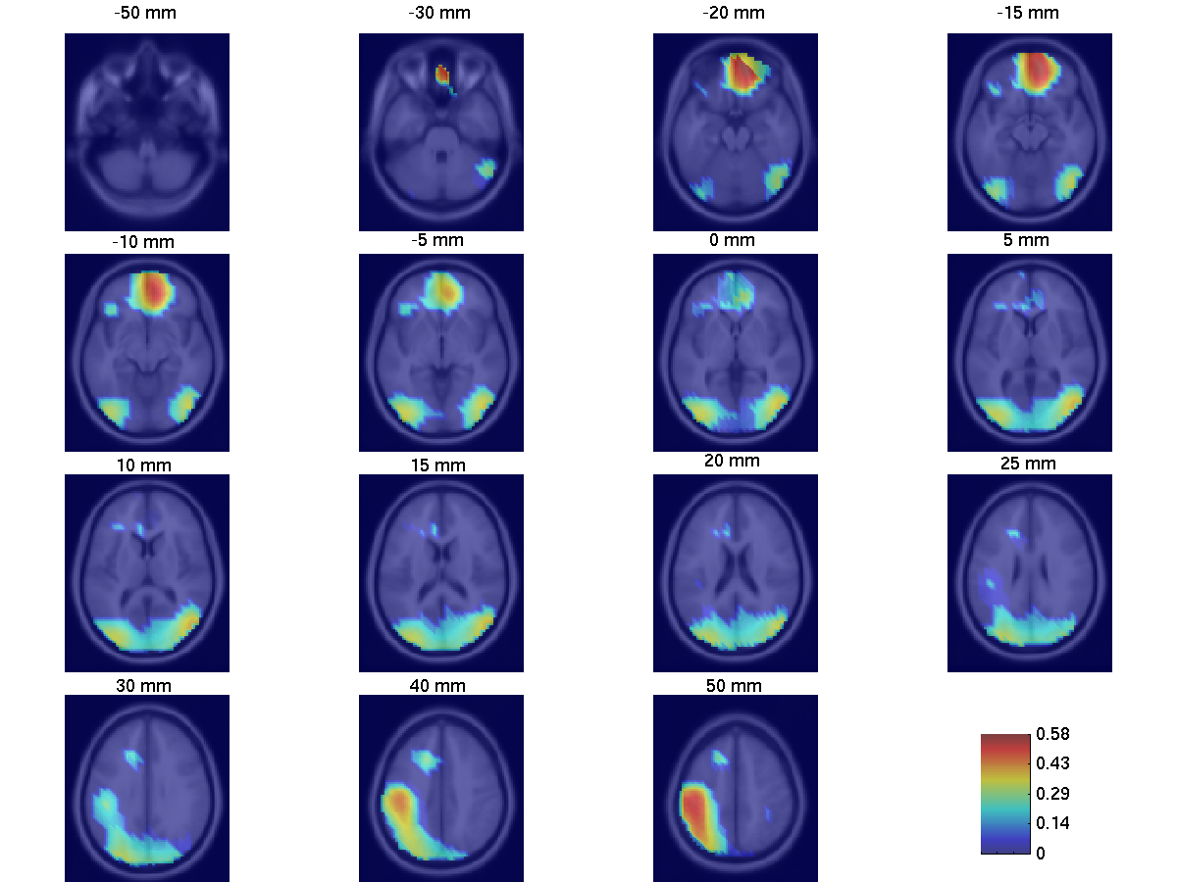
Measure Projection: RSVP Example
Areas in which convergence is significant (p<0.01).
Gaussian std. = 12 mm
Mean weighted correlation in neighborhood

Slide 29
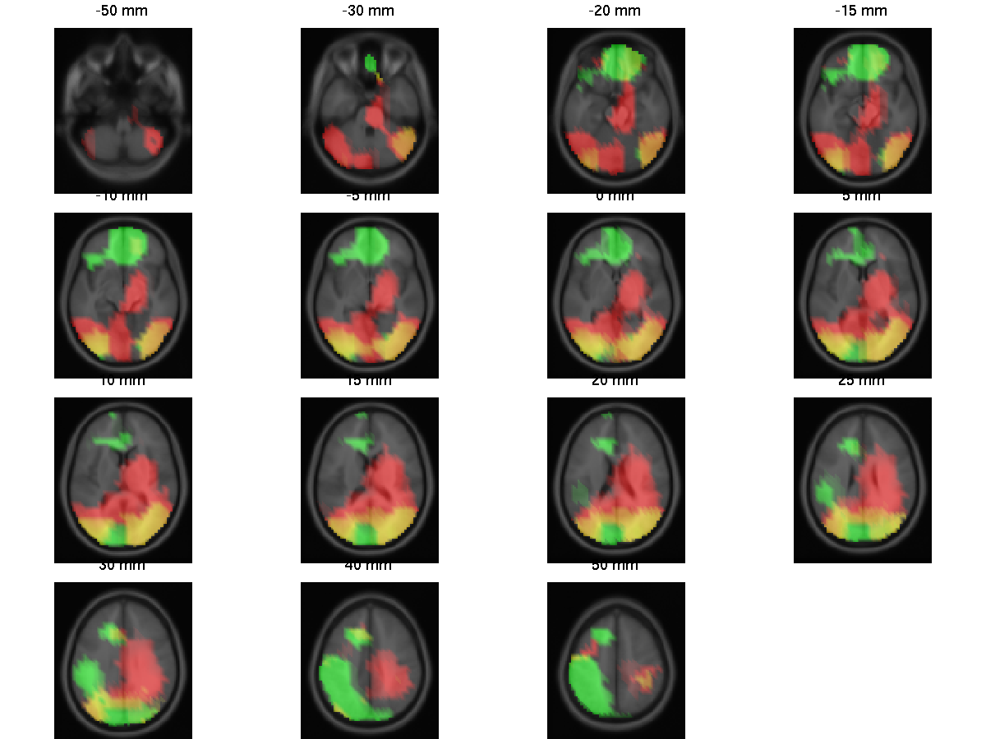
Measure Projection: RSVP Example
ERP and ERSP locations with significant convergence (p<0.01)
ERSP
ERP
ERP and ERSP

Slide 30
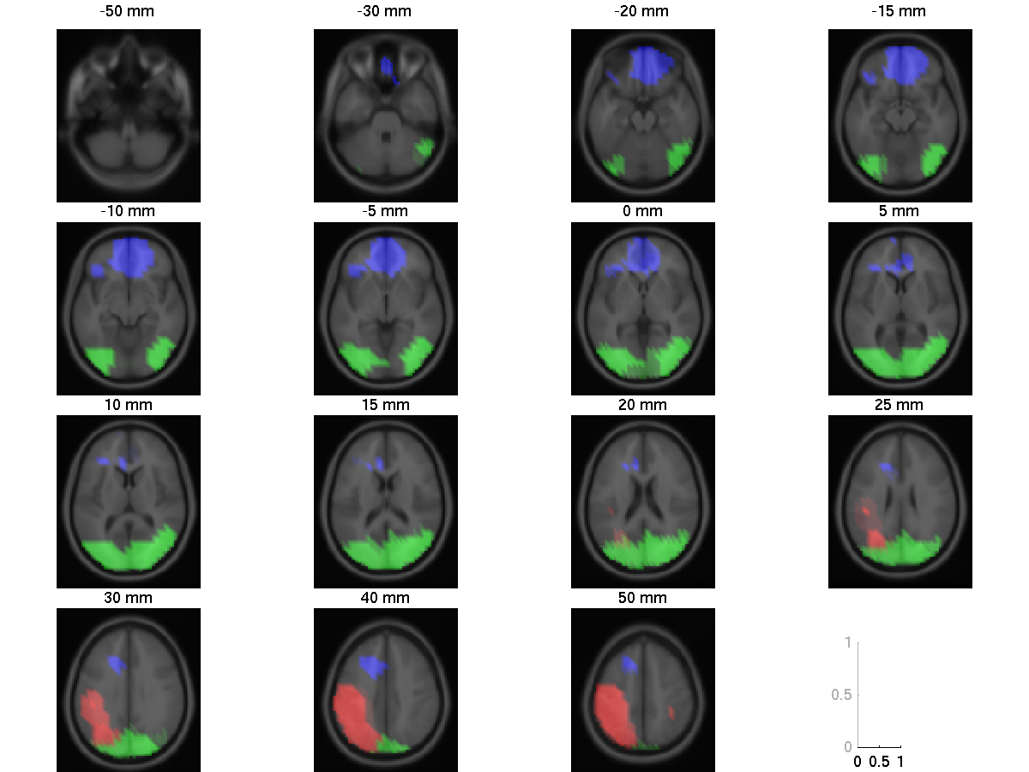
Measure Projection: RSVP Example
ERSP domains (exemplar similarity <0.8)
Domain 1
Domain 2
Domain 3

Slide 31
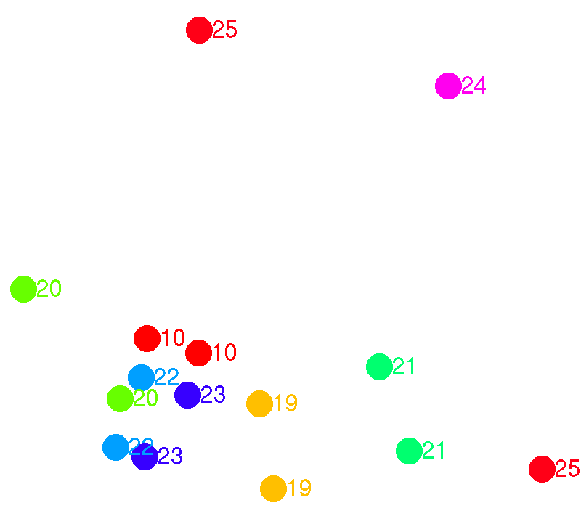
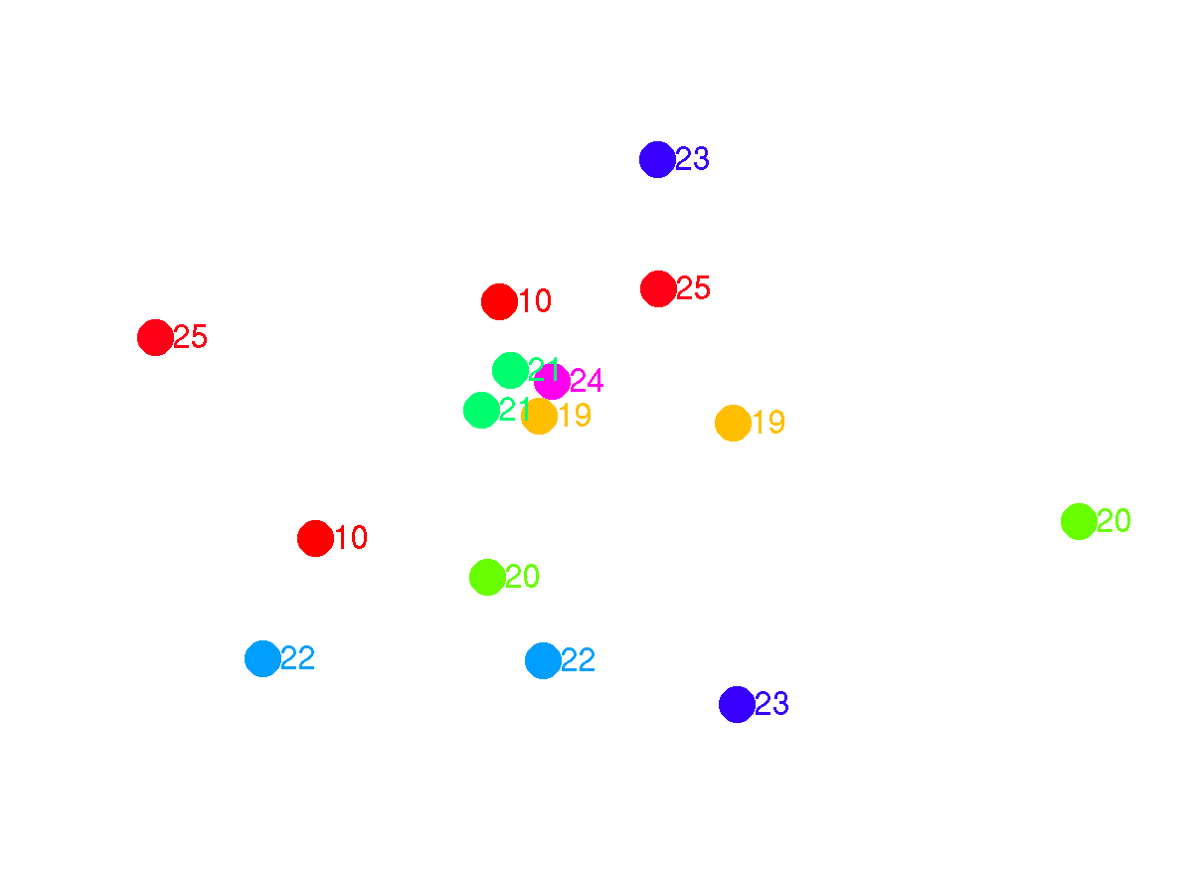
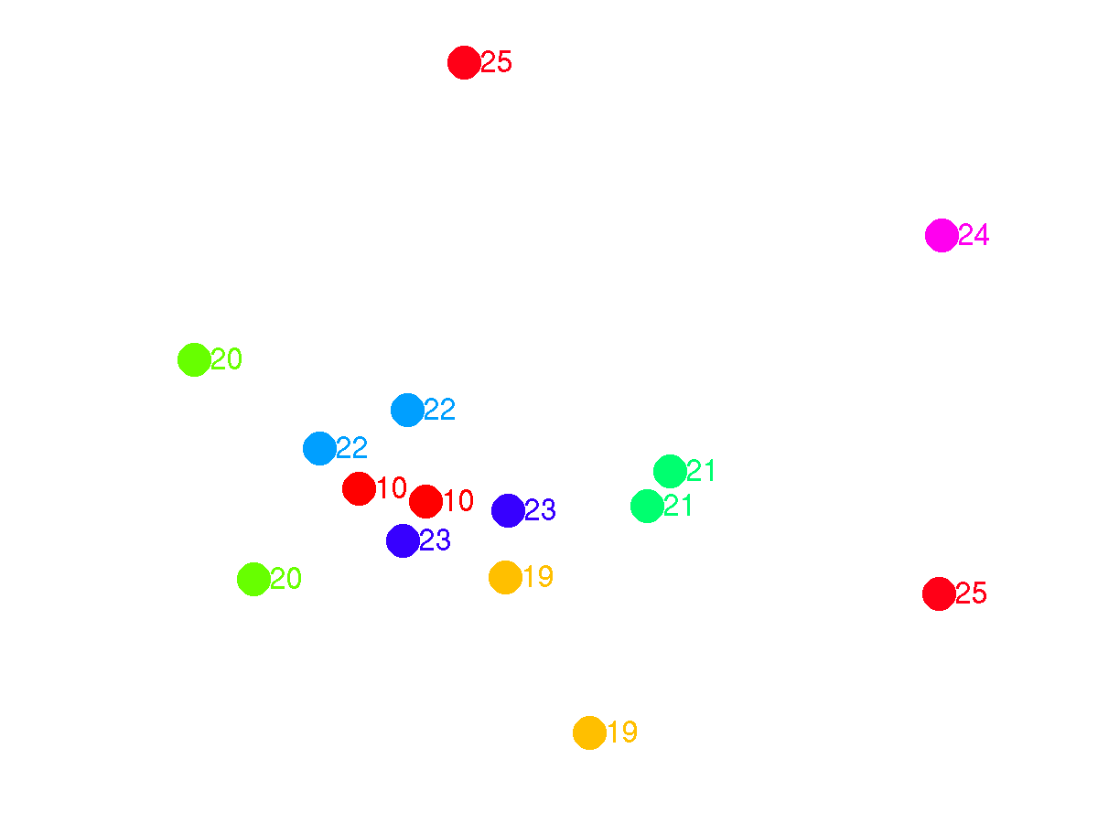
Measure Projection: RSVP Example
Subject-Session Similarity Space (S⁴), All domains
Domain 1 (frontal)
Cross-session classification ROC = 0.56
Domain 2 (occipital, P300-like)
ROC = 0.92
ROC = 0.84
ROC = 0.88
ROC = 0.95

Slide 32
Practical problems with current methods of Study IC Clustering
Number of clusters has to be selected.
Clustering is performed on a mixture of measure which makes clustering parameters less meaningful: one cannot provide thresholds for individual measures (e.g. ERPs has to be more correlated than 0.7)
ERP
Dipole
ERSP

