Slide 1

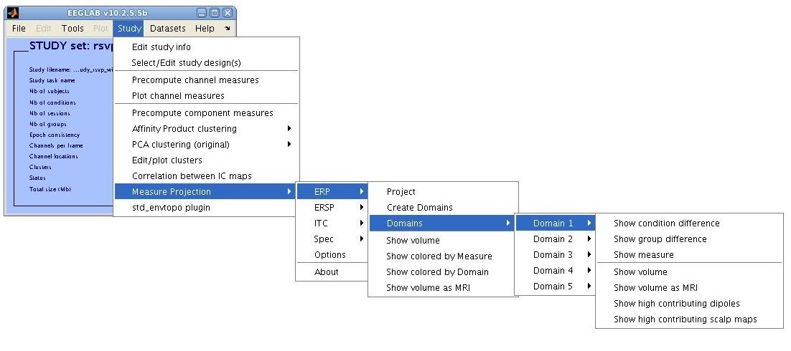
Measure Projection Analysis: Practicum
Nima Bigdely-Shamlo, Tim Mullen, Ozgur Yigit Balkan
Swartz Center for Computational Neuroscience
INC, UCSD, 2011

Slide 2

GUI Overview
Domain operations (similar to IC cluster operations)
Measure type
Steps:
Select a measure and ‘Project’.
Visualize the result and select significance threshold (optional).
Create Domains: cluster projections
Analyze Domains: compare conditions, groups… similar to operations performed on IC clusters.
Each commands runs the chain of pre-required commands.

Slide 3
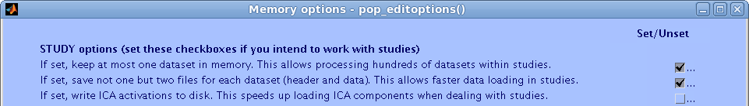
Installation
Installation: unzip [USB drive content]/eeglab10_2_5_5a/ folder into your home directory . If you already have this version (but not from this USB), copy unzipped /eeglab10_2_5_5a/plugins/measure_projection/ folder from to your computer.
Run EEGLAB in Matlab from [home directory]/eeglab10_2_5_5a/. If this version was already running, type >> eeglab rebuild;
In EEGLAB, go to File->Memory and other options and make sure that the option indicated below is checked:

Slide 4
Loading Sample Study
Load study_rsvp.study from [USB driver]/Advanced_EEGLAB_Workshop/Session C - MPA/Data/rsvp_study in EEGLAB.
Check if can you see Measure Projection under Study menu.

Slide 5
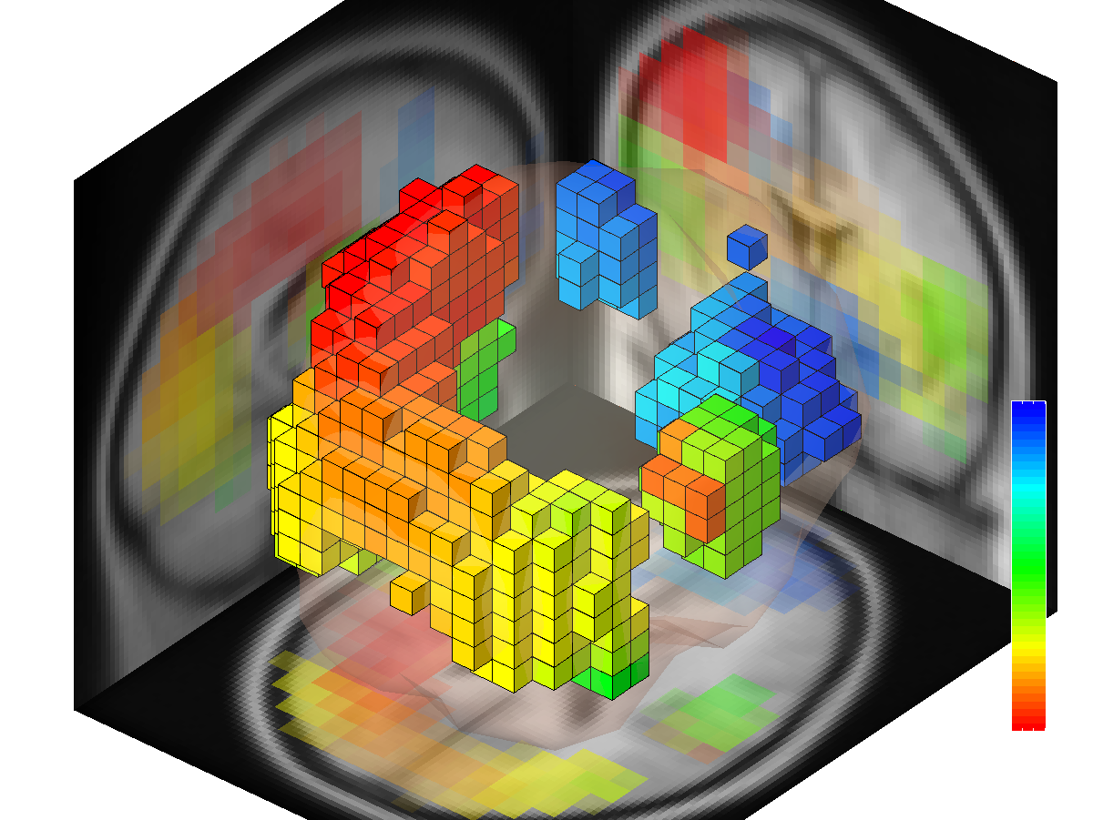
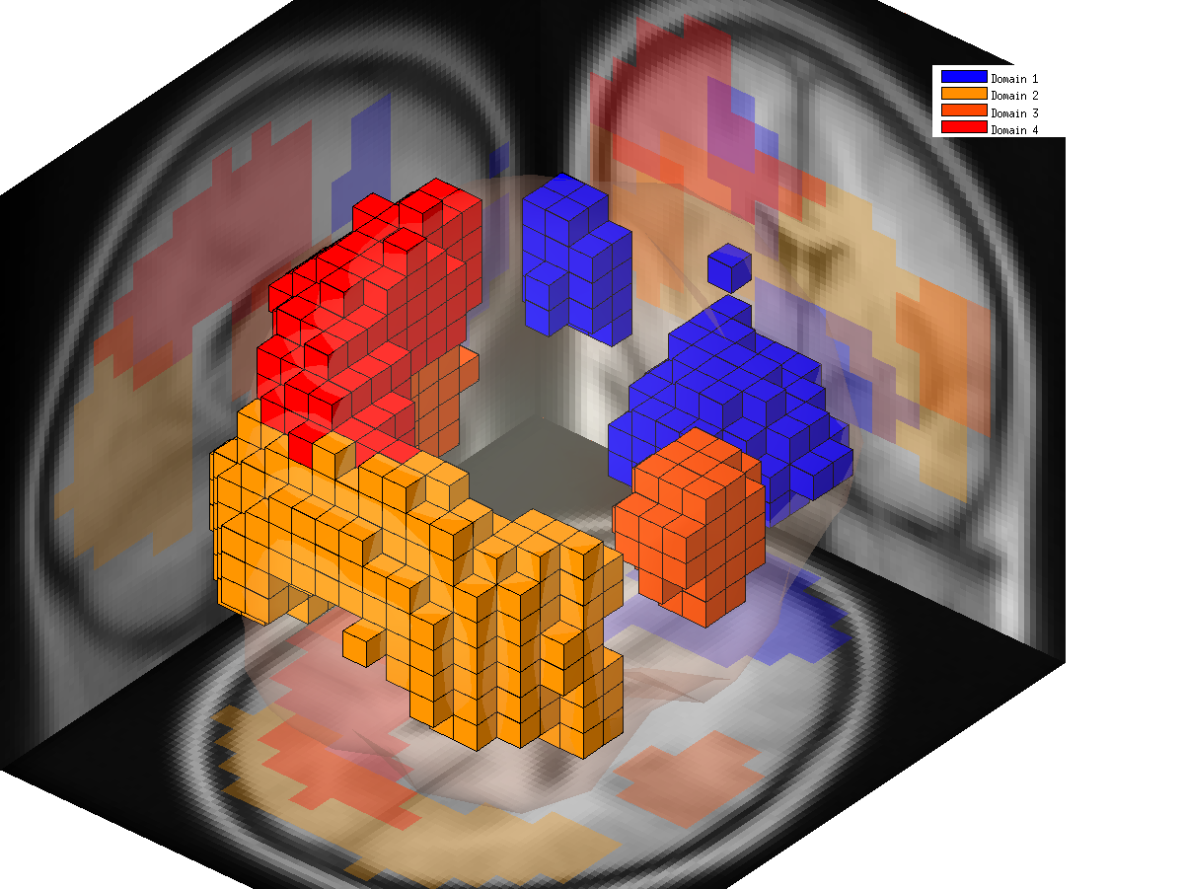
GUI
Go to Study->Measure Projection -> ERSP -> Project
Click Show colored by Measure under ERSP menu (result A).
Click Create Domains under ERSP menu. Notice ‘Domains’ submenu become available, this will take some time to finish…
(you may alternatively load study_rsvp_with_ersp_domains.study to save time, although it can crash Matlab 2009a on 32 bit Windows)
Click Show colored by Domain under ERSP menu (result B).
(A)
(B)

Slide 6
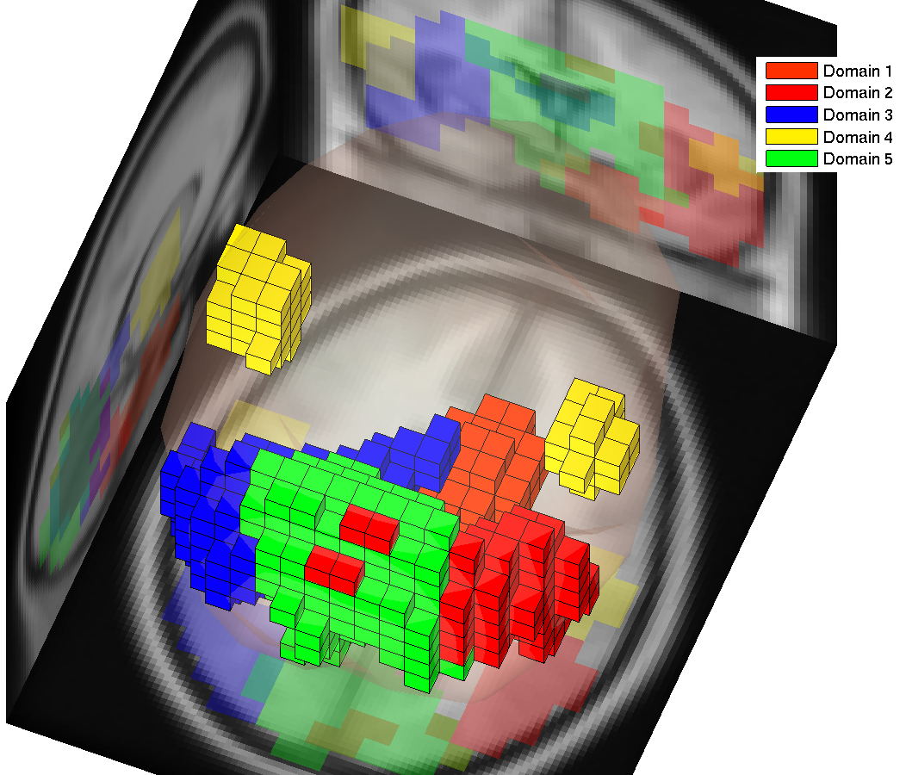
GUI
if your Matlab crashed while loading study_rsvp_with_ersp_domains.study or study_rsvp_with_domains.study , try loading study_rsvp_with_erp_domains.study which is considerably smaller.
You can now follow practicum steps for ERP, instead of ERSP.

Slide 7
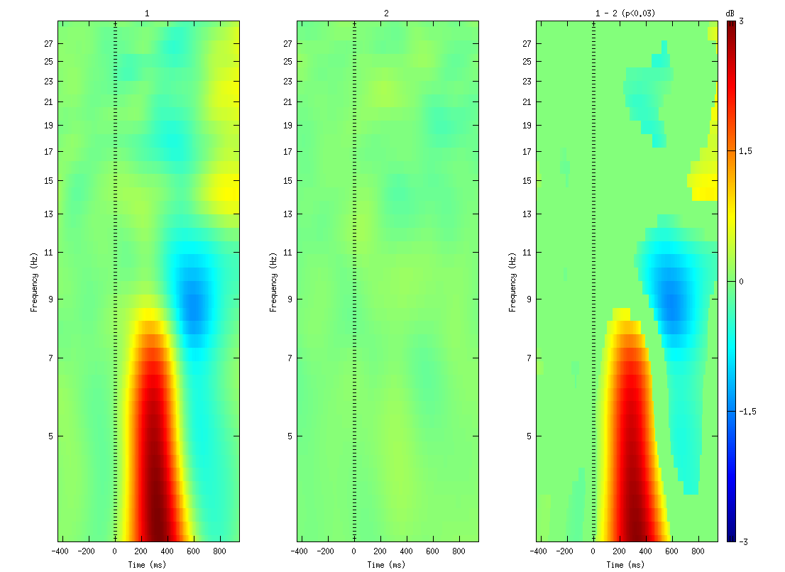
GUI: Condition Differences
Click on ERSP->Domains -> Domain 2 -> Show Measure
Click on ERSP->Domains -> Domain 2 -> Show condition difference.

Slide 8
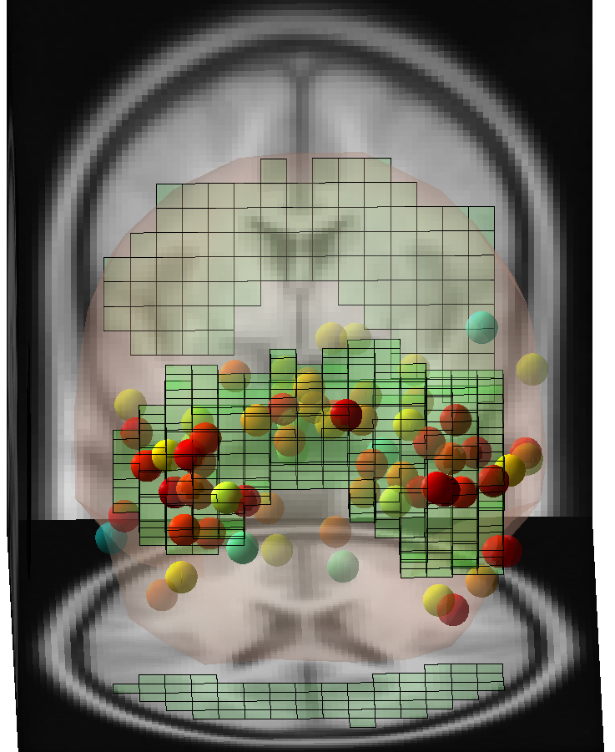
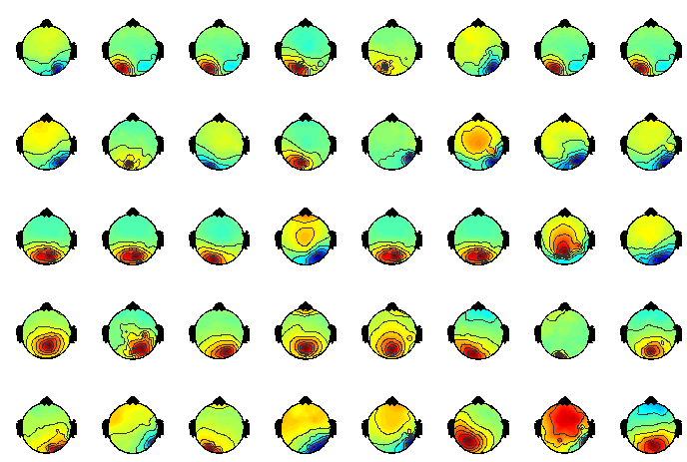
GUI: Domain Dipoles
Click on ERSP->Domains -> Domain 2 -> Show high contributing scalp maps
Click on ERSP->Domains -> Domain 2 -> Show high contributing dipoles

Slide 9
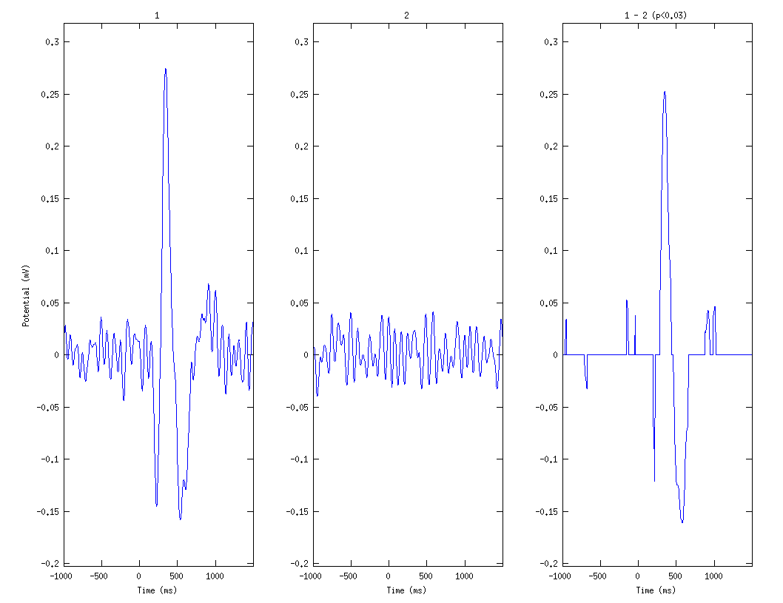
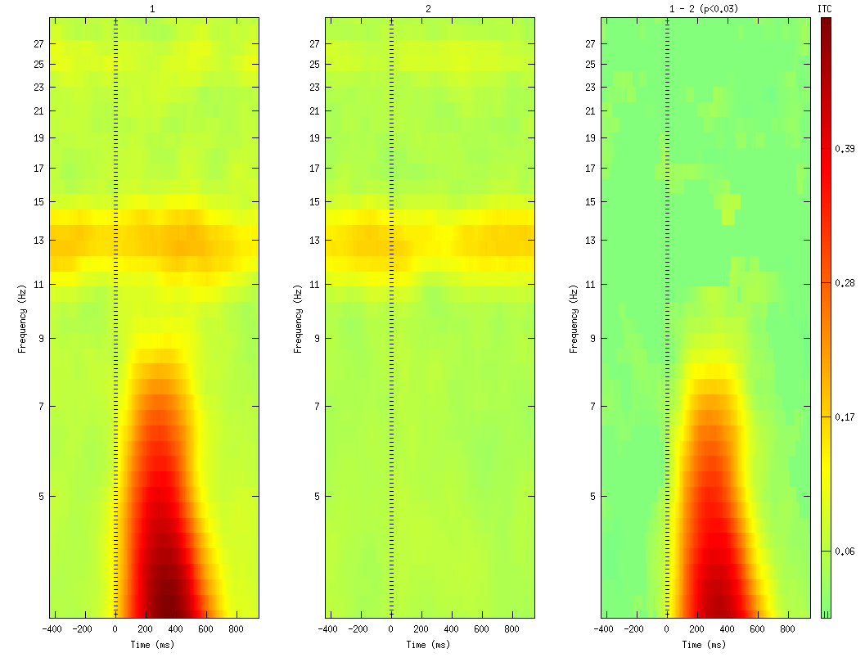
GUI
Load study_rsvp_with_domains.study in EEGLAB.
On Windows 32 bit with old Matlab (2009a), this operation may crash Matlab, instead you can try loading files named study_rsvp_with_[measure name: erp, ersp…]_domains.study separately.
All domain for different measures (ERP, ERSP, ITC..) are already created, choose different measures and run commands on their domains.
ERP Domain 3
ITC Domain 1

Slide 10
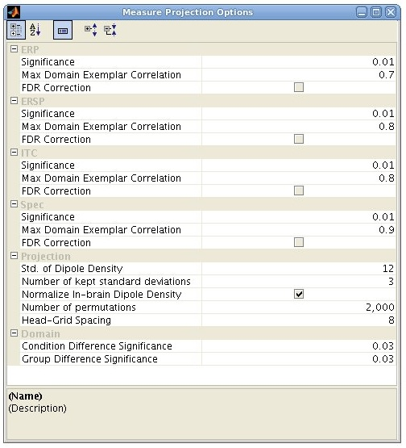
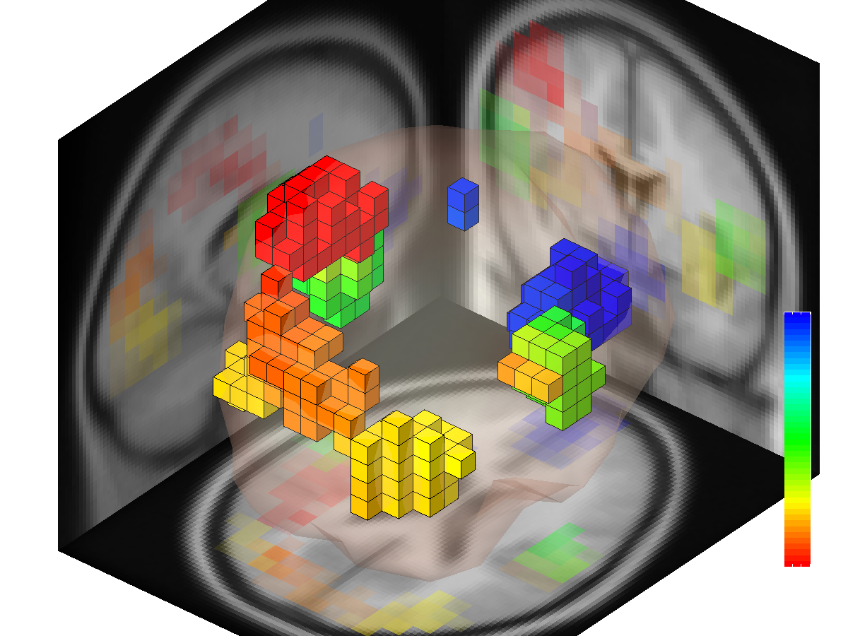
Setting Options from GUI
Select Measure Projection->Options
Change ERSP->Significance from 0.01 to 0.001
Close the figure.
Select STUDY -> Measure Projection->ERSP-> Show colored by Measure

Slide 11
Scripting
1) Load ERSP data into MPT (creates a Matlab object):
>> erspInfo = pr.dipoleAndMeasureOfStudyErsp(STUDY, ALLEEG);
Type >> erspInfo to see what information is contained in the object.
2) Create a head grid:
>> headGrid = pr.headGrid;
(you can run headGrid .plot; to see the grid)
3) Project ERSP (using this head grid) and calculate significance of projections:
>> erspProjection = pr.meanProjection(erspInfo, erspInfo.getPairwiseCorrelationSimilarity, headGrid);
(all in one line, press Tab key to autocomplete)
4) Visualize significant locations:
>> erspProjection.plotVolume(0.01);

Slide 12
Scripting
5) To see the list of function of measure projection object erspInfo type:
>> methods(erspProjection)
6) Visualize ERSP domain 4 (calculated before and saved in the STUDY.measureProjection):
>> domain4 = STUDY.measureProjection.ersp.projection.domain(4).plotVolume;
>> domain4.plotVolume;
>> domain4.plotMeasure;
7) Create subject space with domain 4 as an ROI:
>> subjectSpace = pr.subjectSpace(erspInfo, headGrid, erspProjection.projectionParameter, domain4.membershipCube);
8) Plot subject space in 2D:
>> subjectSpace.plot;

Slide 13
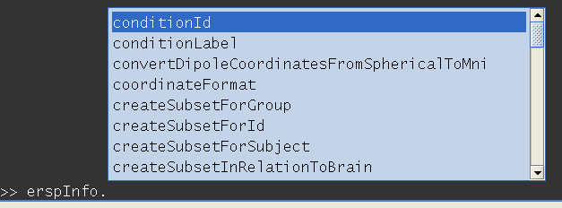
Scripting
MPT uses Matlab object classes, so it is easy to find functions that act on each object. (place a dot after the name of the object and press the Tab key
Variable and function names are descriptive.
MPT objects have minimal interdependency (almost all related information is encapsulated in the properties of each object to simply scripting).
You can extend the toolbox by deriving new classes from current object.

Slide 14
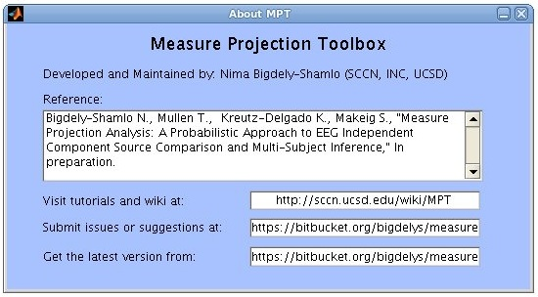
New Versions
New versions of MPT can be downloaded directly from our repository:
https://bitbucket.org/bigdelys/measure-projection/get/default.zip
Please report bugs/feature request using our issue tracking system (no login necessary):
https://bitbucket.org/bigdelys/measure-projection/issues?status=new&status=open
A Wiki is under construction and located at:
http://sccn.ucsd.edu/wiki/MPT
These links are available under Measure Projection->About menu.

Slide 15
Roadmap
Multiple ICA models for each session.
Expansion of support for subject session comparison on regions of interest (ROIs).
Operate on projections into anatomical regions (alternative to domains).
May enable investigation of diverse group responses (that may not form domains since measures could be quite different across subjects)

Slide 16
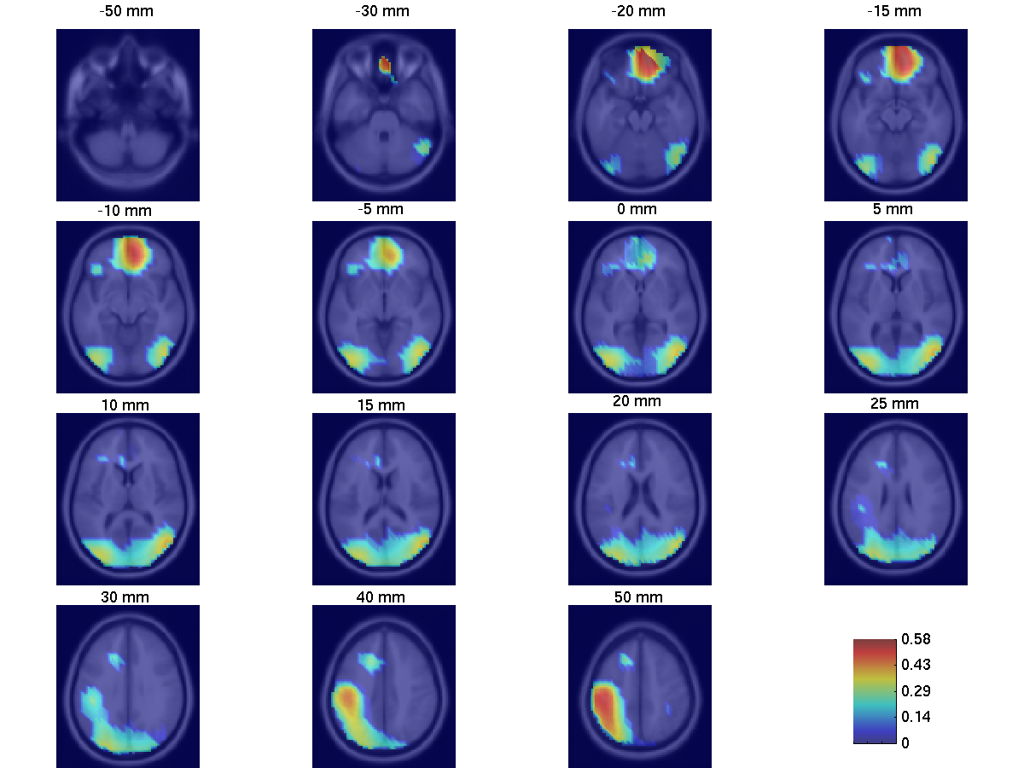
Measure Projection: RSVP Example
Areas in which convergence is significant (p<0.01).
Gaussian std. = 12 mm
Mean weighted correlation in neighborhood

Slide 17
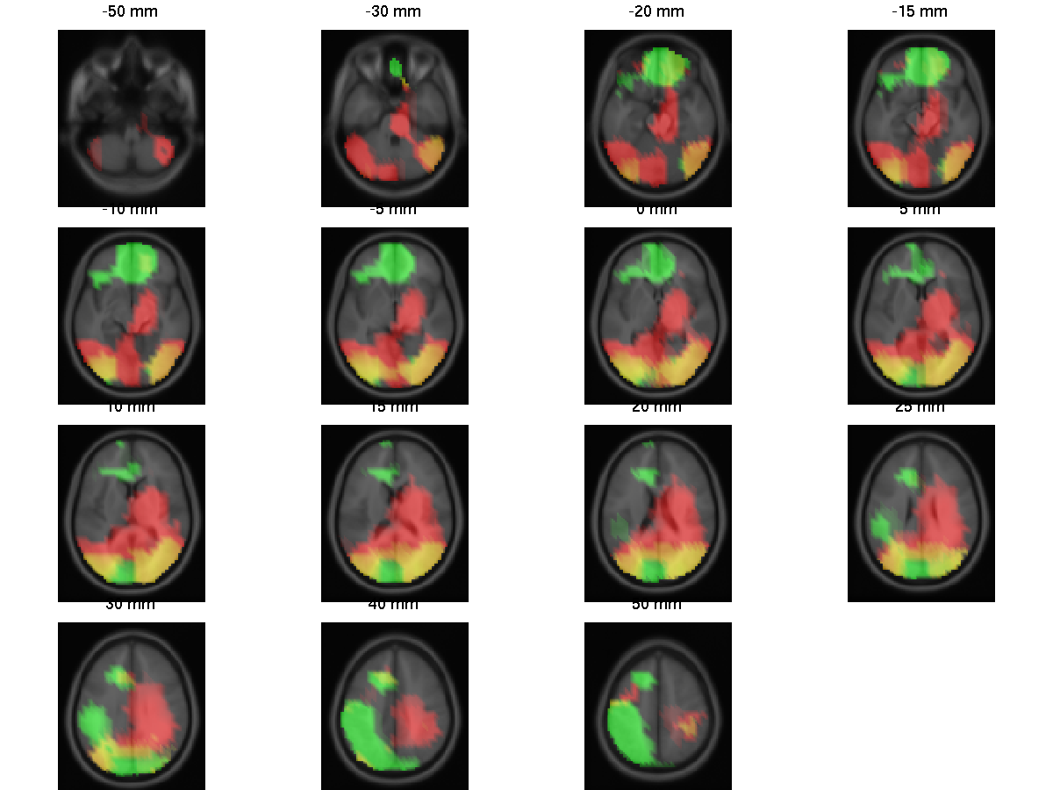
Measure Projection: RSVP Example
ERP and ERSP locations with significant convergence (p<0.01)
ERSP
ERP
ERP and ERSP

Slide 18
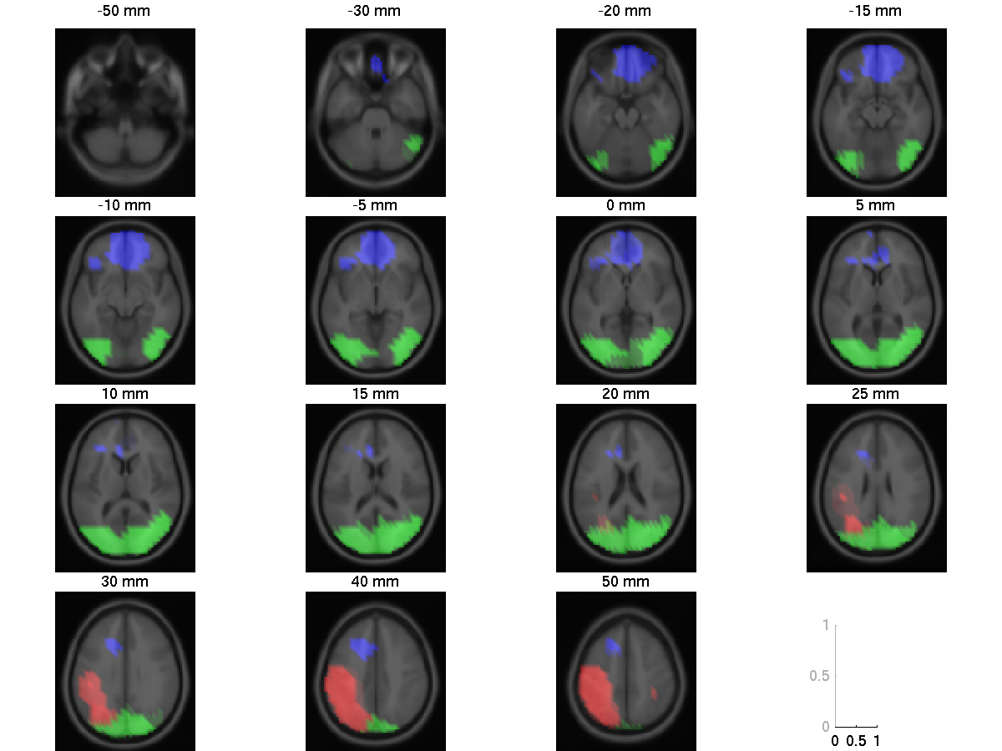
Measure Projection: RSVP Example
ERSP domains (exemplar similarity <0.8)
Domain 1
Domain 2
Domain 3

Slide 19
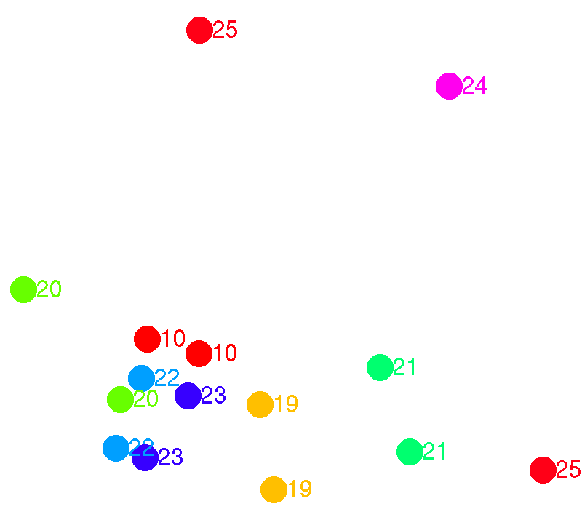
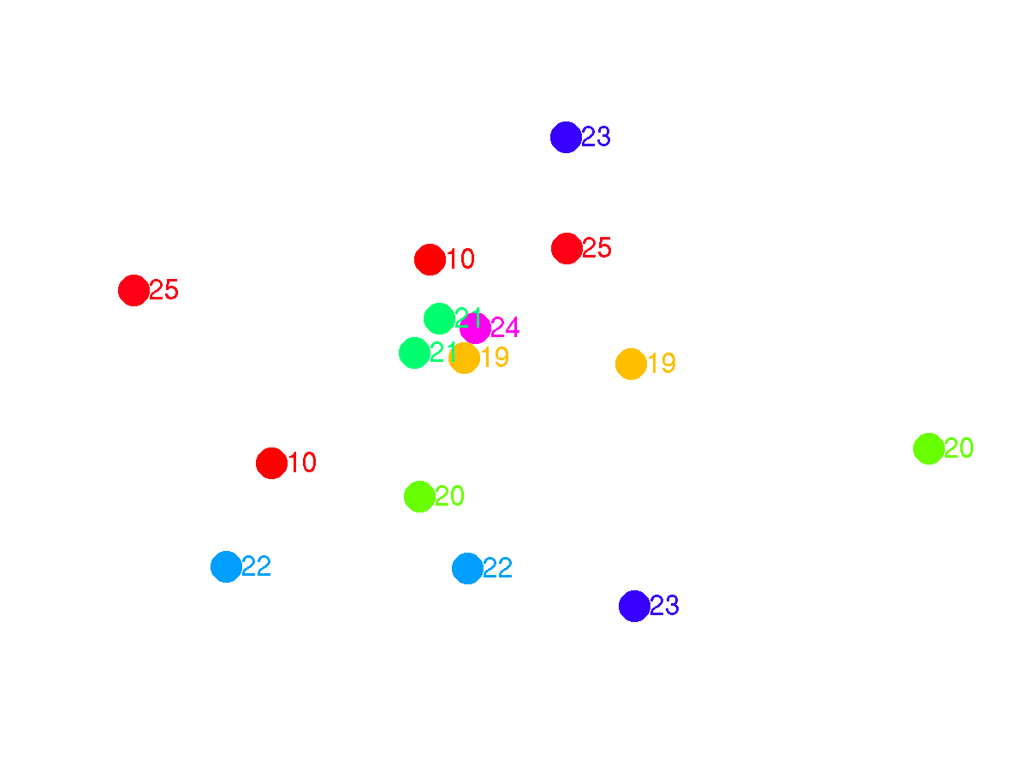
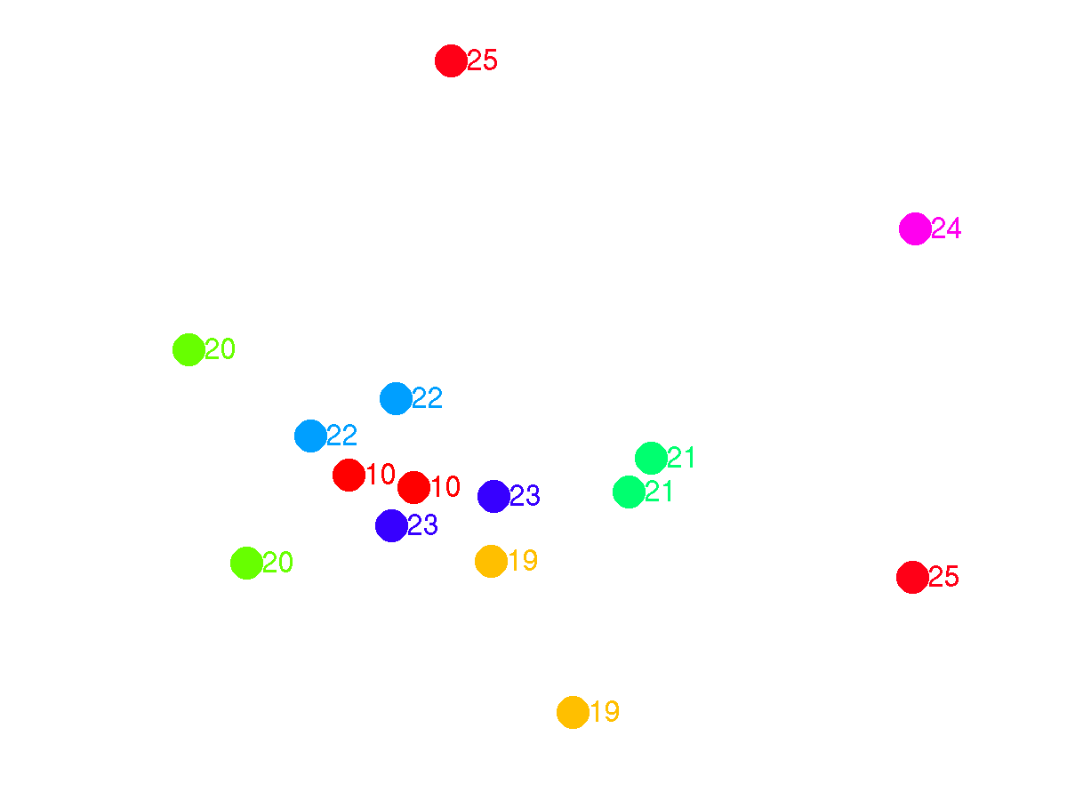
Measure Projection: RSVP Example
Subject-Session Similarity Space (S⁴), All domains
Domain 1 (frontal)
Cross-session classification ROC = 0.56
Domain 2 (occipital, P300-like)
ROC = 0.92
ROC = 0.84
ROC = 0.88
ROC = 0.95

Slide 20
Practical problems with current methods of Study IC Clustering
Number of clusters has to be selected.
Clustering is performed on a mixture of measure which makes clustering parameters less meaningful: one cannot provide thresholds for individual measures (e.g. ERPs has to be more correlated than 0.7)
ERP
Dipole
ERSP

